Slide 1
CEIS103 Final Course Project
Presented by:
Mitchell Woodworth

Slide 2
Introduction
The purpose of this presentation is to show the many ways on how to use the Linux OS. The Linux OS is very helpful towards new users but can be tricky. This presentation will show how to use the system.

Slide 3
Navigate the Linux filesystem tree
1. What is the pwd command an acronym for? What about the cd command?
Answer here:
Print Working Directory
Change Directory
2. Explain the differences between a relative path and an absolute/full path in Linux.
Answer here:
An absolute path in Linux is the full path of the directory and will start with /.
A Relative path is the partial path of a directory or subdirectory
References:
1. https://www.hostinger.com/tutorials/linux-commands
2. https://tecadmin.net/linux-cd-command/#:~:text=Absolute%20Path%20is%20the%20full%20path%20of%20directory,the%20partial%20path%20of%20any%20directory%20or%20subdirectory.

Slide 4
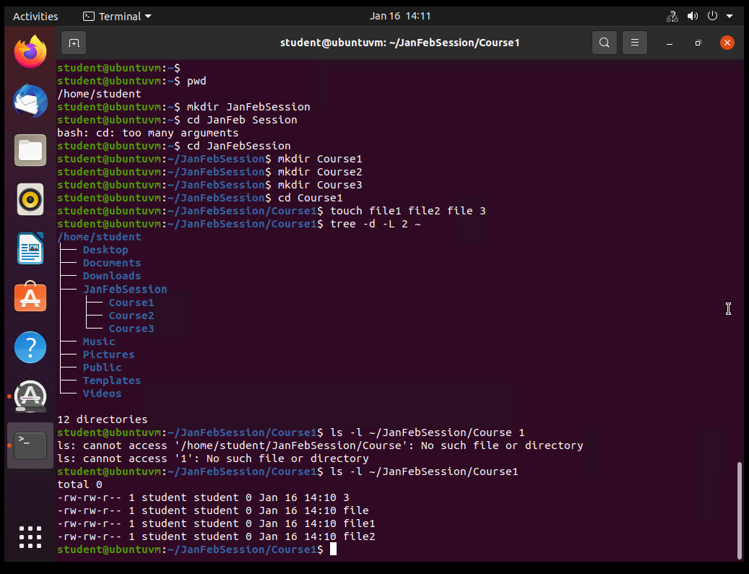
Create directories and files

Slide 5
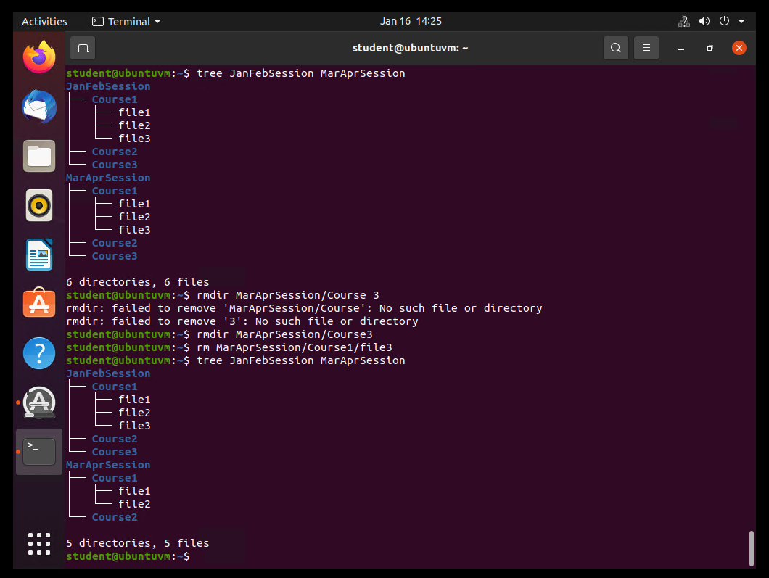
Copy and remove directories and files

Slide 6
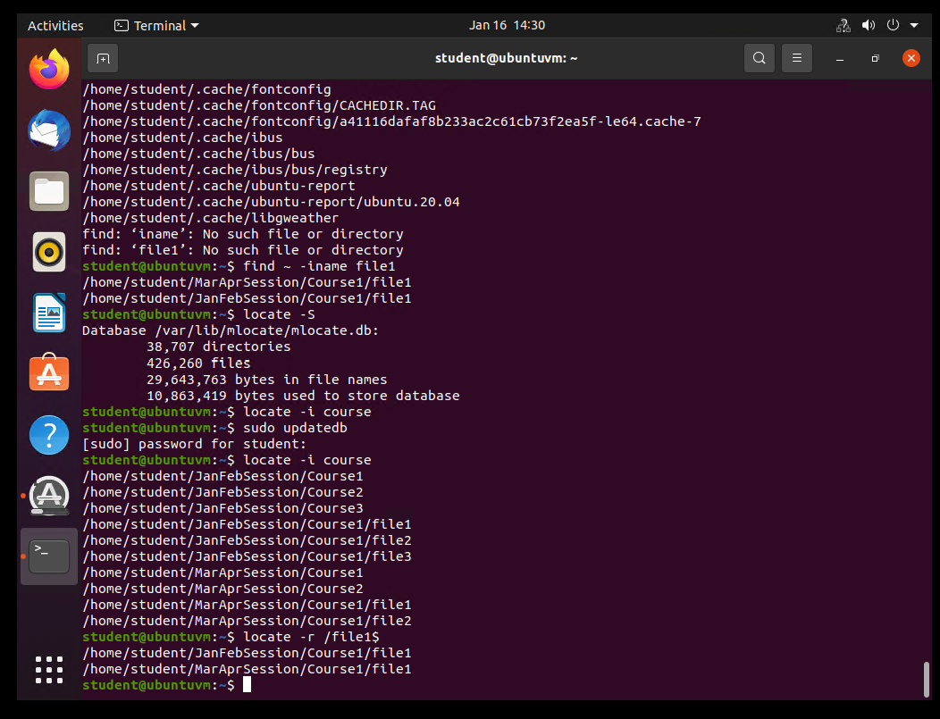
Locate directories and files

Slide 7
Create a shell script
1. What are the file permissions of the script?
Answer here:
Read, write, and execute.
2. What’s the name of the user-defined variable in the script?
Answer here:
student
3. Which redirection meta-character is used in the script? What does it do?
Answer here:
>
We used this meta-character to direct the script to the of the output of the script.
References:
1.N/A (ND) How to Use Command Redirection under Linux The Geek Diary
https://www.thegeekdiary.com/how-to-use-command-redirection-under-linux/#:~:text=Command%20redirection%20is%20enabled%20by%20the%20following%20shell,standard%20error%20%282%3E%29%204%20The%20pipe%20character%20%28%7C%29
2.Brent, M., (2021) File Permissions in Linux / Unix: How to Read, Write, & Change? Guru99
https://www.guru99.com/file-permissions.html#:~:text=Linux%20divides%20the%20file%20permissions%20into%20read%2C%20write,command%20can%20change%20the%20ownership%20of%20a%20file%2Fdirectory.

Slide 8
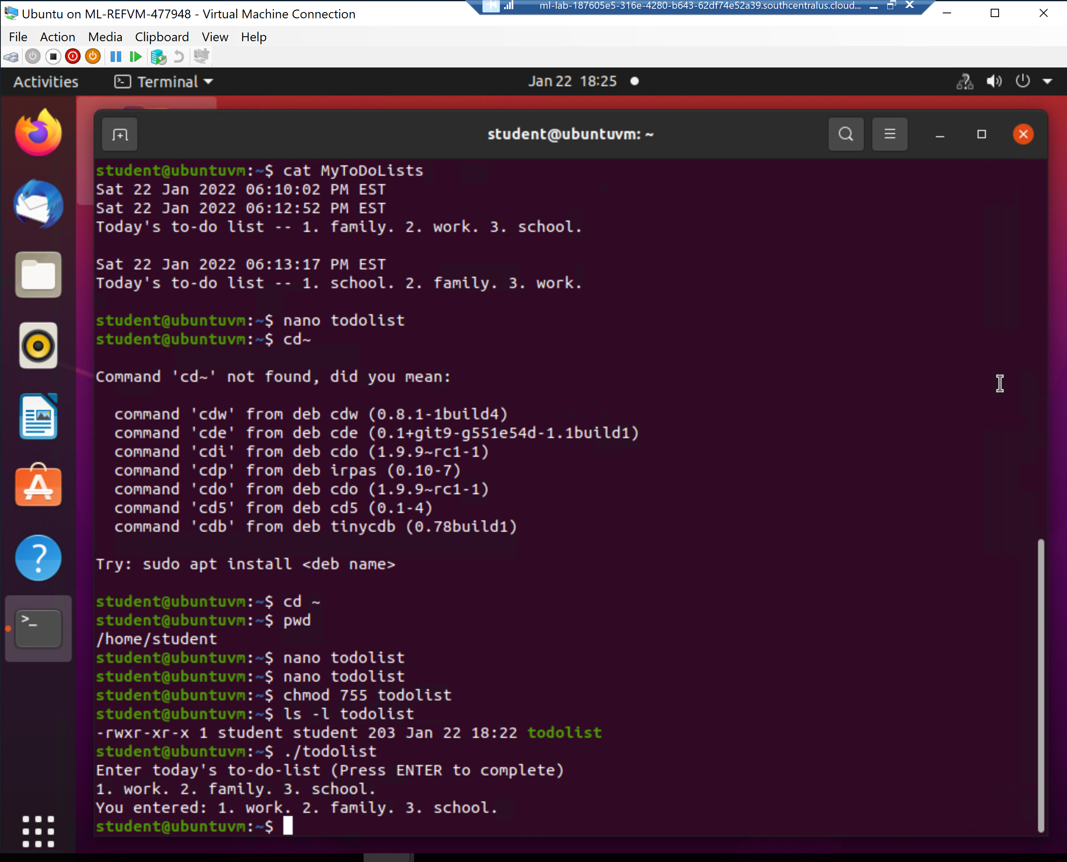
Change script file permissions

Slide 9
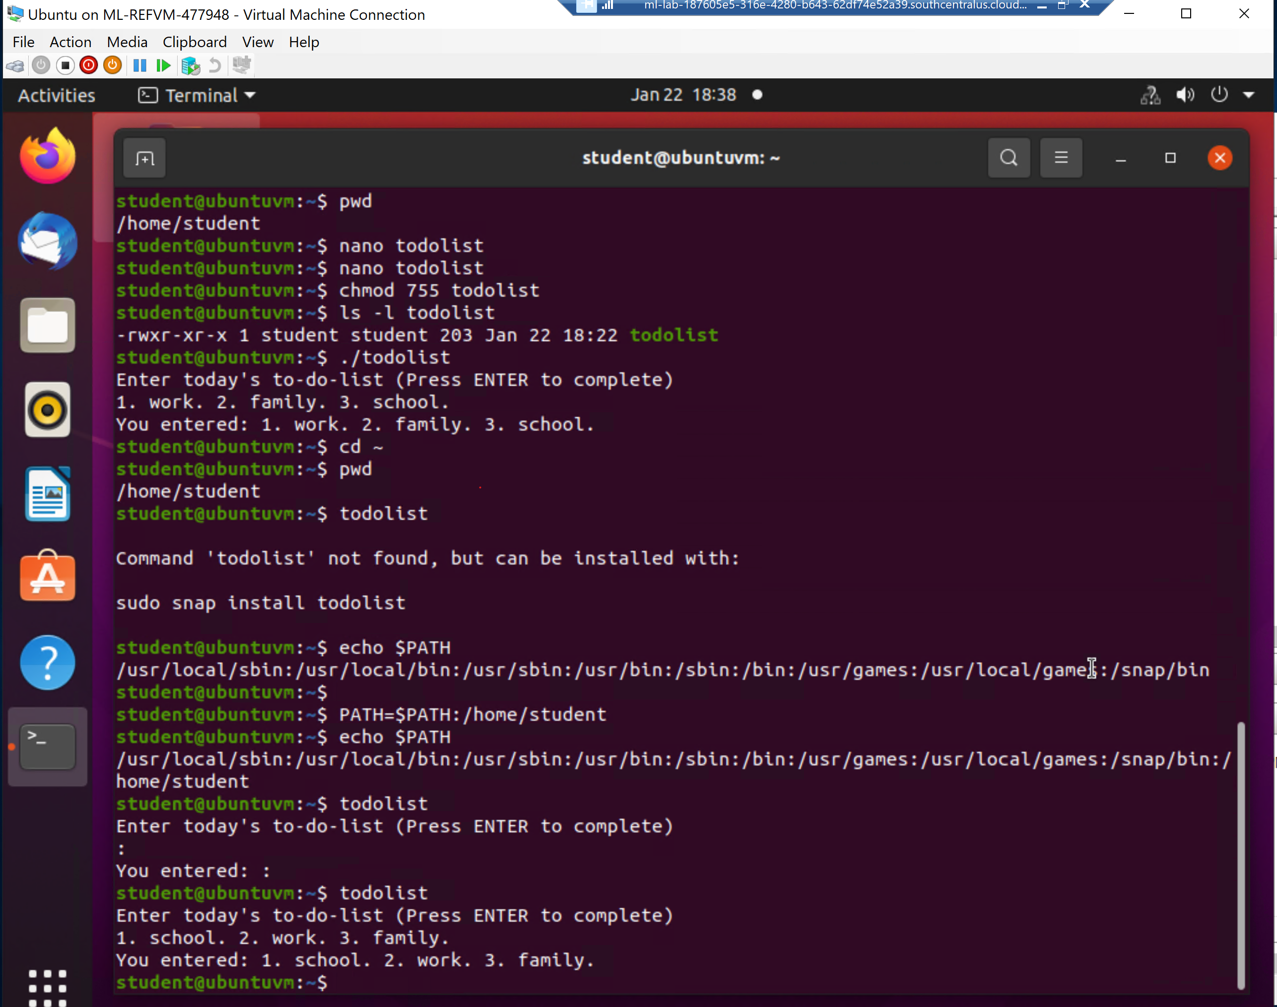
Set the PATH variable

Slide 10
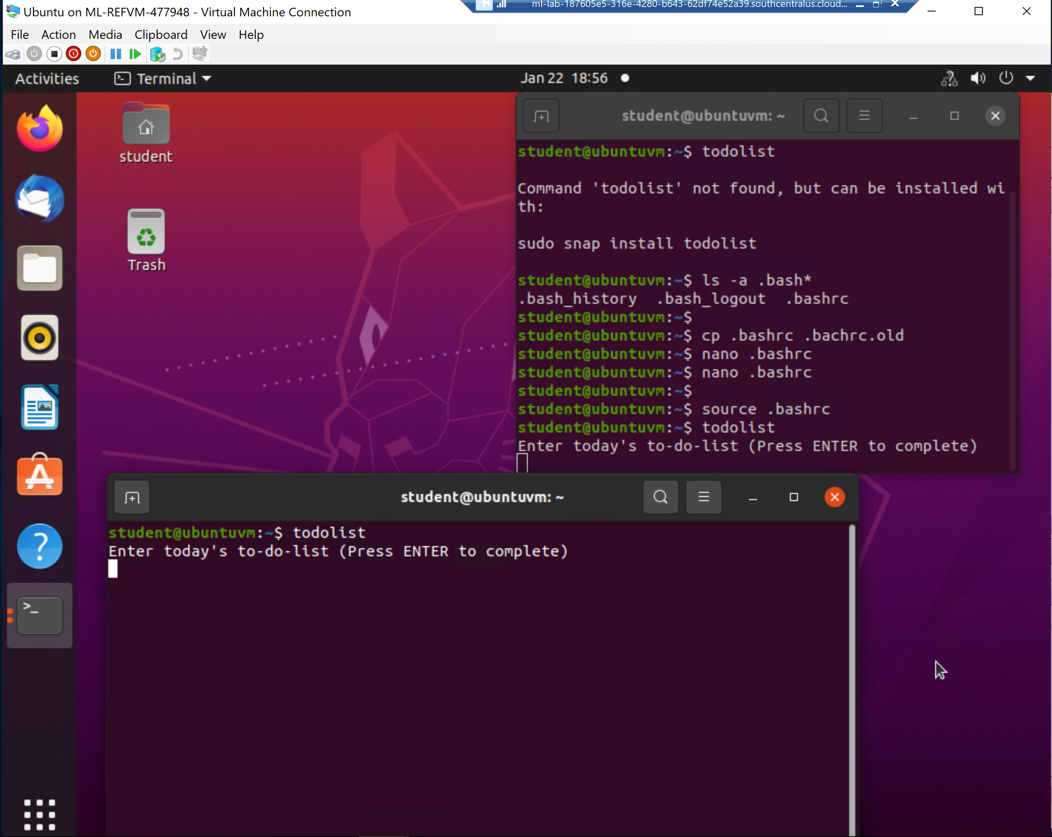
Make the PATH variable permanent

Slide 11
Add users and groups in CLI
1. What does the –m option in the useradd command do?
Answer here:
Create users without a home directory
2. What does the -3 option in the tail command do?
Answer here:
This number indicates how much bytes it will use.
3. Which line of the /etc/group file lists members of the “students” group? Copy it here.
Answer here:
sudo tail -3 /etc/group
References:
1. https://www.tecmint.com/add-users-in-linux/
2. https://www.guyhowto.com/linux-tail-command/#:~:text=The%20tail%20command%20displays%20the,file%20changes%20in%20real%2Dtime.

Slide 12
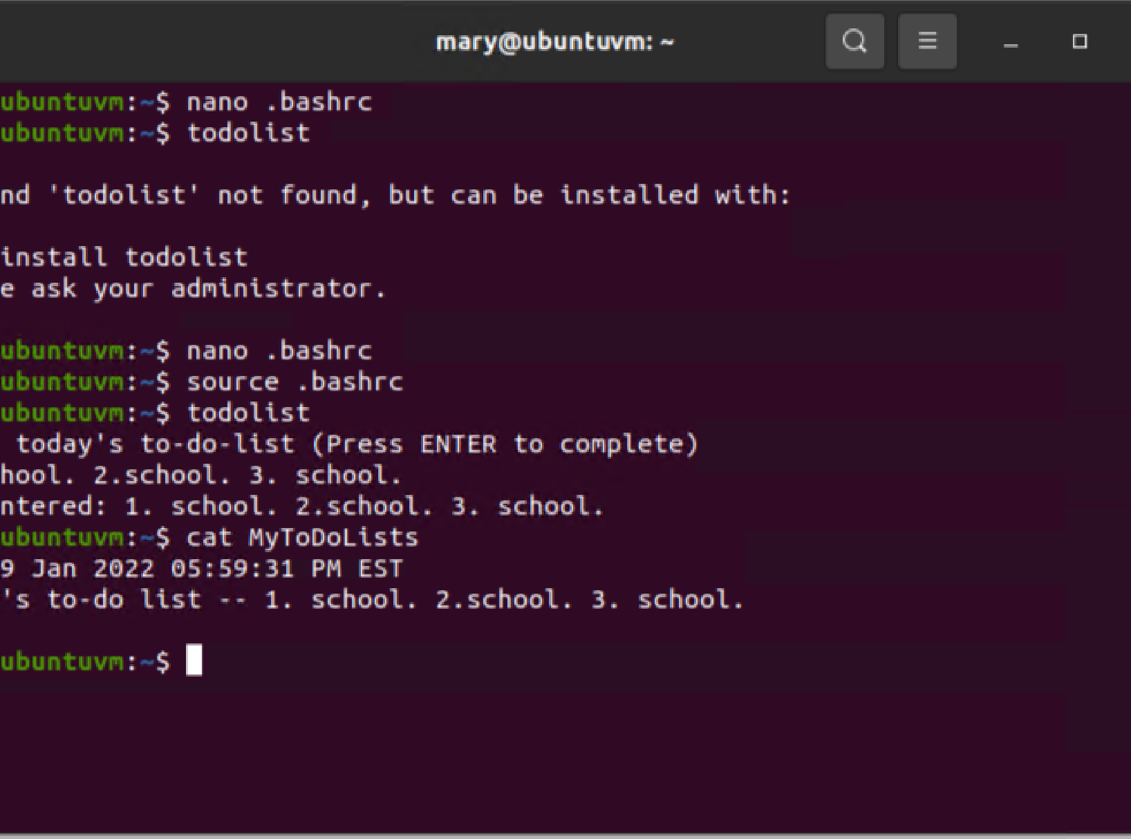
Test user and group settings

Slide 13
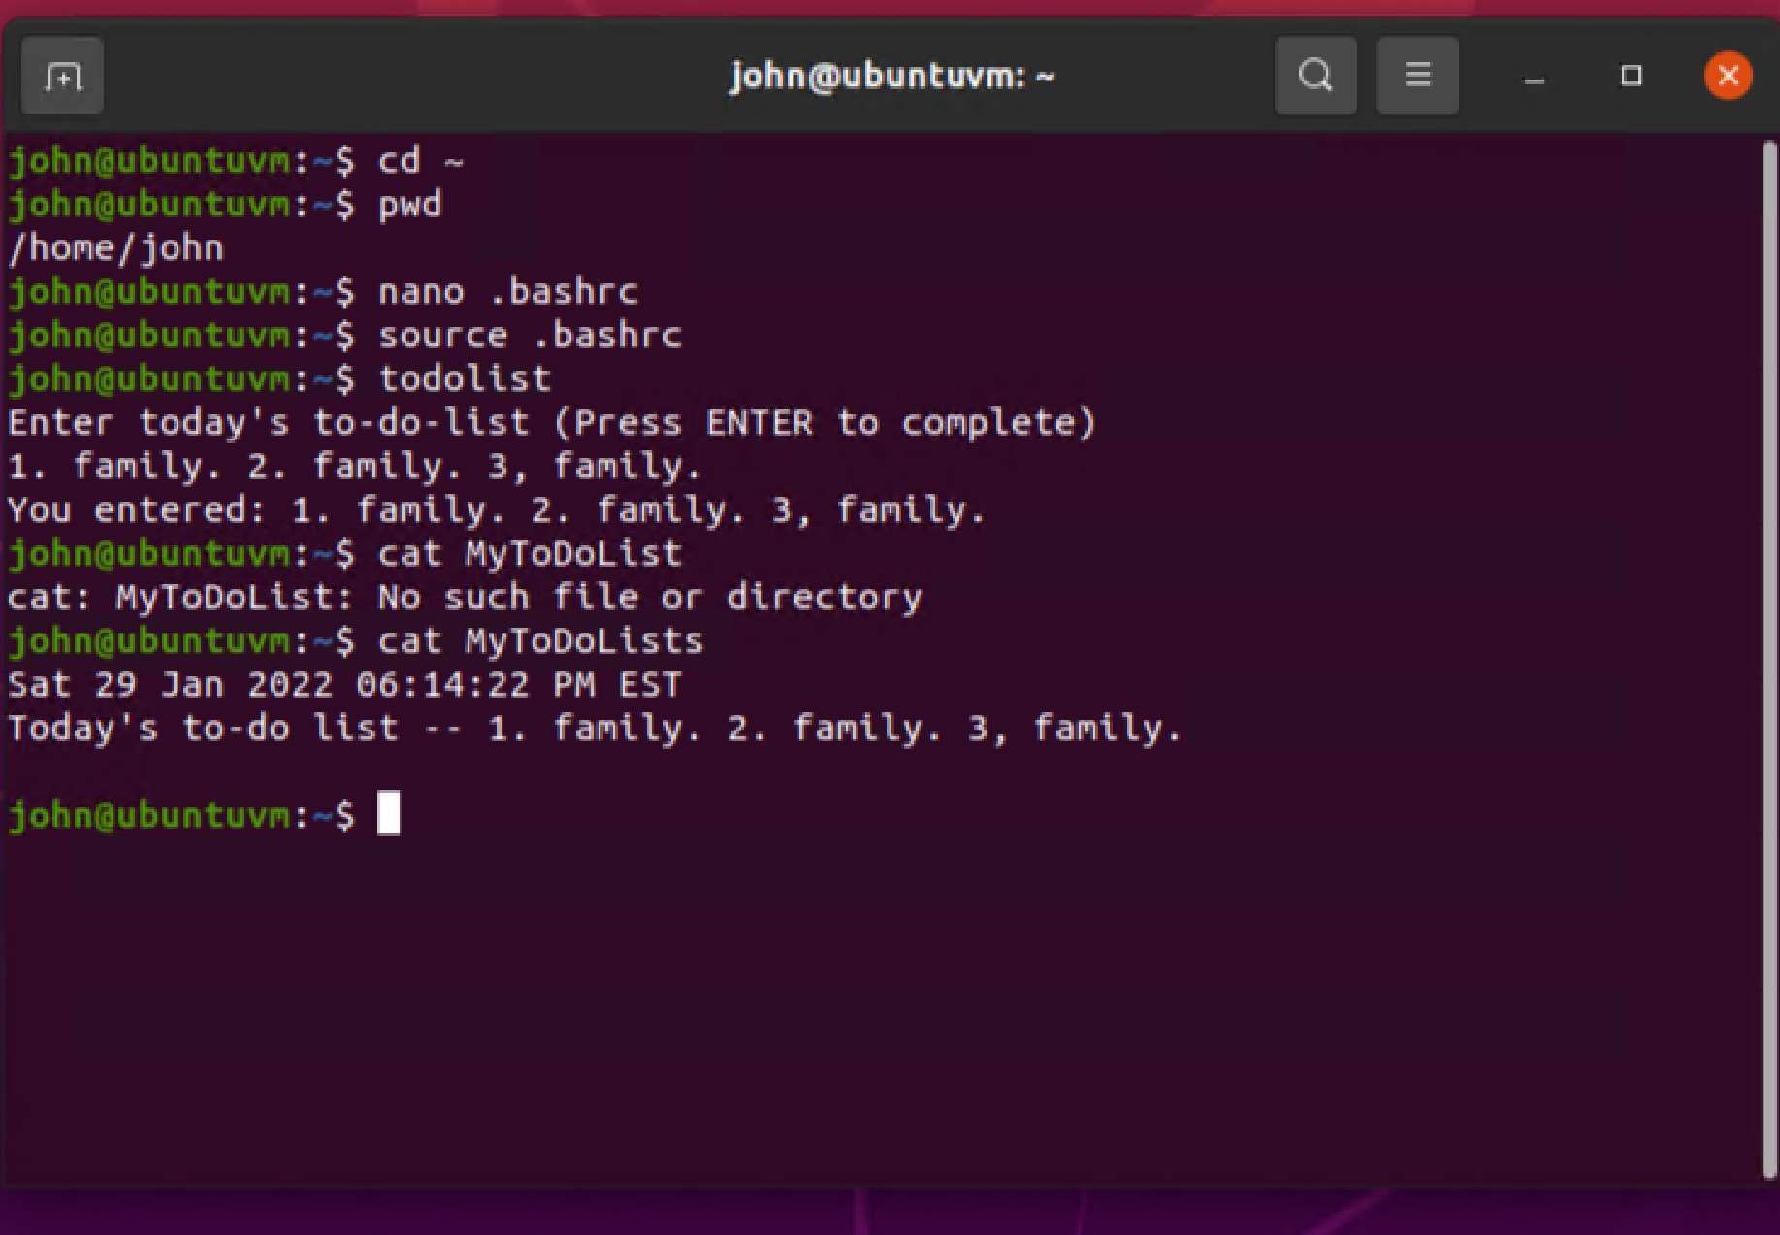
Add users in GUI

Slide 14
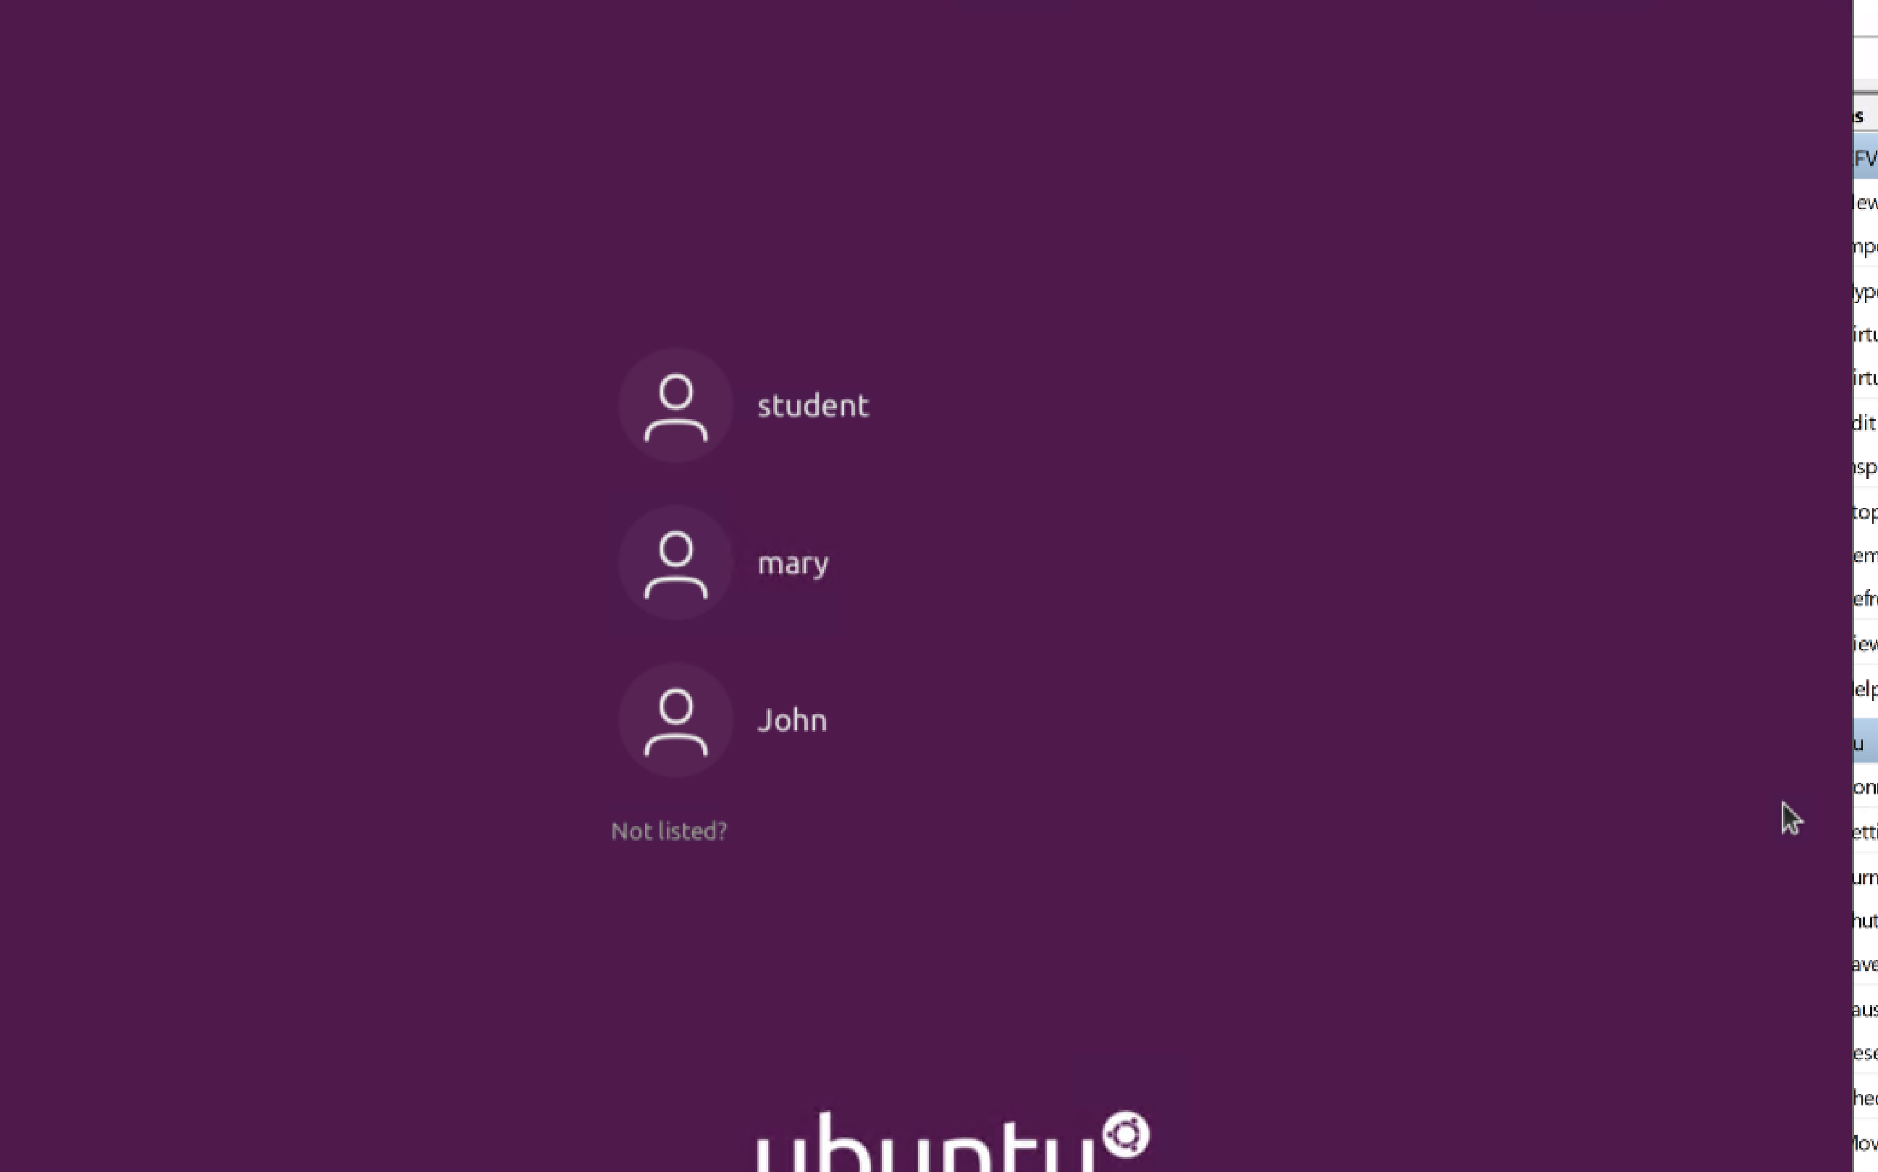
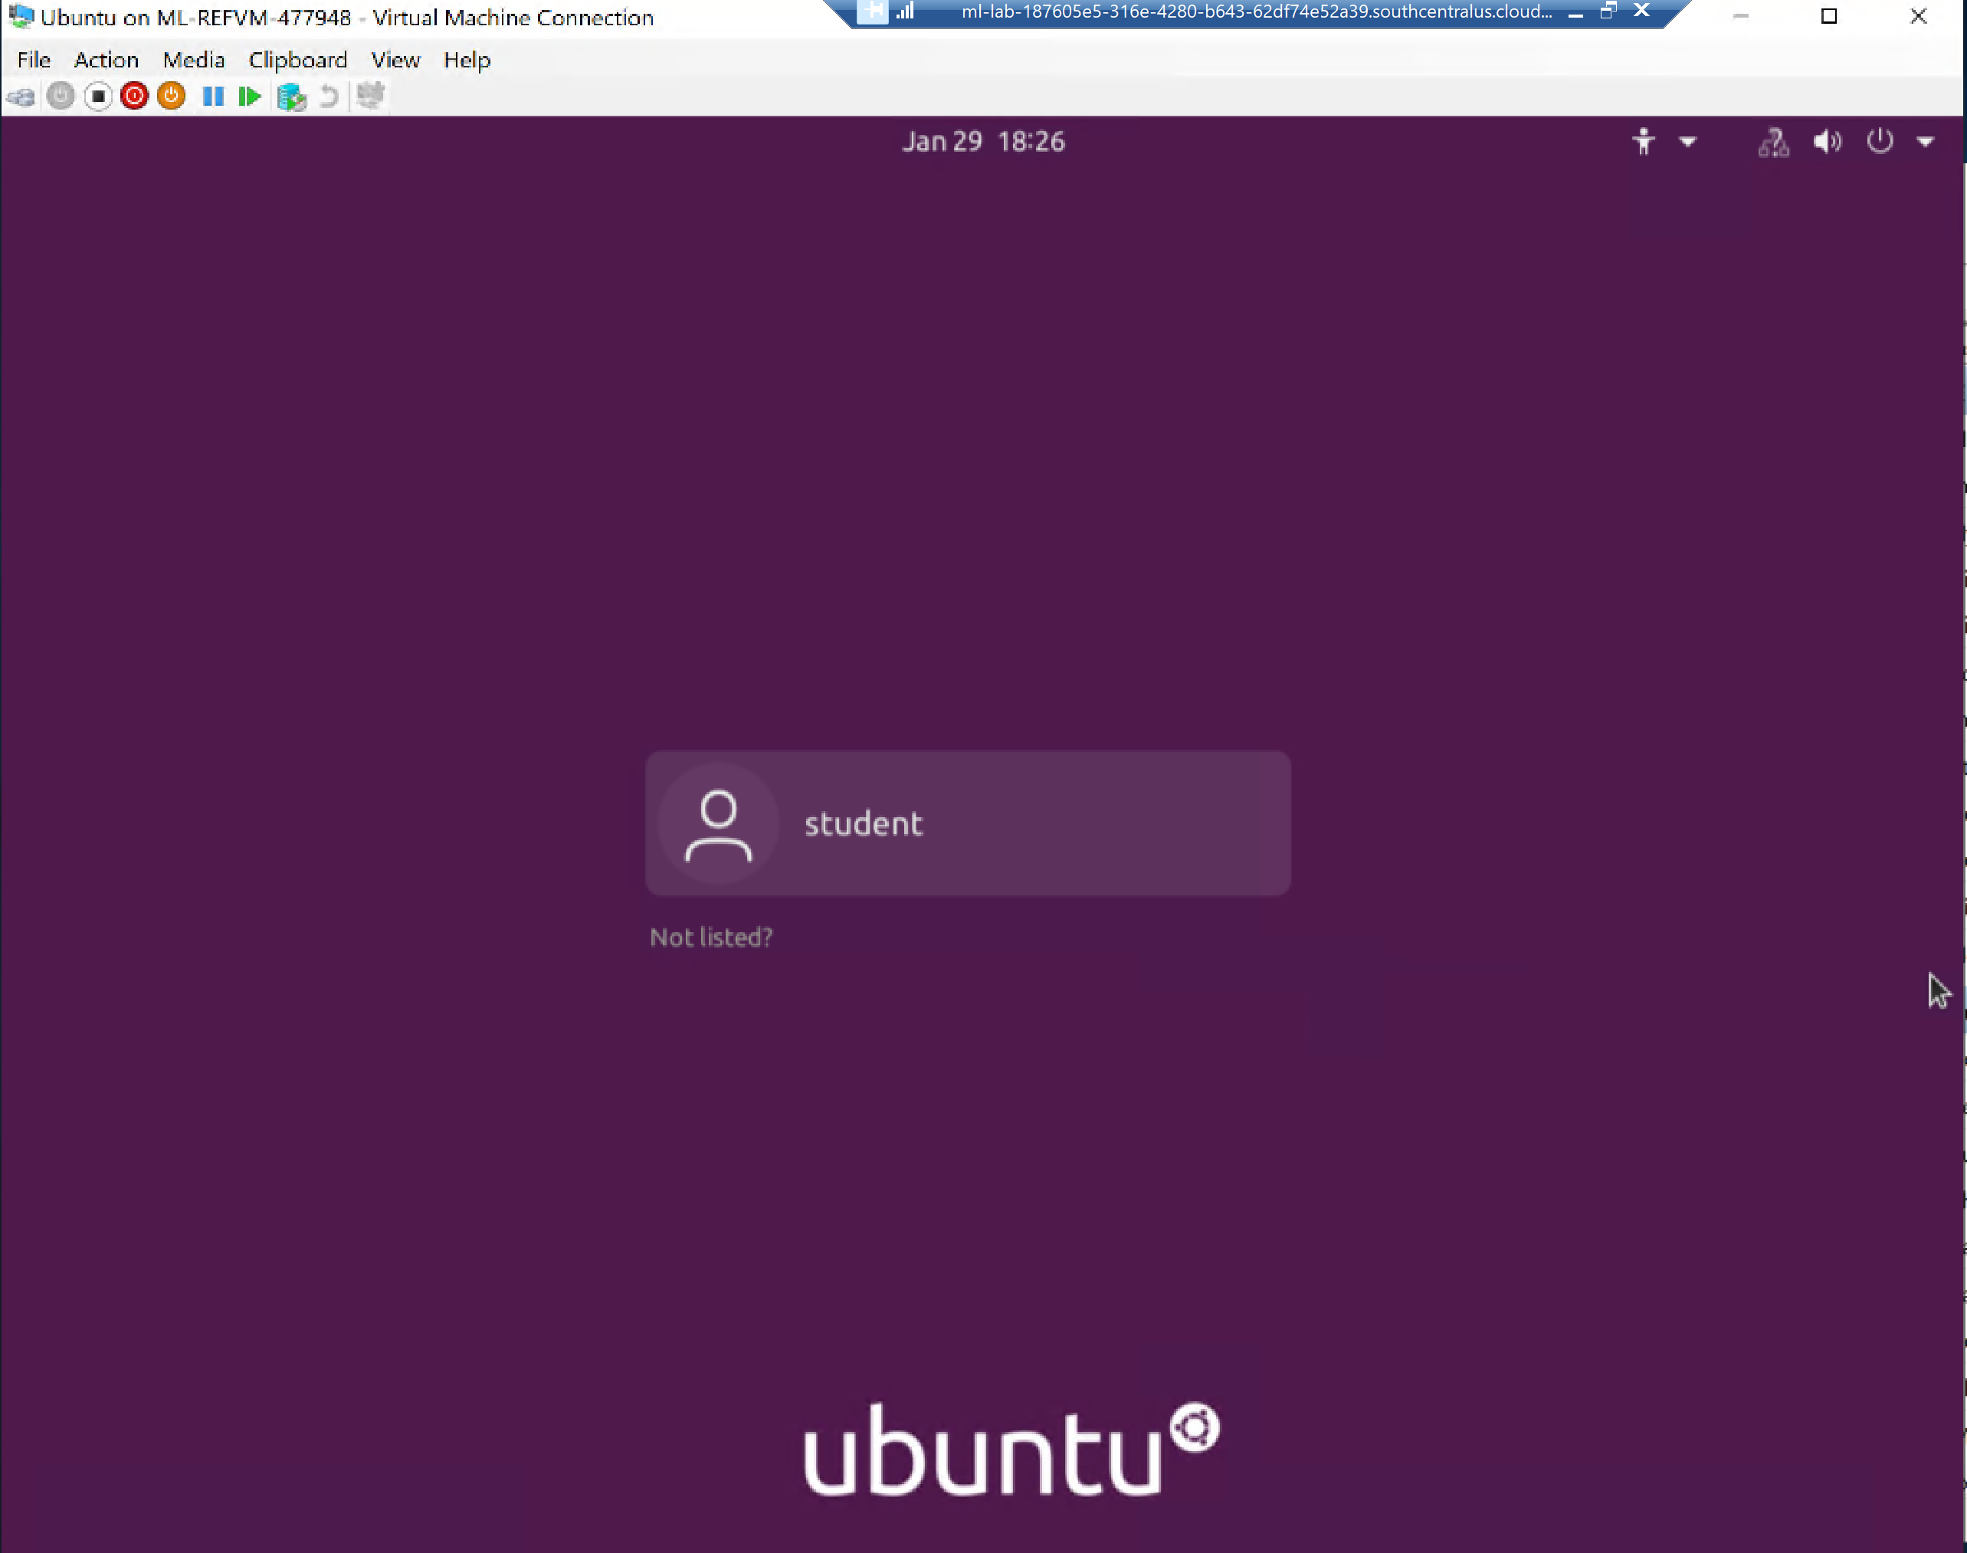
Remove users and groups

Slide 15
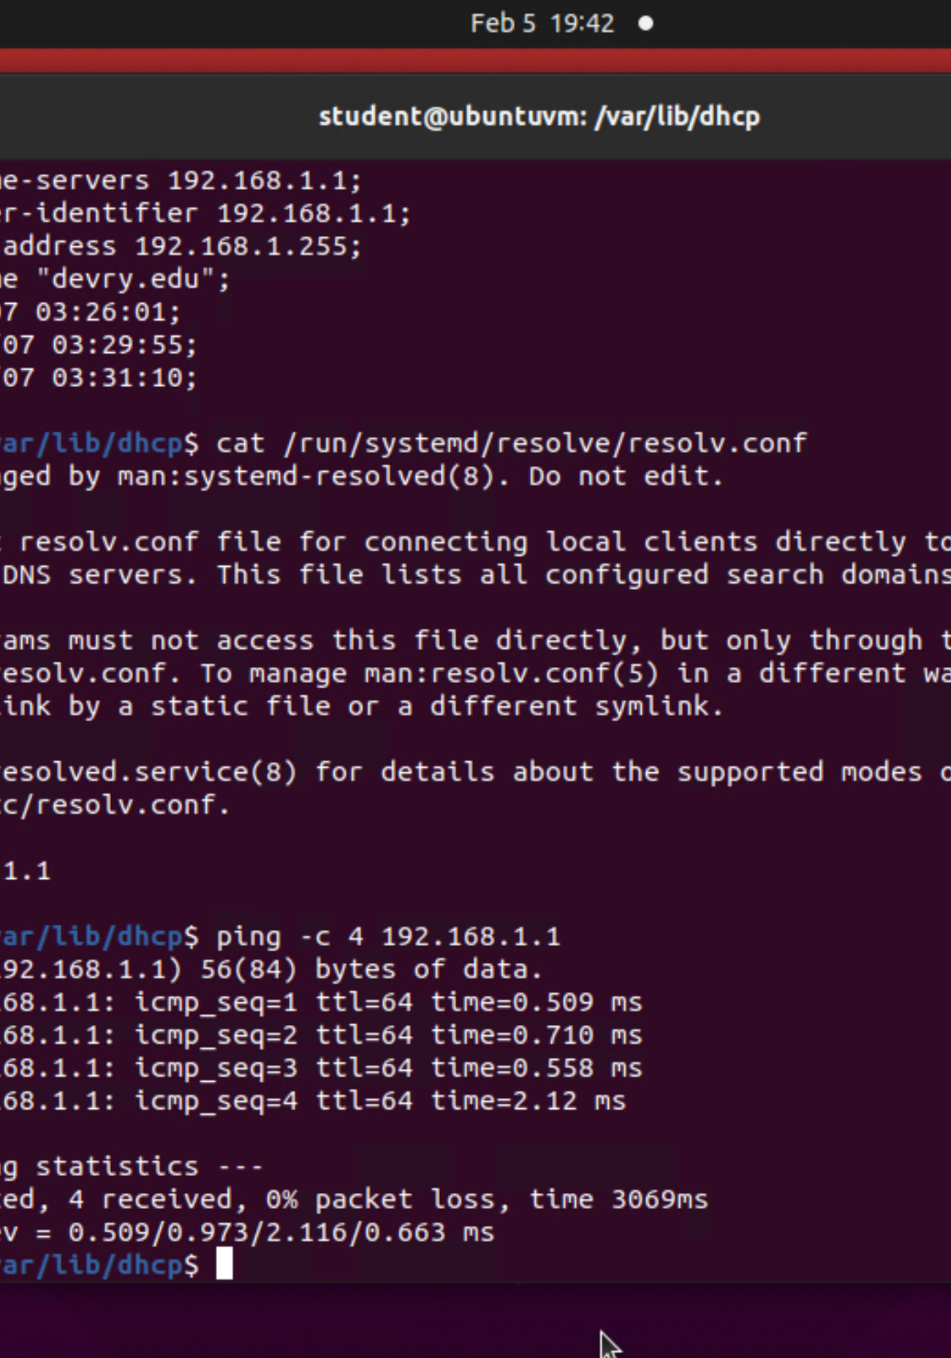
Discover host IP configurations
1. What is the IP address of your Ubuntu machine?
Answer here:
192.168.1.105
2. What is the IP address of its default gateway?
Answer here:
192.168.1.1
3. What is the IP address of its DHCP server?
Answer here:
192.168.1.1
4. What is the IP address of its DNS server?
Answer here:
192.168.1.1

Slide 16
Manage network interfaces
1. Which DHCP message is shown in the output of the sudo dhclient –v –r eth0 command? [hint: the message name is in uppercase.]
Answer here:
DHCPRELEASE
2. Which four DHCP messages are shown in the output of the sudo dhclient –v eth0 command? [hint: the message names are in uppercase.]
Answer here:
DHCPDISCOVER, DHCPOFFER, DHCPREQUEST, and DHCPACK
References:
1. https://linuxconfig.org/what-is-dhcp-and-how-to-configure-dhcp-server-in-linux
2. https://www.educba.com/dhcp-server-in-linux/

Slide 17
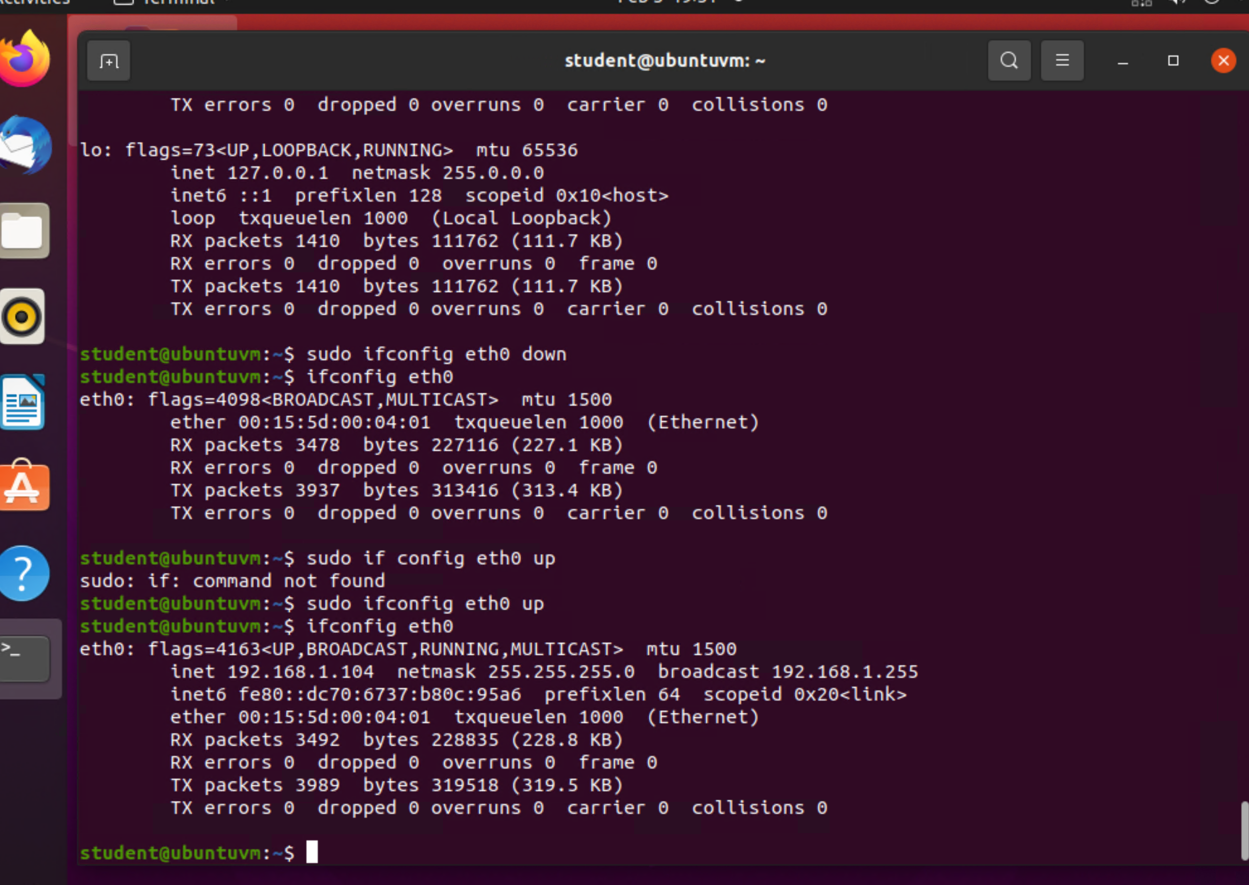
Use network utilities

Slide 18
Monitor Linux processes
1. What is the default action of the 15 SIGTERM kill signal?
Answer here:
Cancel the open program
2. In the System Monitor window, click on % CPU to sort the processes by CPU load. Which process shows the highest percentage of CPU usage?
Answer here:
Gnome shell is the most used one

Slide 19
Monitor user activities
Issue the sudo accton on command to turn on GNC accounting. Run the sudo updatedb command. Enter lastcomm updatedb to check if the updatedb command was executed before. Remember to turn off GNC accounting (sudo accton off) after answering the questions.
1. What flag value is displayed in the output?
Answer here:
S
2. Why is the name of the user who ran the processes shown as root, not student?
Answer here:
It’s the main user so they have root access.sudo accton

Slide 20
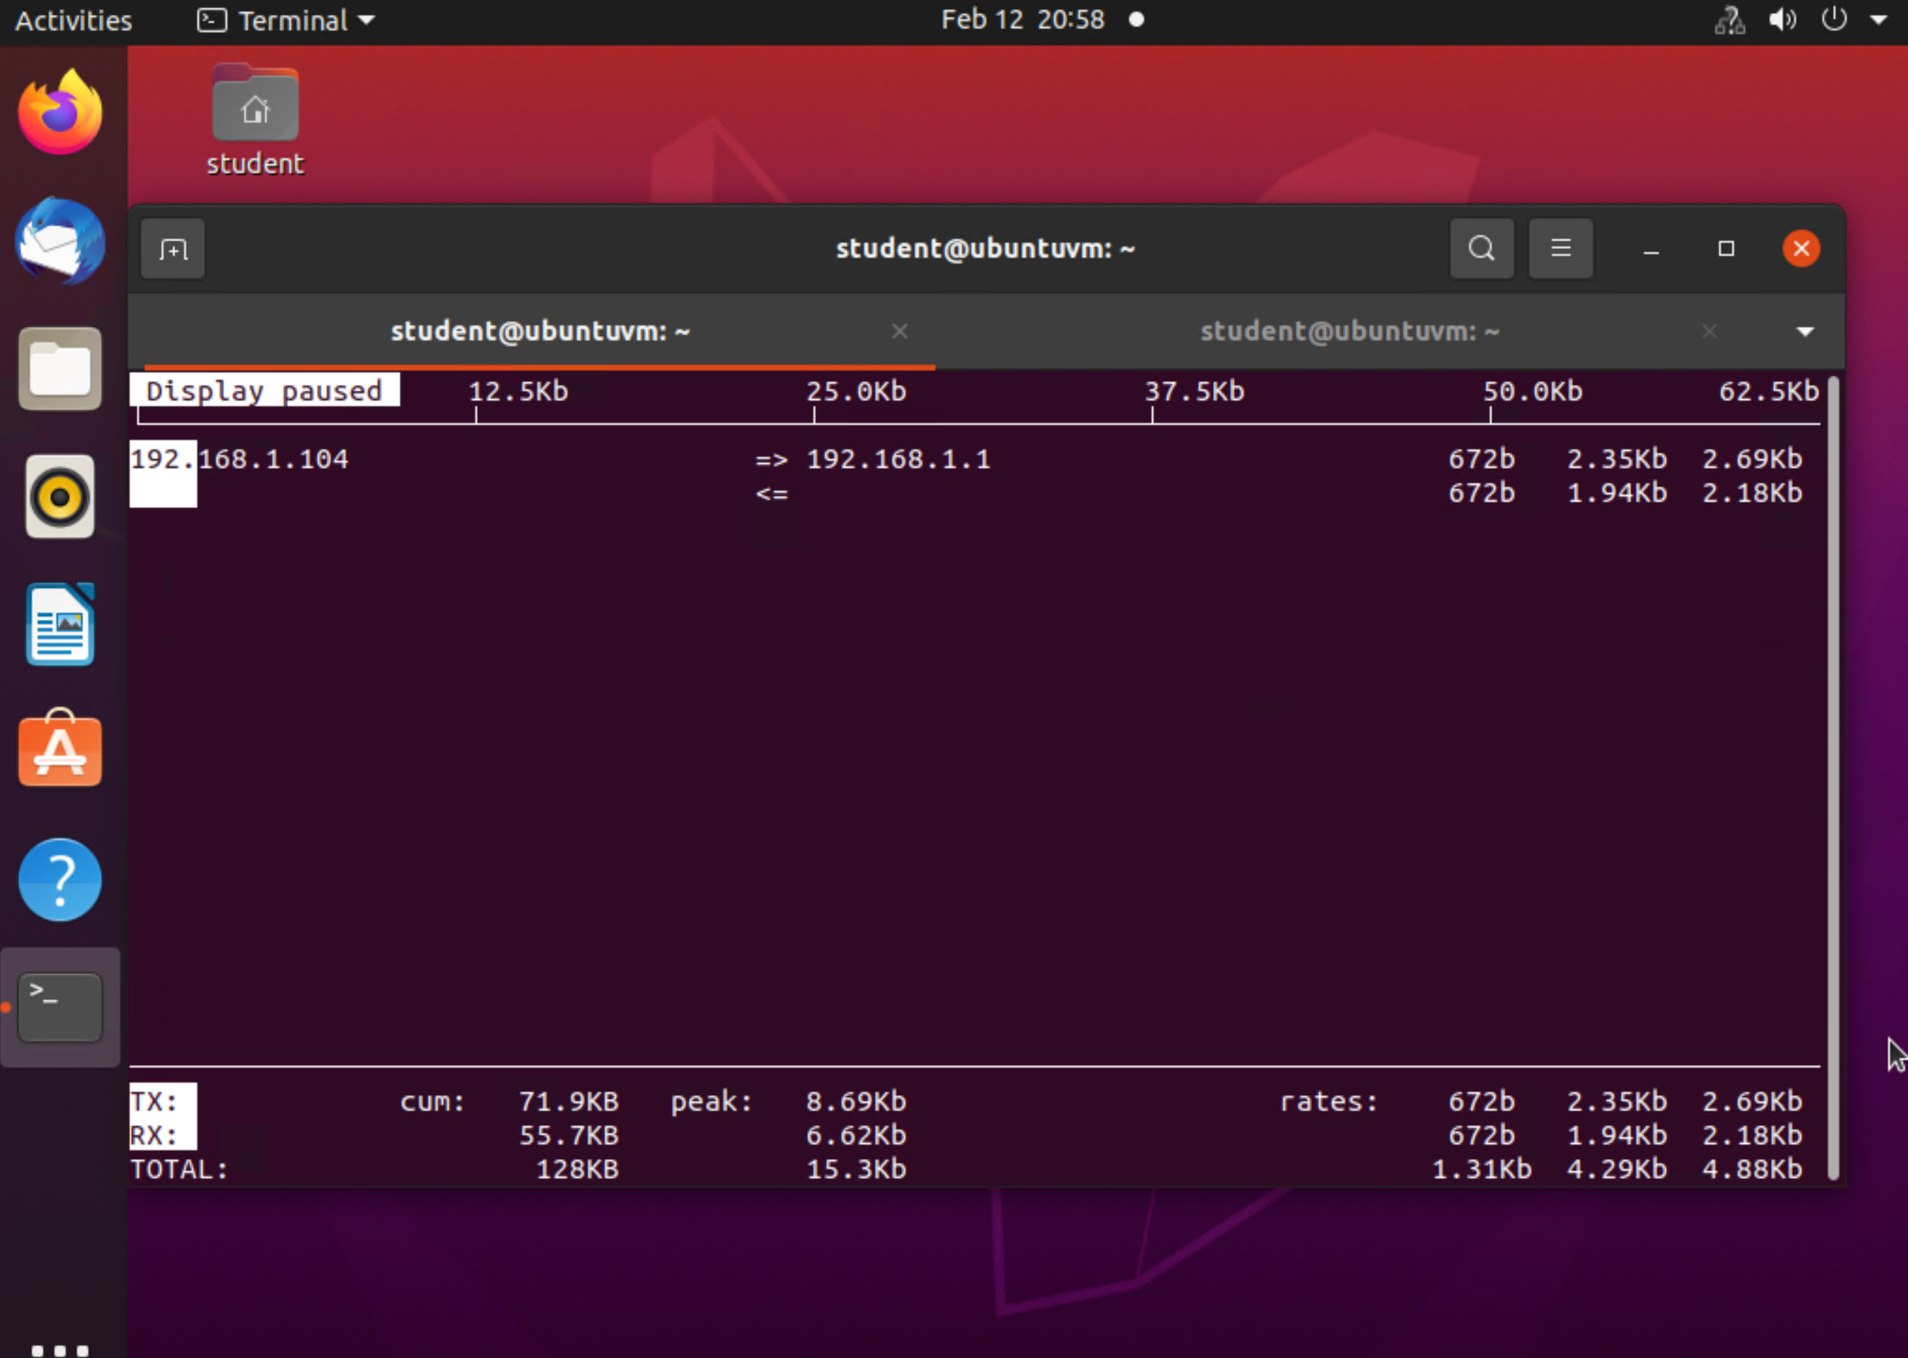
Monitor network bandwidth usage

Slide 21
Challenges
This project was semi hard, but it was fun and relatively easy. One challenge I did have was making sure I put in the correct character into the script.

Slide 22
Conclusion
This project was a great introduction to the usage of the Linux OS.
I got some good knowledge out of this project. It was my first time working with the Linux OS and found it fun to use.

