Slide 1
NEWT211 Course Project
Cloud NEtworking
Presented by:
Mitchell Woodworth

Slide 2
Introduction
This project uses cloud-based system Azure to create familiarity with the system.
During this project we created Virtual Machine (VM) instances,

Slide 3
Software Inventory
The Azure Cloud provider was the source for this project.

Slide 4

Virtual Machine (VM) Instances

Slide 5

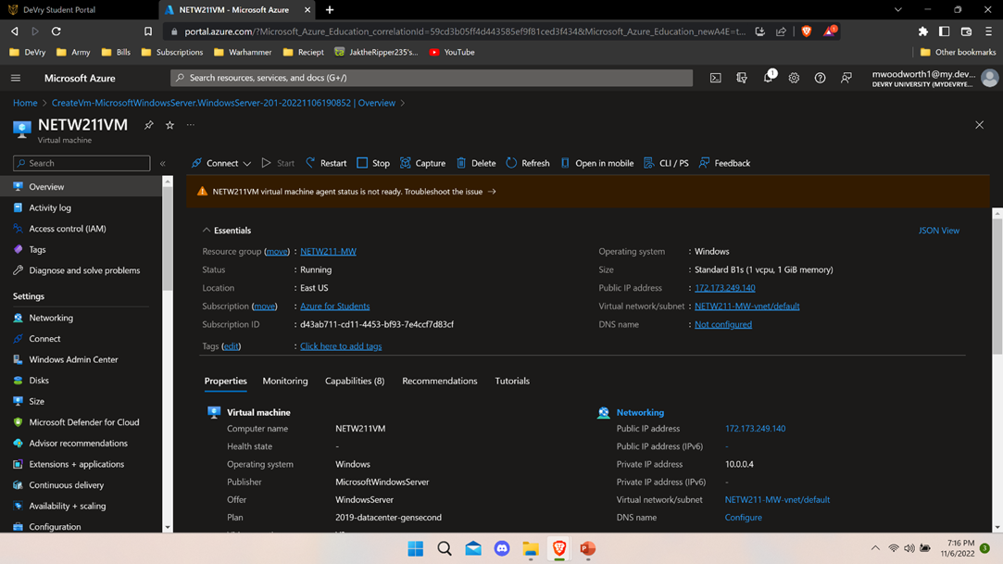
Deploying a VM in Azure
The naming convection I used for the VM is NEWT211VM

Slide 6
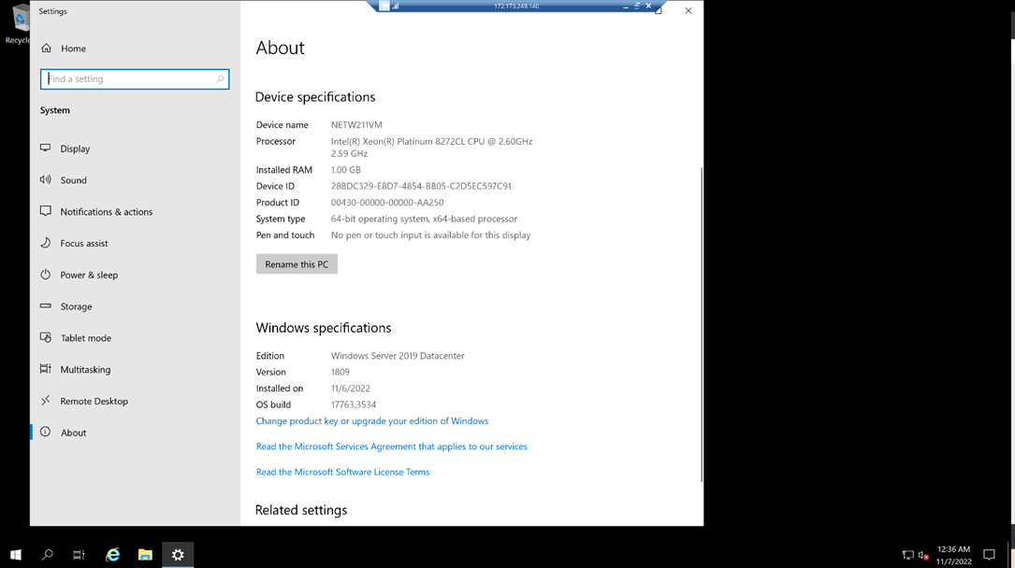
Connecting to the VM
We successfully connected to the VM and verified the information in the properties of the VM.

Slide 7
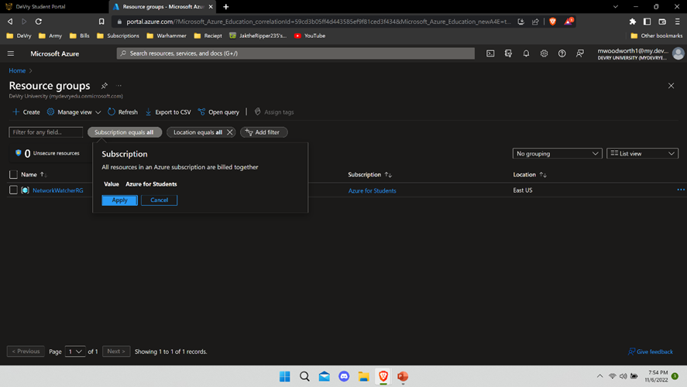
Deleting the VM
In order to save resources after successfully doing the task we delete all the resource groups associated with the project.

Slide 8
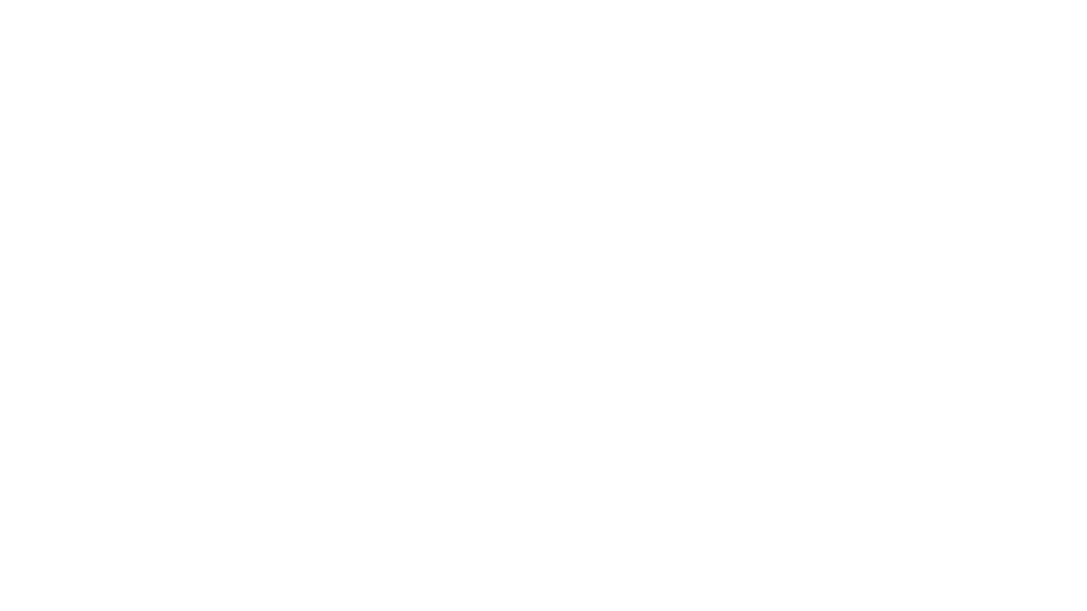
Azure VNet and Subnets

Slide 9
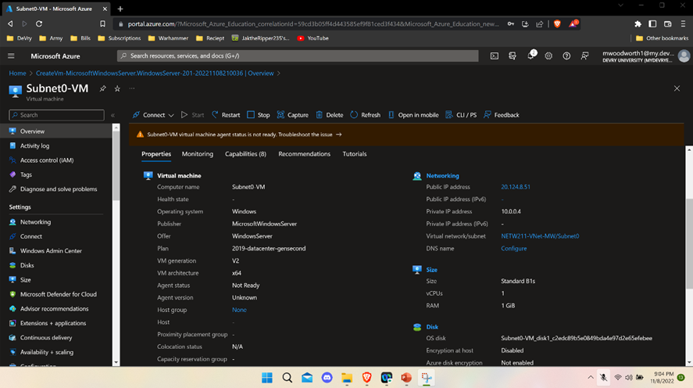
Deploying VMs into Subnets
I created a subnet named: Subnet0-VM

Slide 10
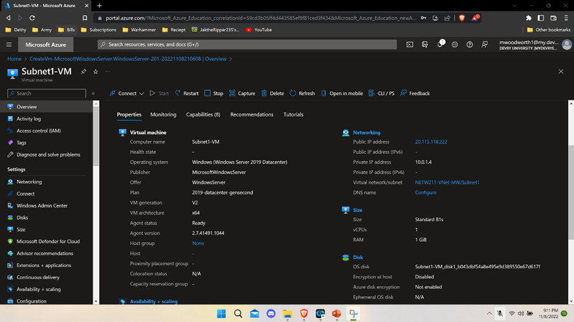
Deploying VMs into Subnets cont’d

Slide 11
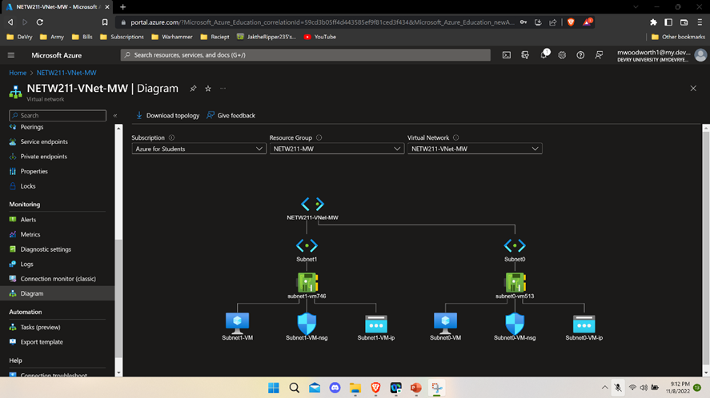
Deploying VMs into Subnets cont’d

Slide 12
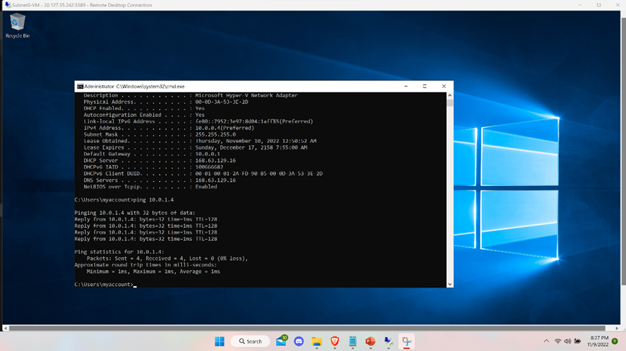
Verifying Connectivity between VMs
I then verified my connection between the two VMs

Slide 13
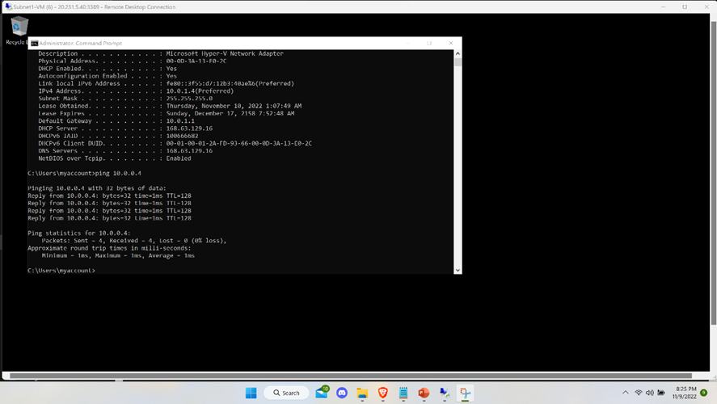
Verifying Connectivity between VMs cont’d

Slide 14
Azure VM Security

Slide 15
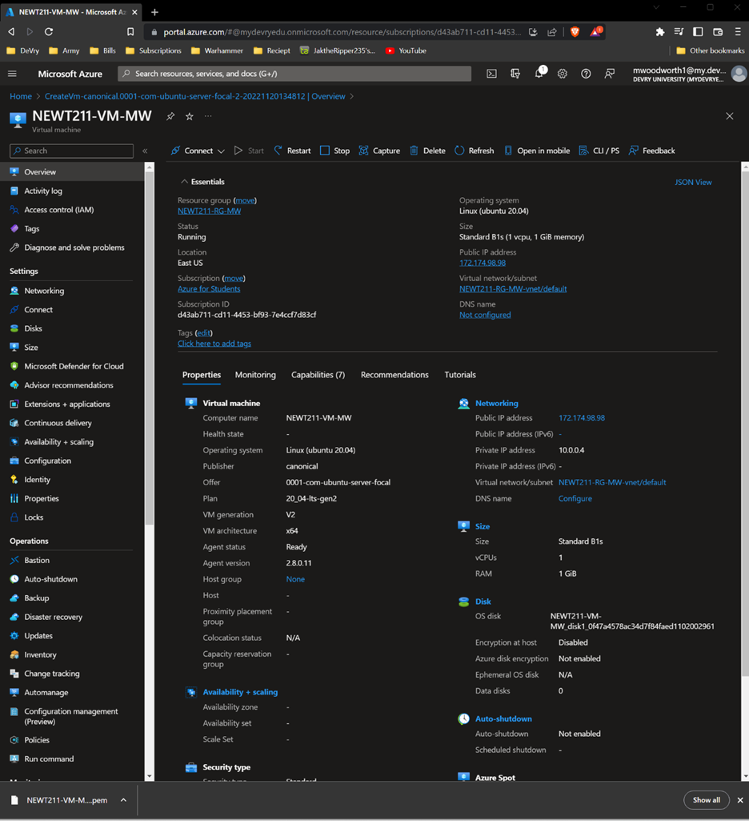
Launching a VM
I created a VM named NEWT211-VM-MW. Here is a screenshot of the VM.

Slide 16
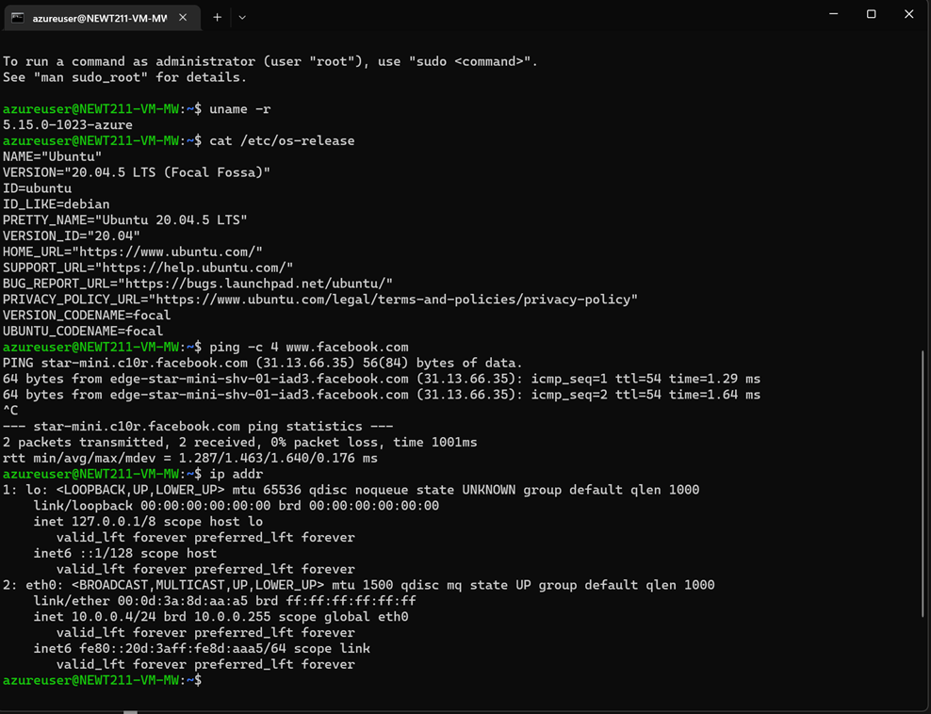
Connecting to the VM via SSH
I then connected to VM NEWT211-VM-MW via SSH connection.

Slide 17
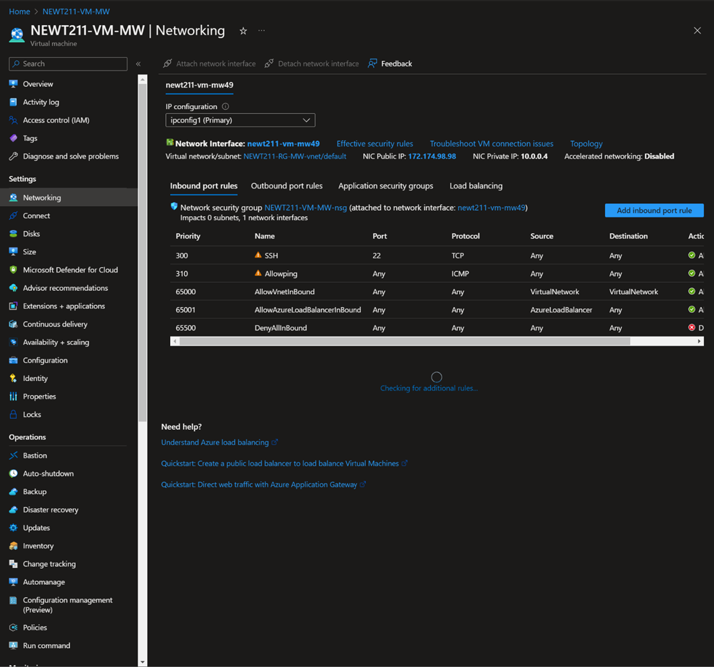
Configuring an NSG
I configured the Inbound Port Rules to allow me to ping the VM.

Slide 18
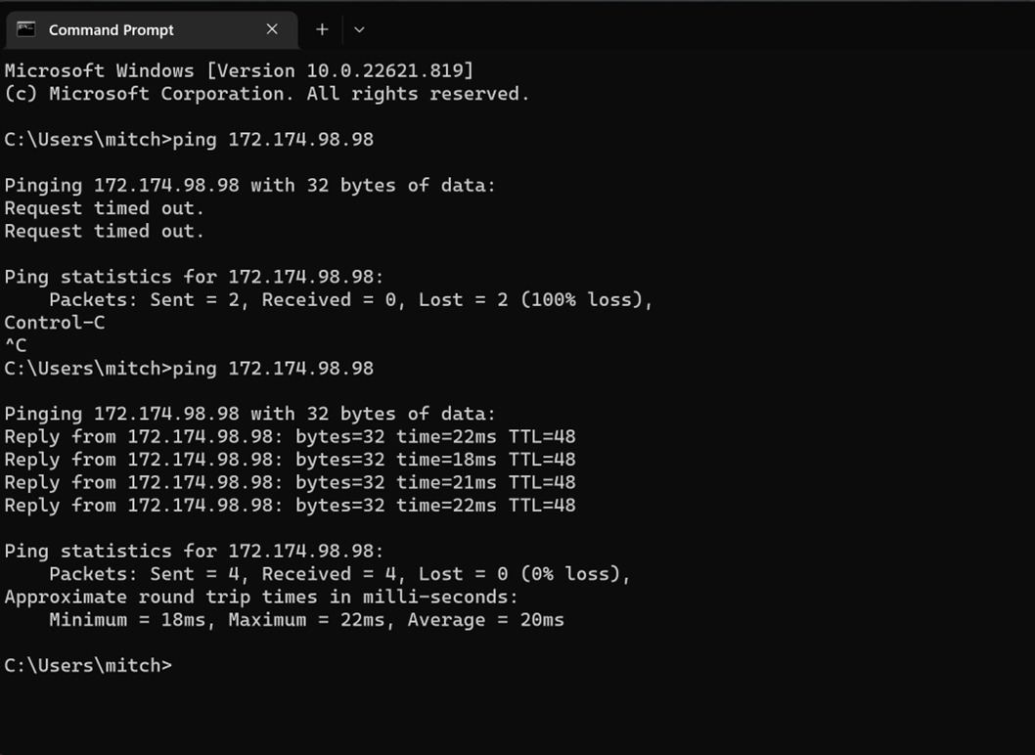
Configuring an NSG cont’d
This screenshot is from my local computer showing I was successfully able to ping the VM.

Slide 19
Cloud Storage

Slide 20
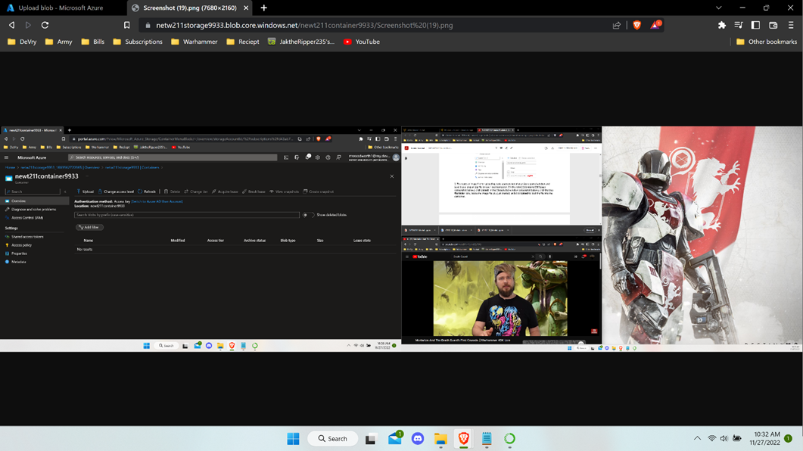
Uploading and Accessing a File
This screenshot shows that I have uploaded an image into the Azure database. I was able to pull that photo from the Azure database.

Slide 21
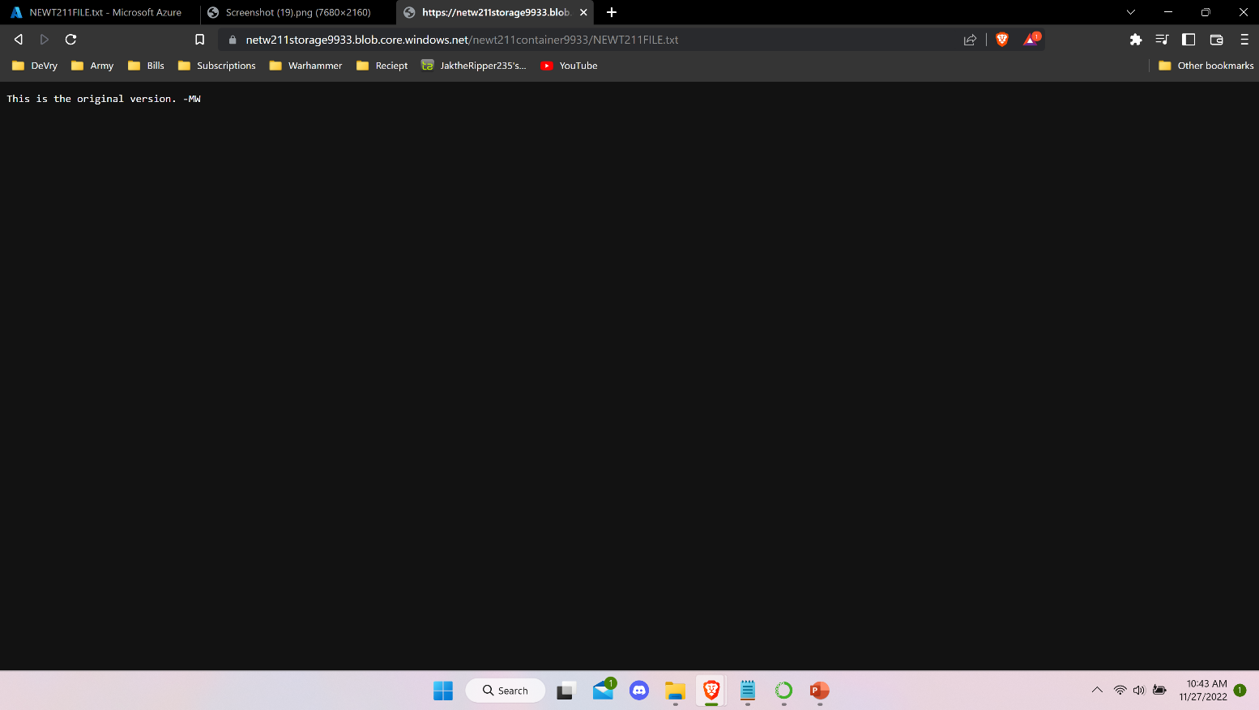
Creating Blob Snapshots
This screenshot shows that I was able to upload a .txt file and was able to pull the file up.

Slide 22
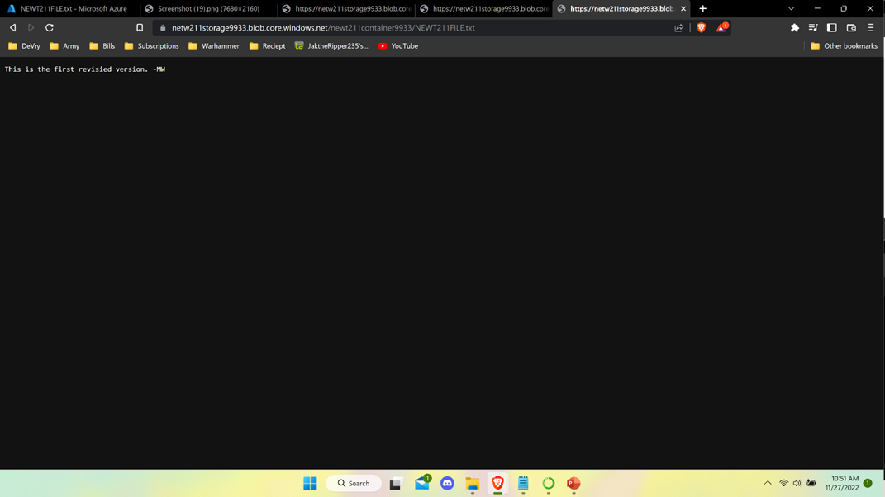
Enabling Blob Versioning
The screenshot shows That I enabled a blob and was able to bring up the blob succesfuly.

Slide 23
Cloud Monitoring

Slide 24
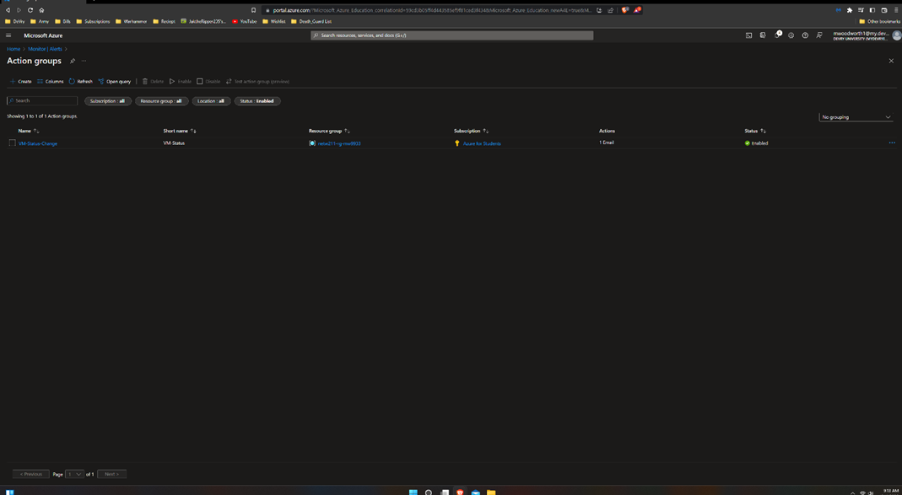
Setting up an Action Group and Notifications
Here I add group notifications to the VM. This will allow the Cloud Admin to receive notifications if changes where made.

Slide 25
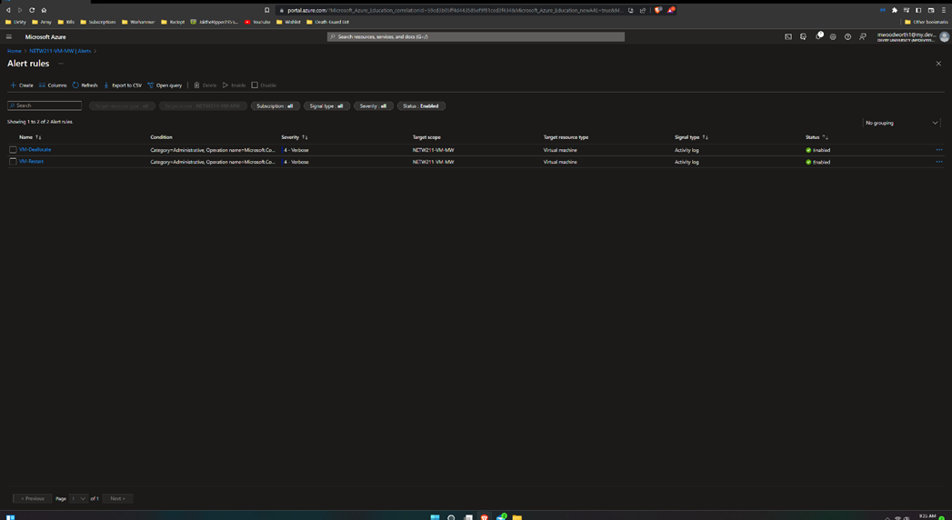
Setting up Alert Rules
I set up the proper rules to receive the notifications.

Slide 26
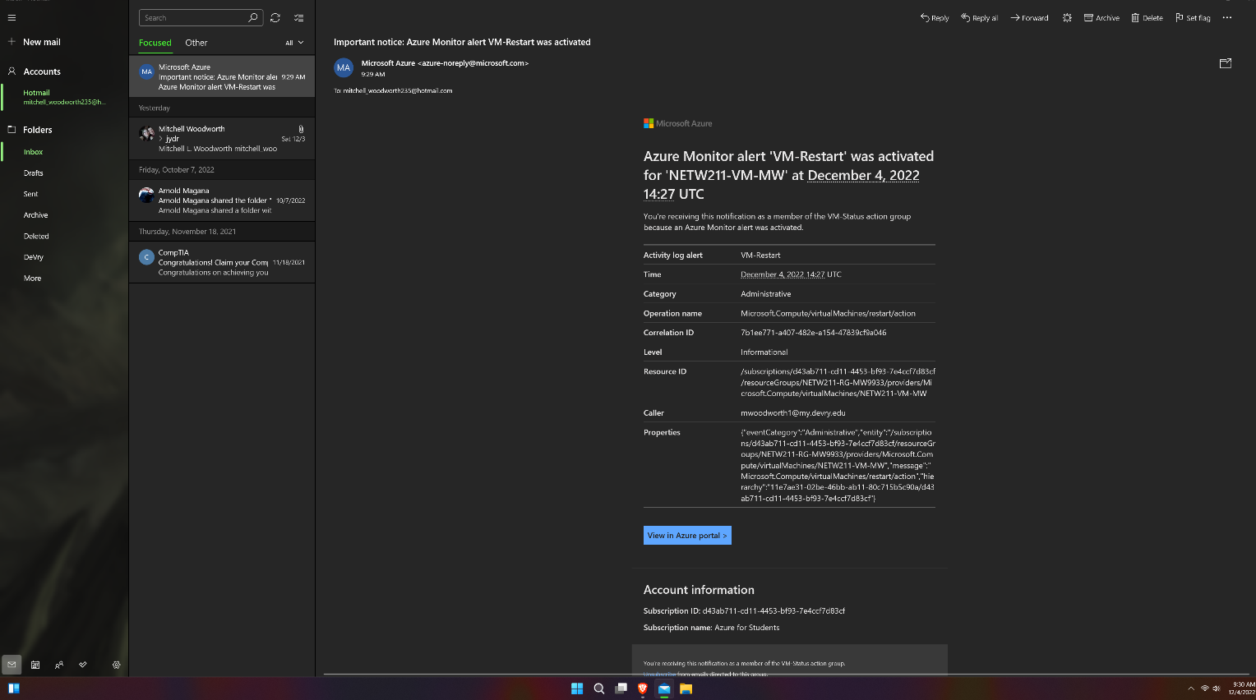
Testing Alerts
I tested the alert system when the VM restarted.

Slide 27
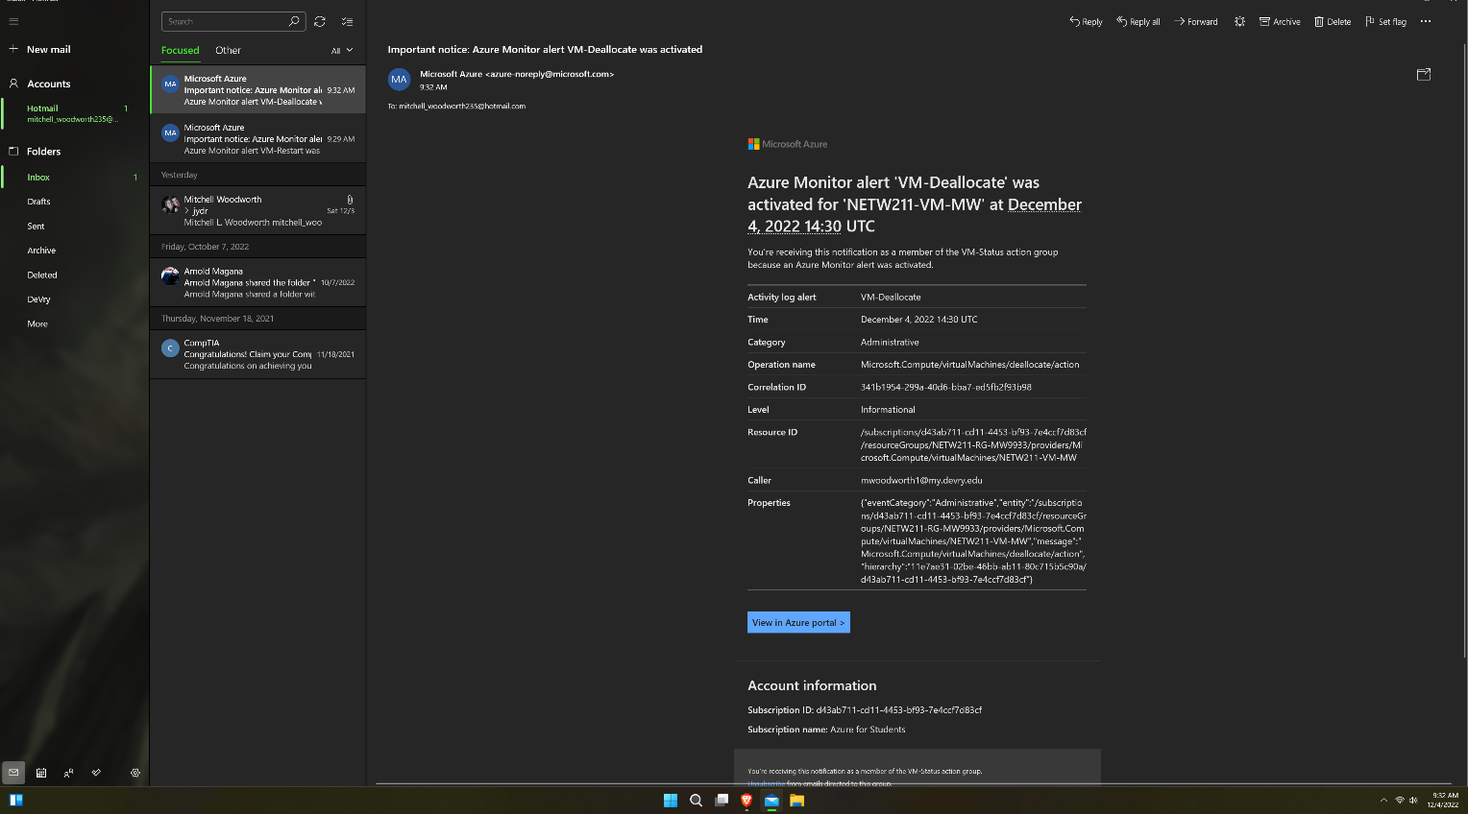
Testing Alerts cont’d
I tested the alert system when the VM being shut down.

Slide 28
Challenges
A challenge I had doing this project was making sure I set up the VMs properly to work the way I want it too. Another challenge was making sure I deleted the resources, so I don’t waste away the money for the rest and my future projects.

Slide 29
Career Skills Acquired
Cloud based operating
Operating system fundamentals
Automation

Slide 30
Conclusion
This project was a great introduction to Azure and cloud-based OS overall.
I went through some of the basic operations of the Azure software.

Slide 31
Reference:
https://www.calculator.net/ip-subnet-calculator.html
https://docs.microsoft.com/en-us/azure/virtual-network/virtual-networks-faq
https://docs.microsoft.com/en-us/azure/storage/blobs/access-tiers-overview
https://devry.percipio.com/courses/c7ef0333-8560-403f-a004-9c5c843866b0/videos/2658bbe6-ee97-438b-a376-fbb079c3b3a0

