Slide 1
CEIS 114 Course Project Traffic control
Mitchell Woodworth

Slide 2

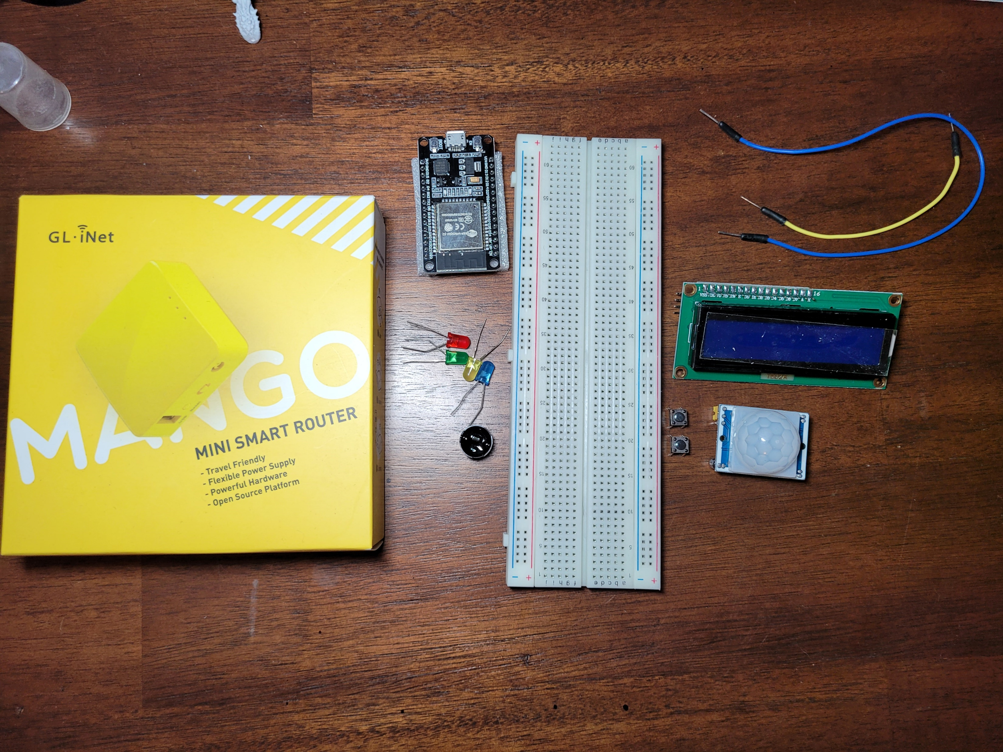
Inventory
ESP 32 Board
Colored LEDs: Red, Yellow, Green, and Blue
Wires
Breadboard(s)
LCD Unit with I2C Adapter
Active Buzzer
Mini Router
Push Button(s)
PIR Motion Sensor

Slide 3
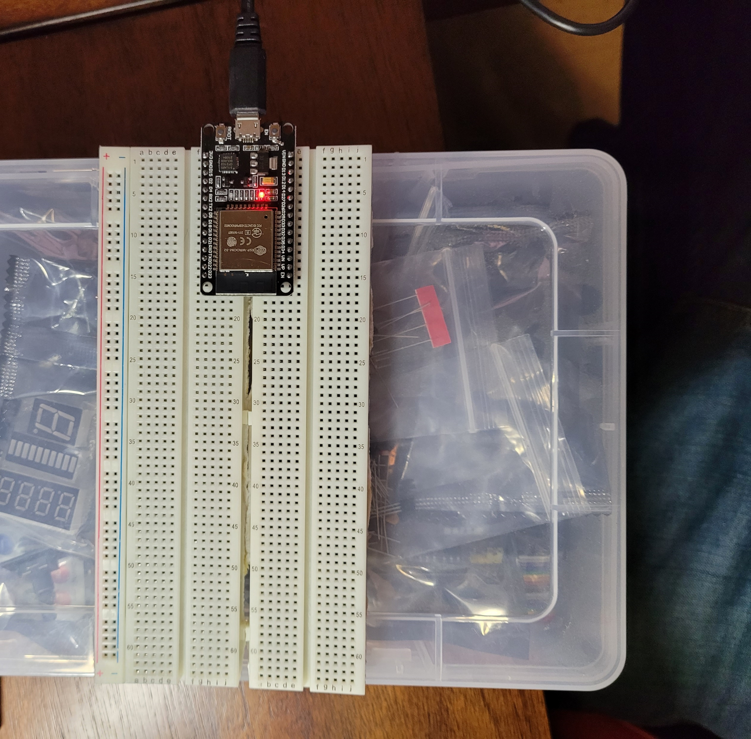
ESP32
Microcontroller mounted and powered ON

Slide 4
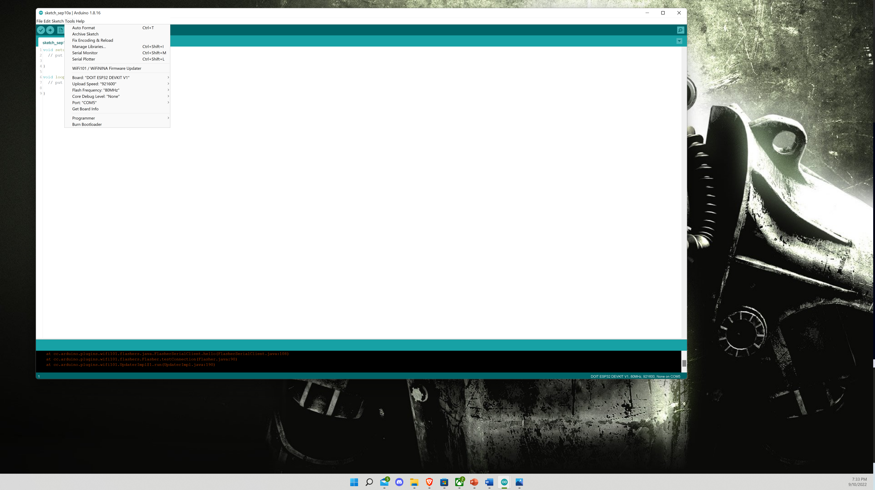

Installation of Arduino IDE

Slide 5
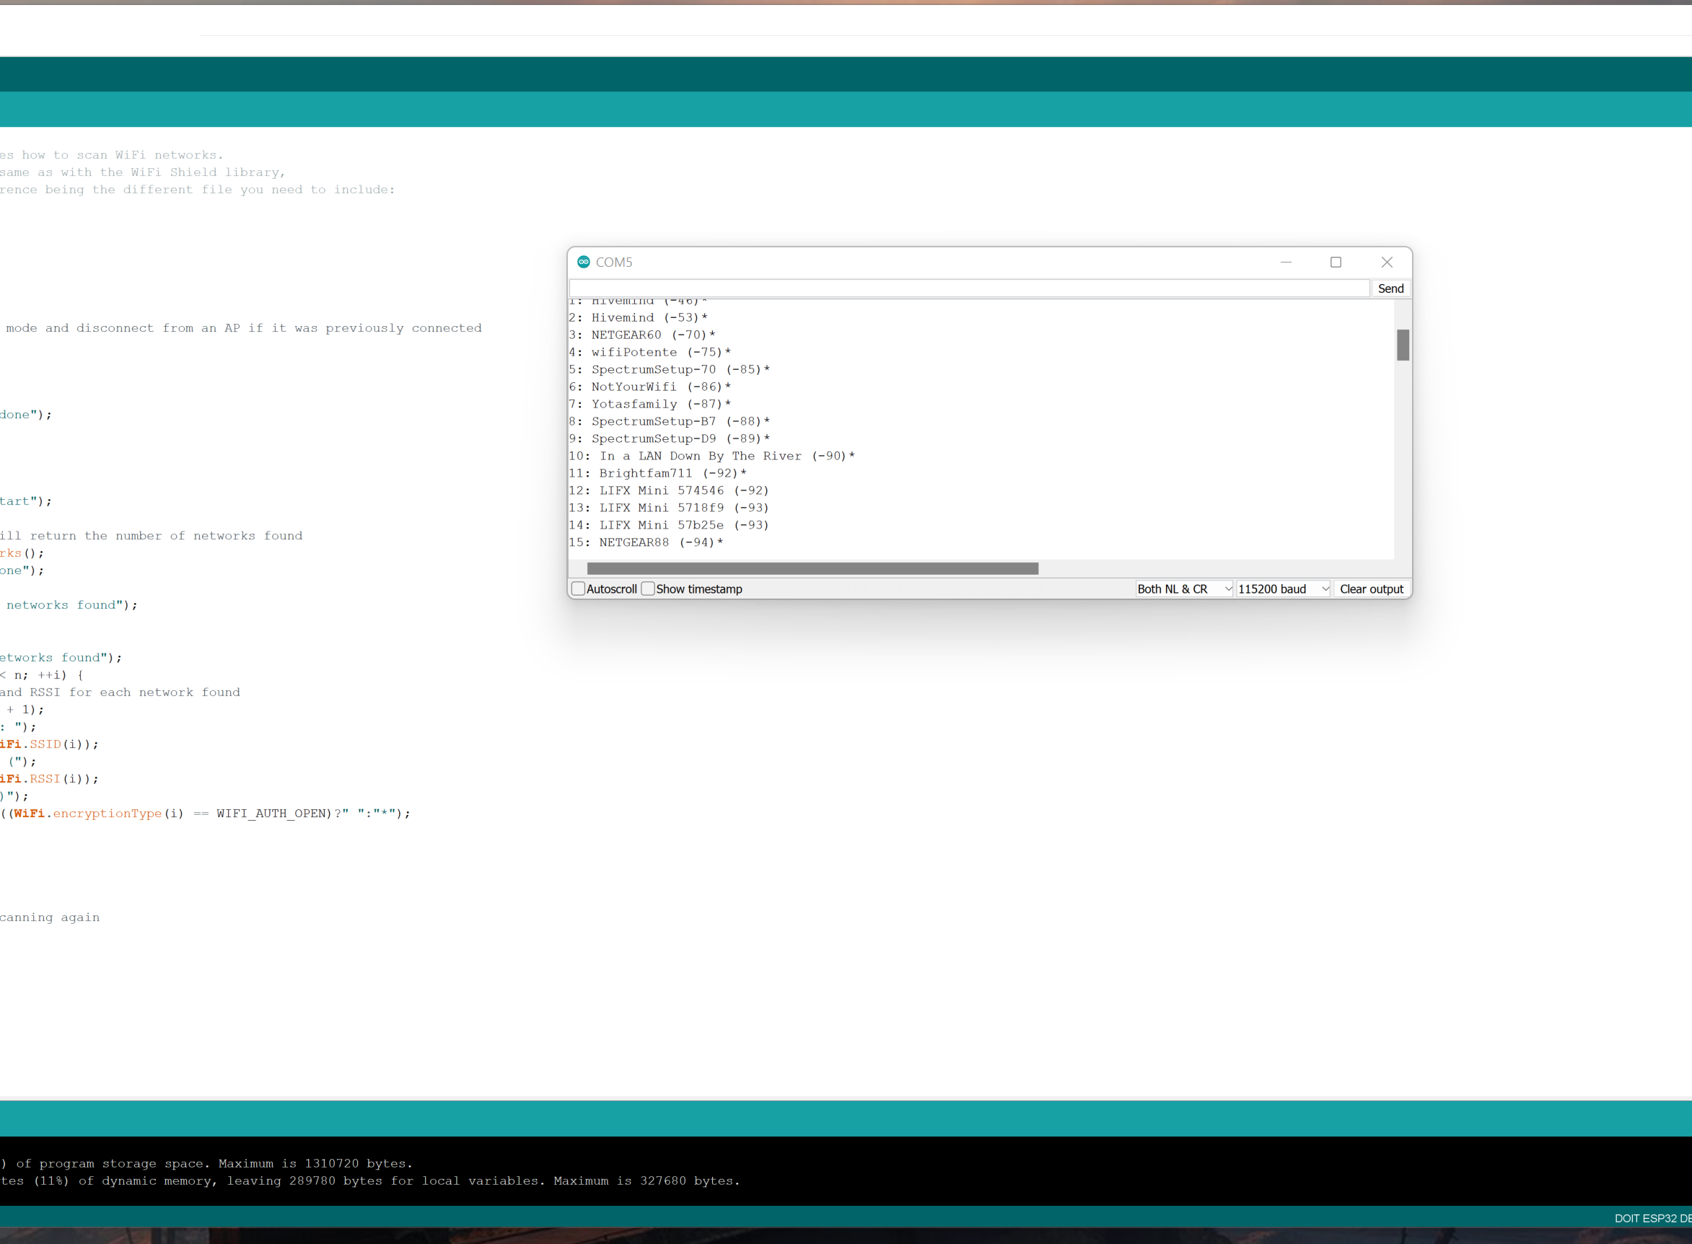
ESP32 WiFi Scan

Slide 6
Implementing LED
Adding the code for basic light usage

Slide 7
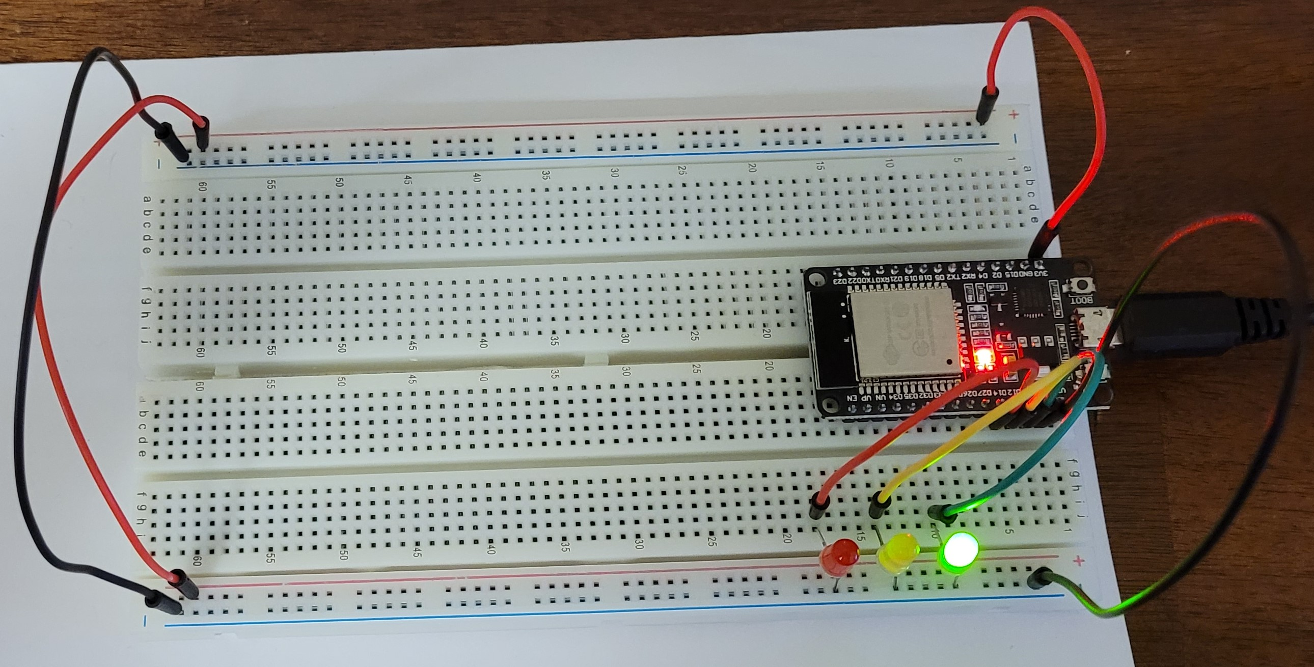
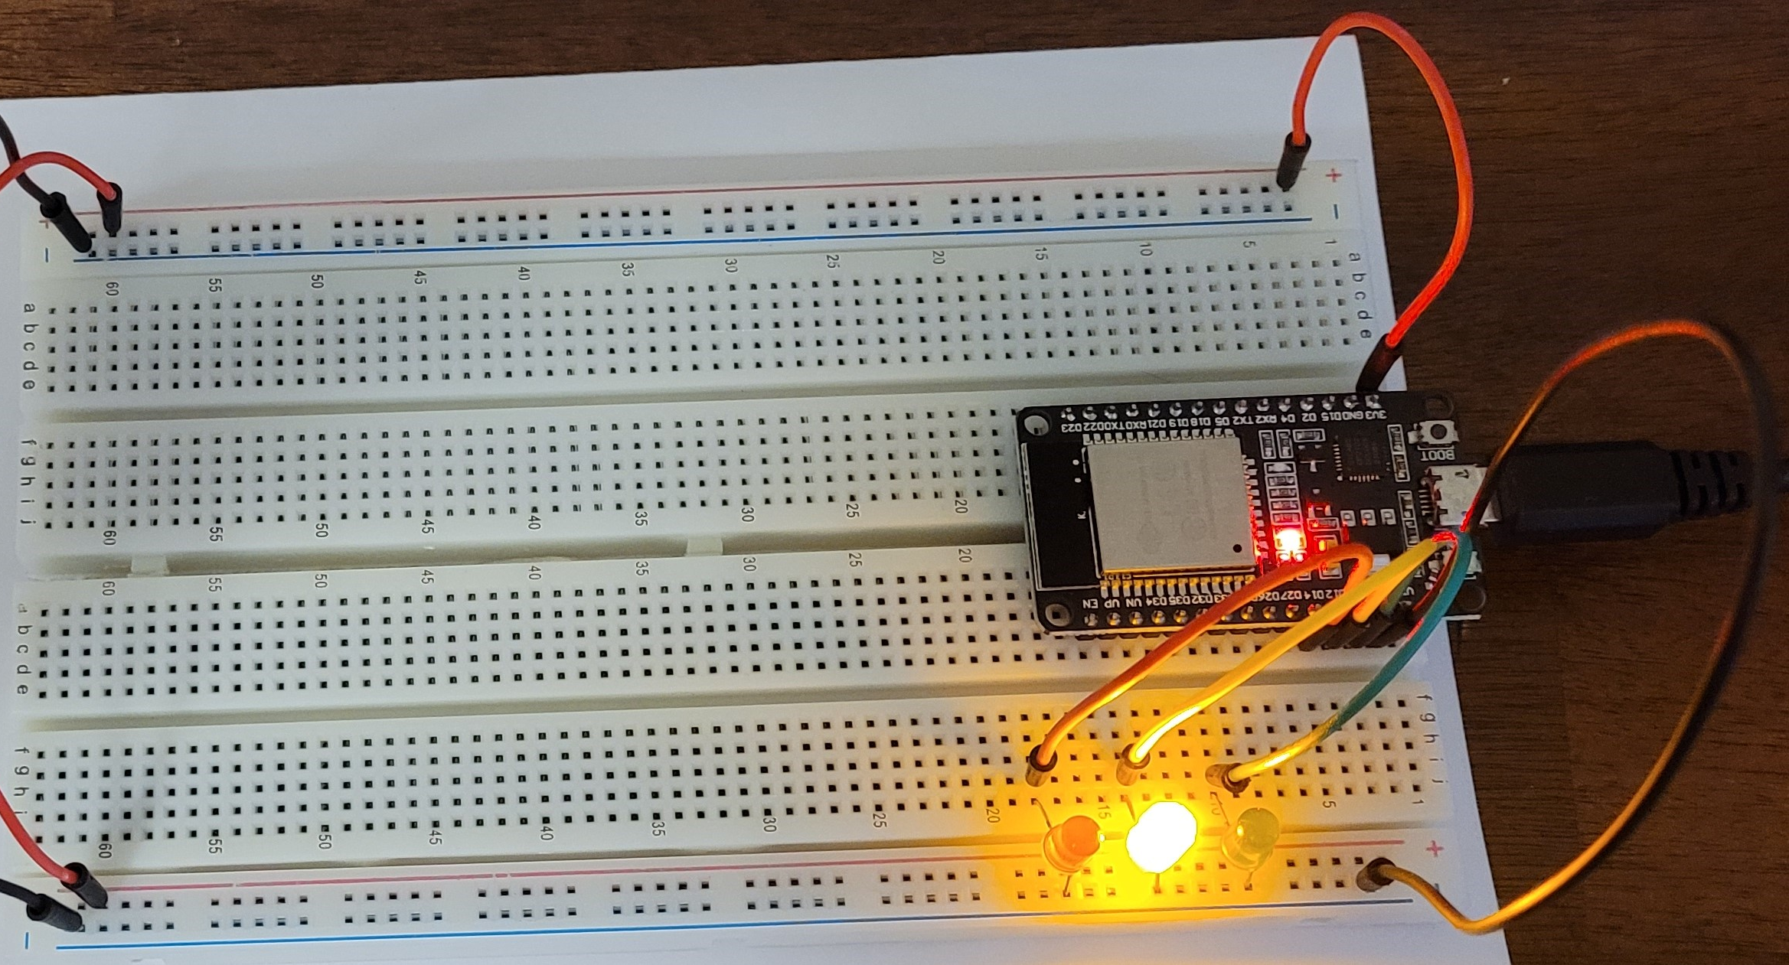
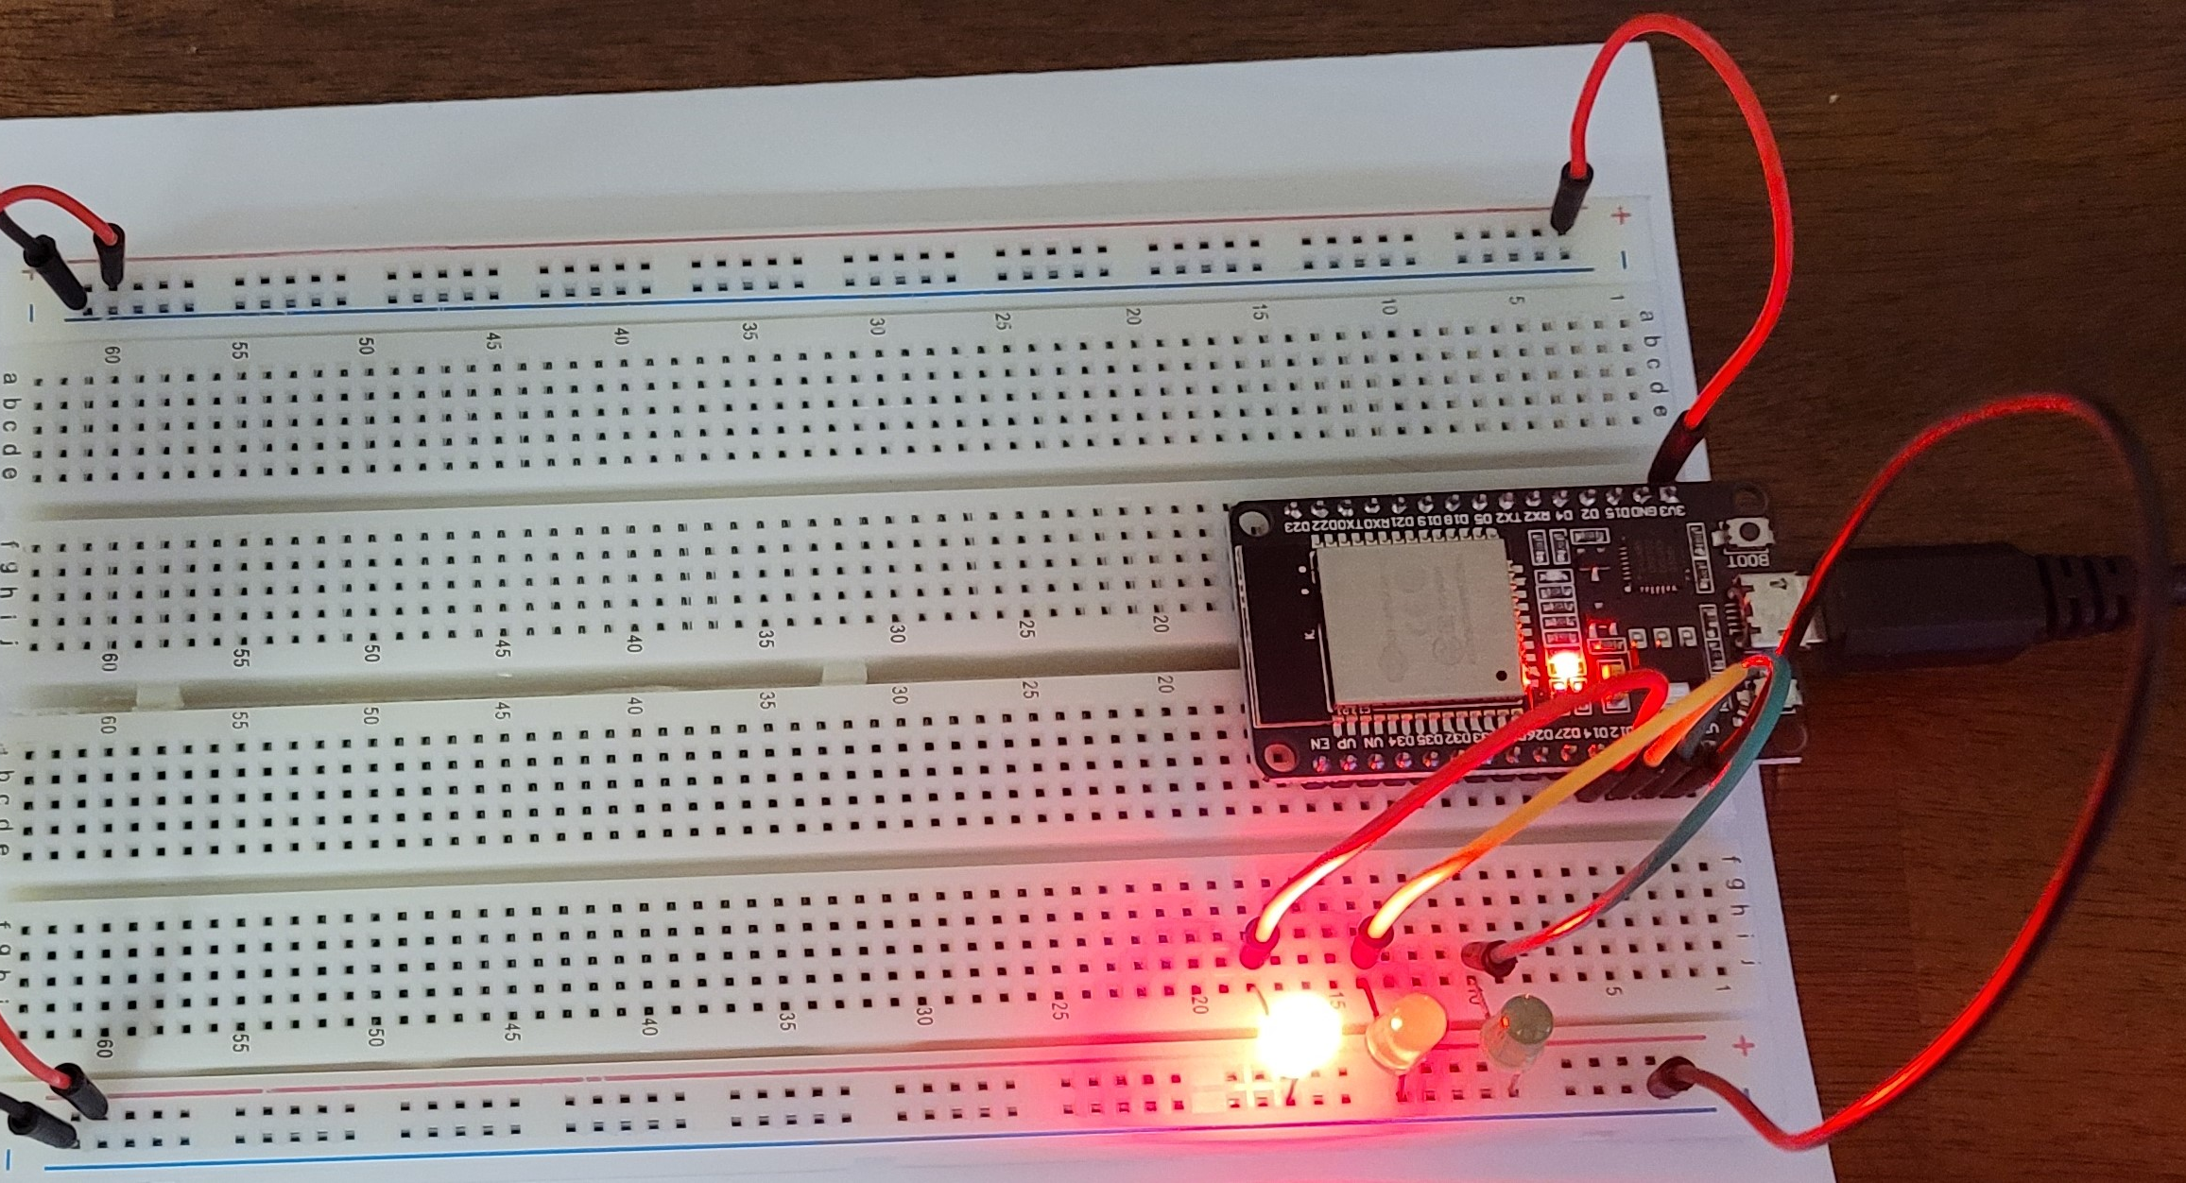
Picture of circuit with working LEDs
ESP 32 Board
Colored LEDs: Red, Yellow and Green
Wires
Breadboard

Slide 8
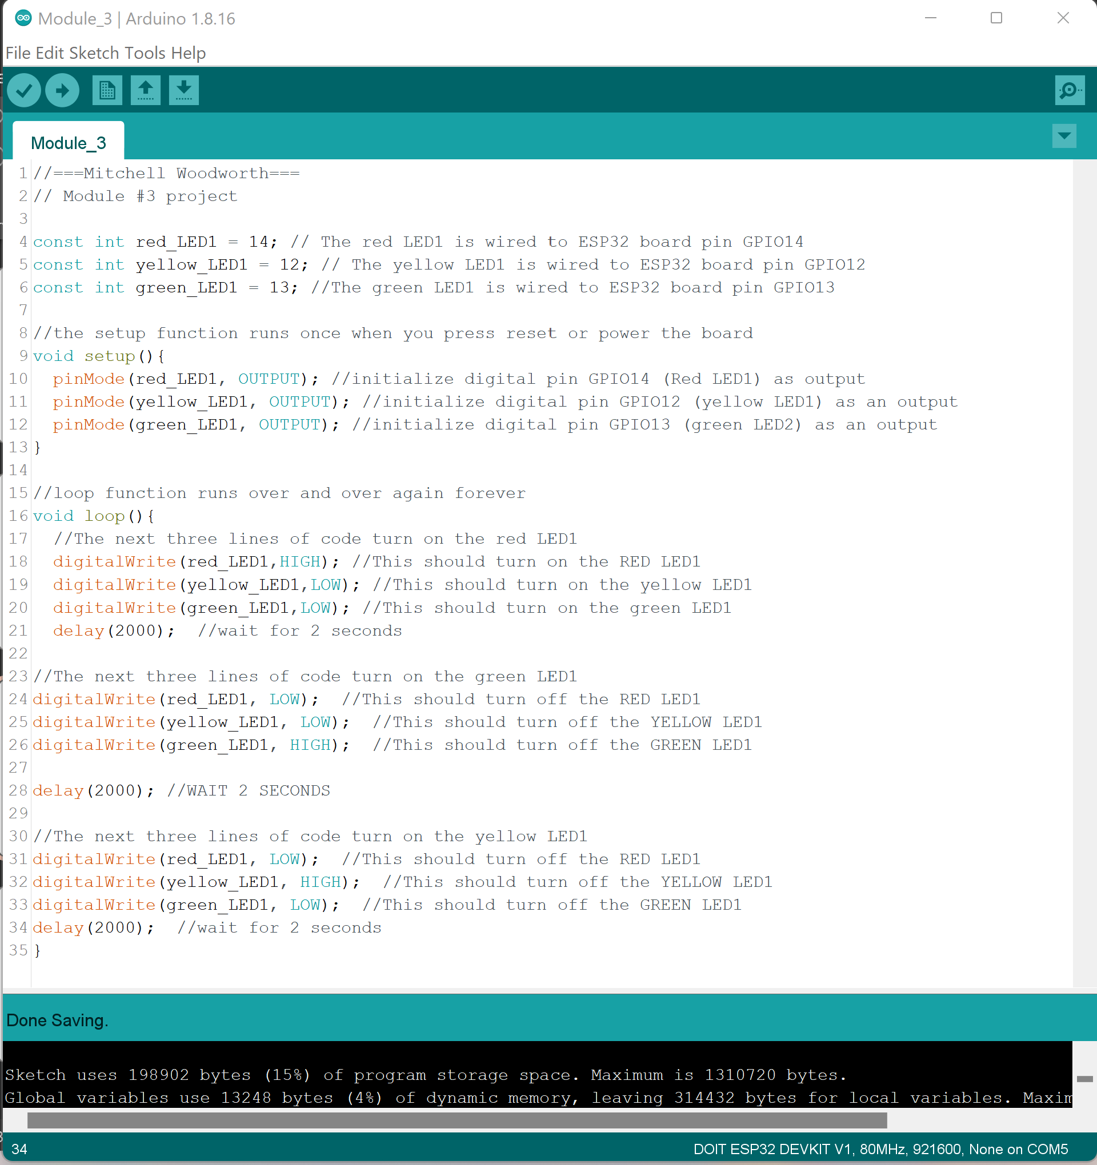
Screenshot of code in Arduino IDE

Slide 9
Two Sets of Lights
Adding another set of LED

Slide 10
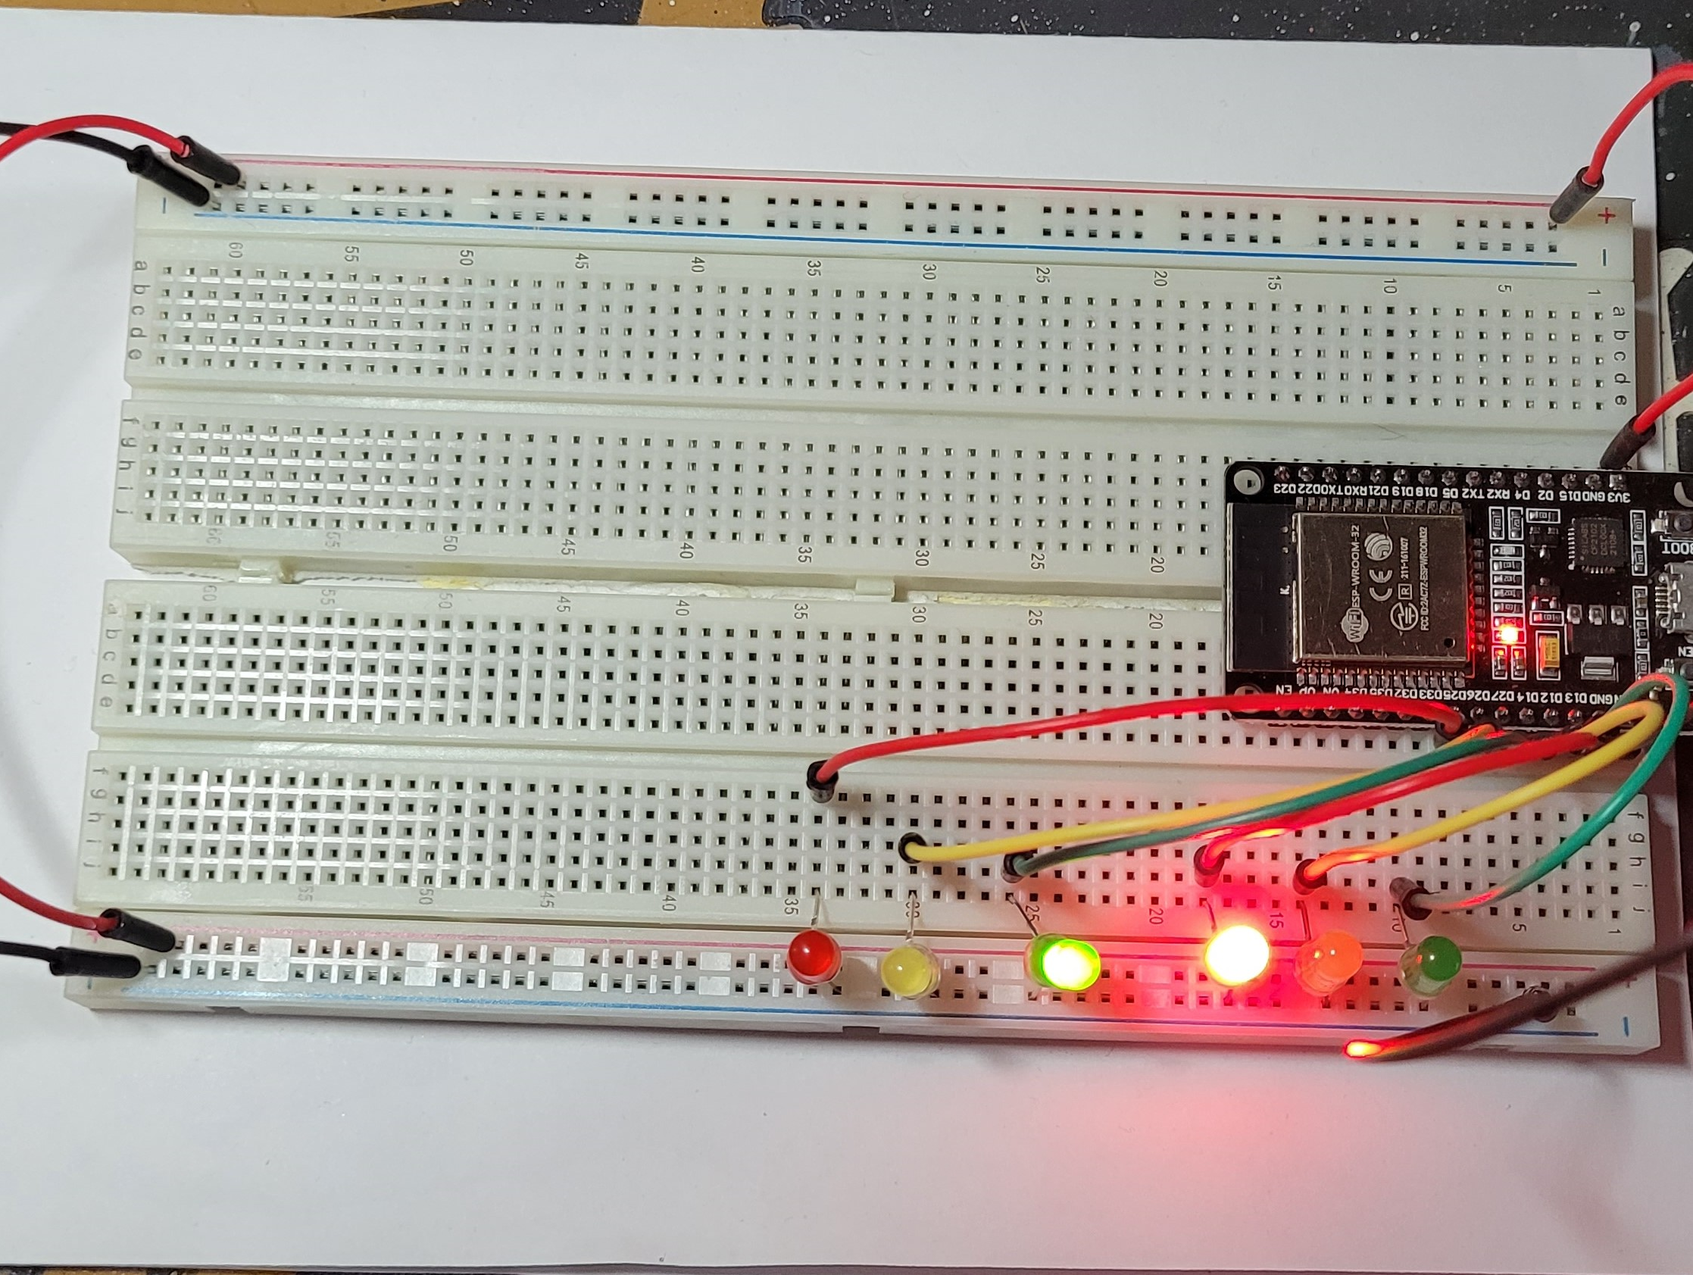
Picture of circuit with working LEDs
ESP 32 Board
Colored LEDs: Red, Yellow and Green (two sets)
Wires
Breadboard

Slide 11
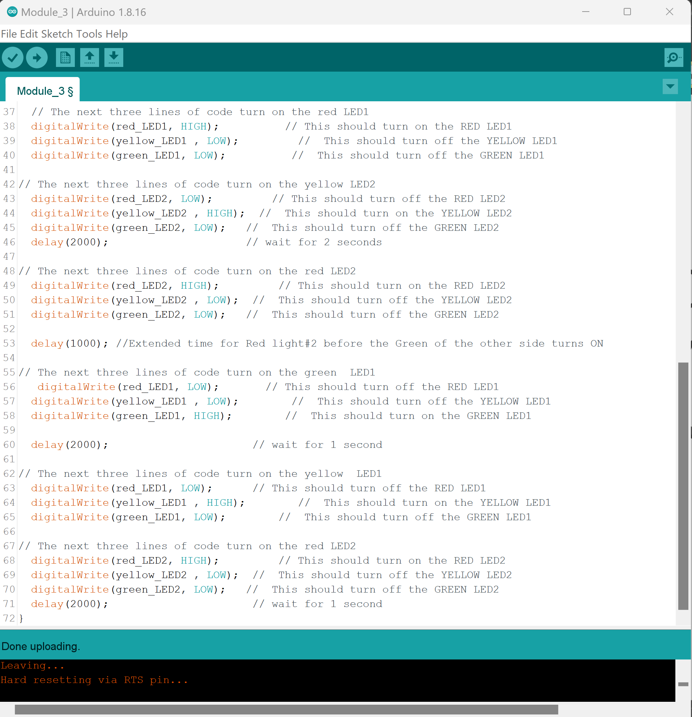
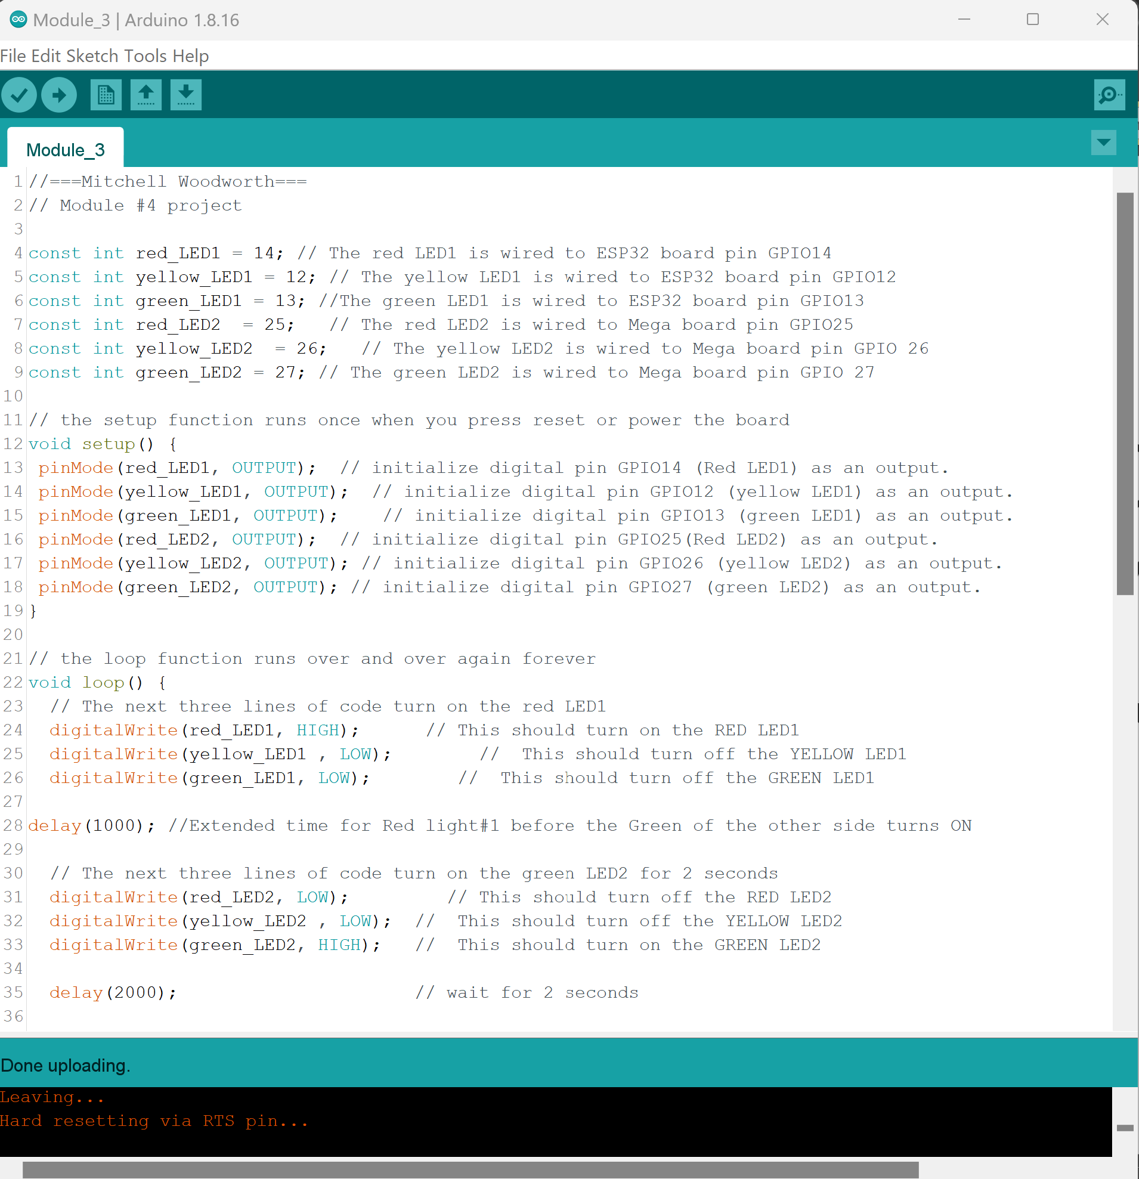
Screenshot of code in Arduino IDE

Slide 12
more control of the lights
Implementing a push button to simulate a pedestrian walk button.

Slide 13
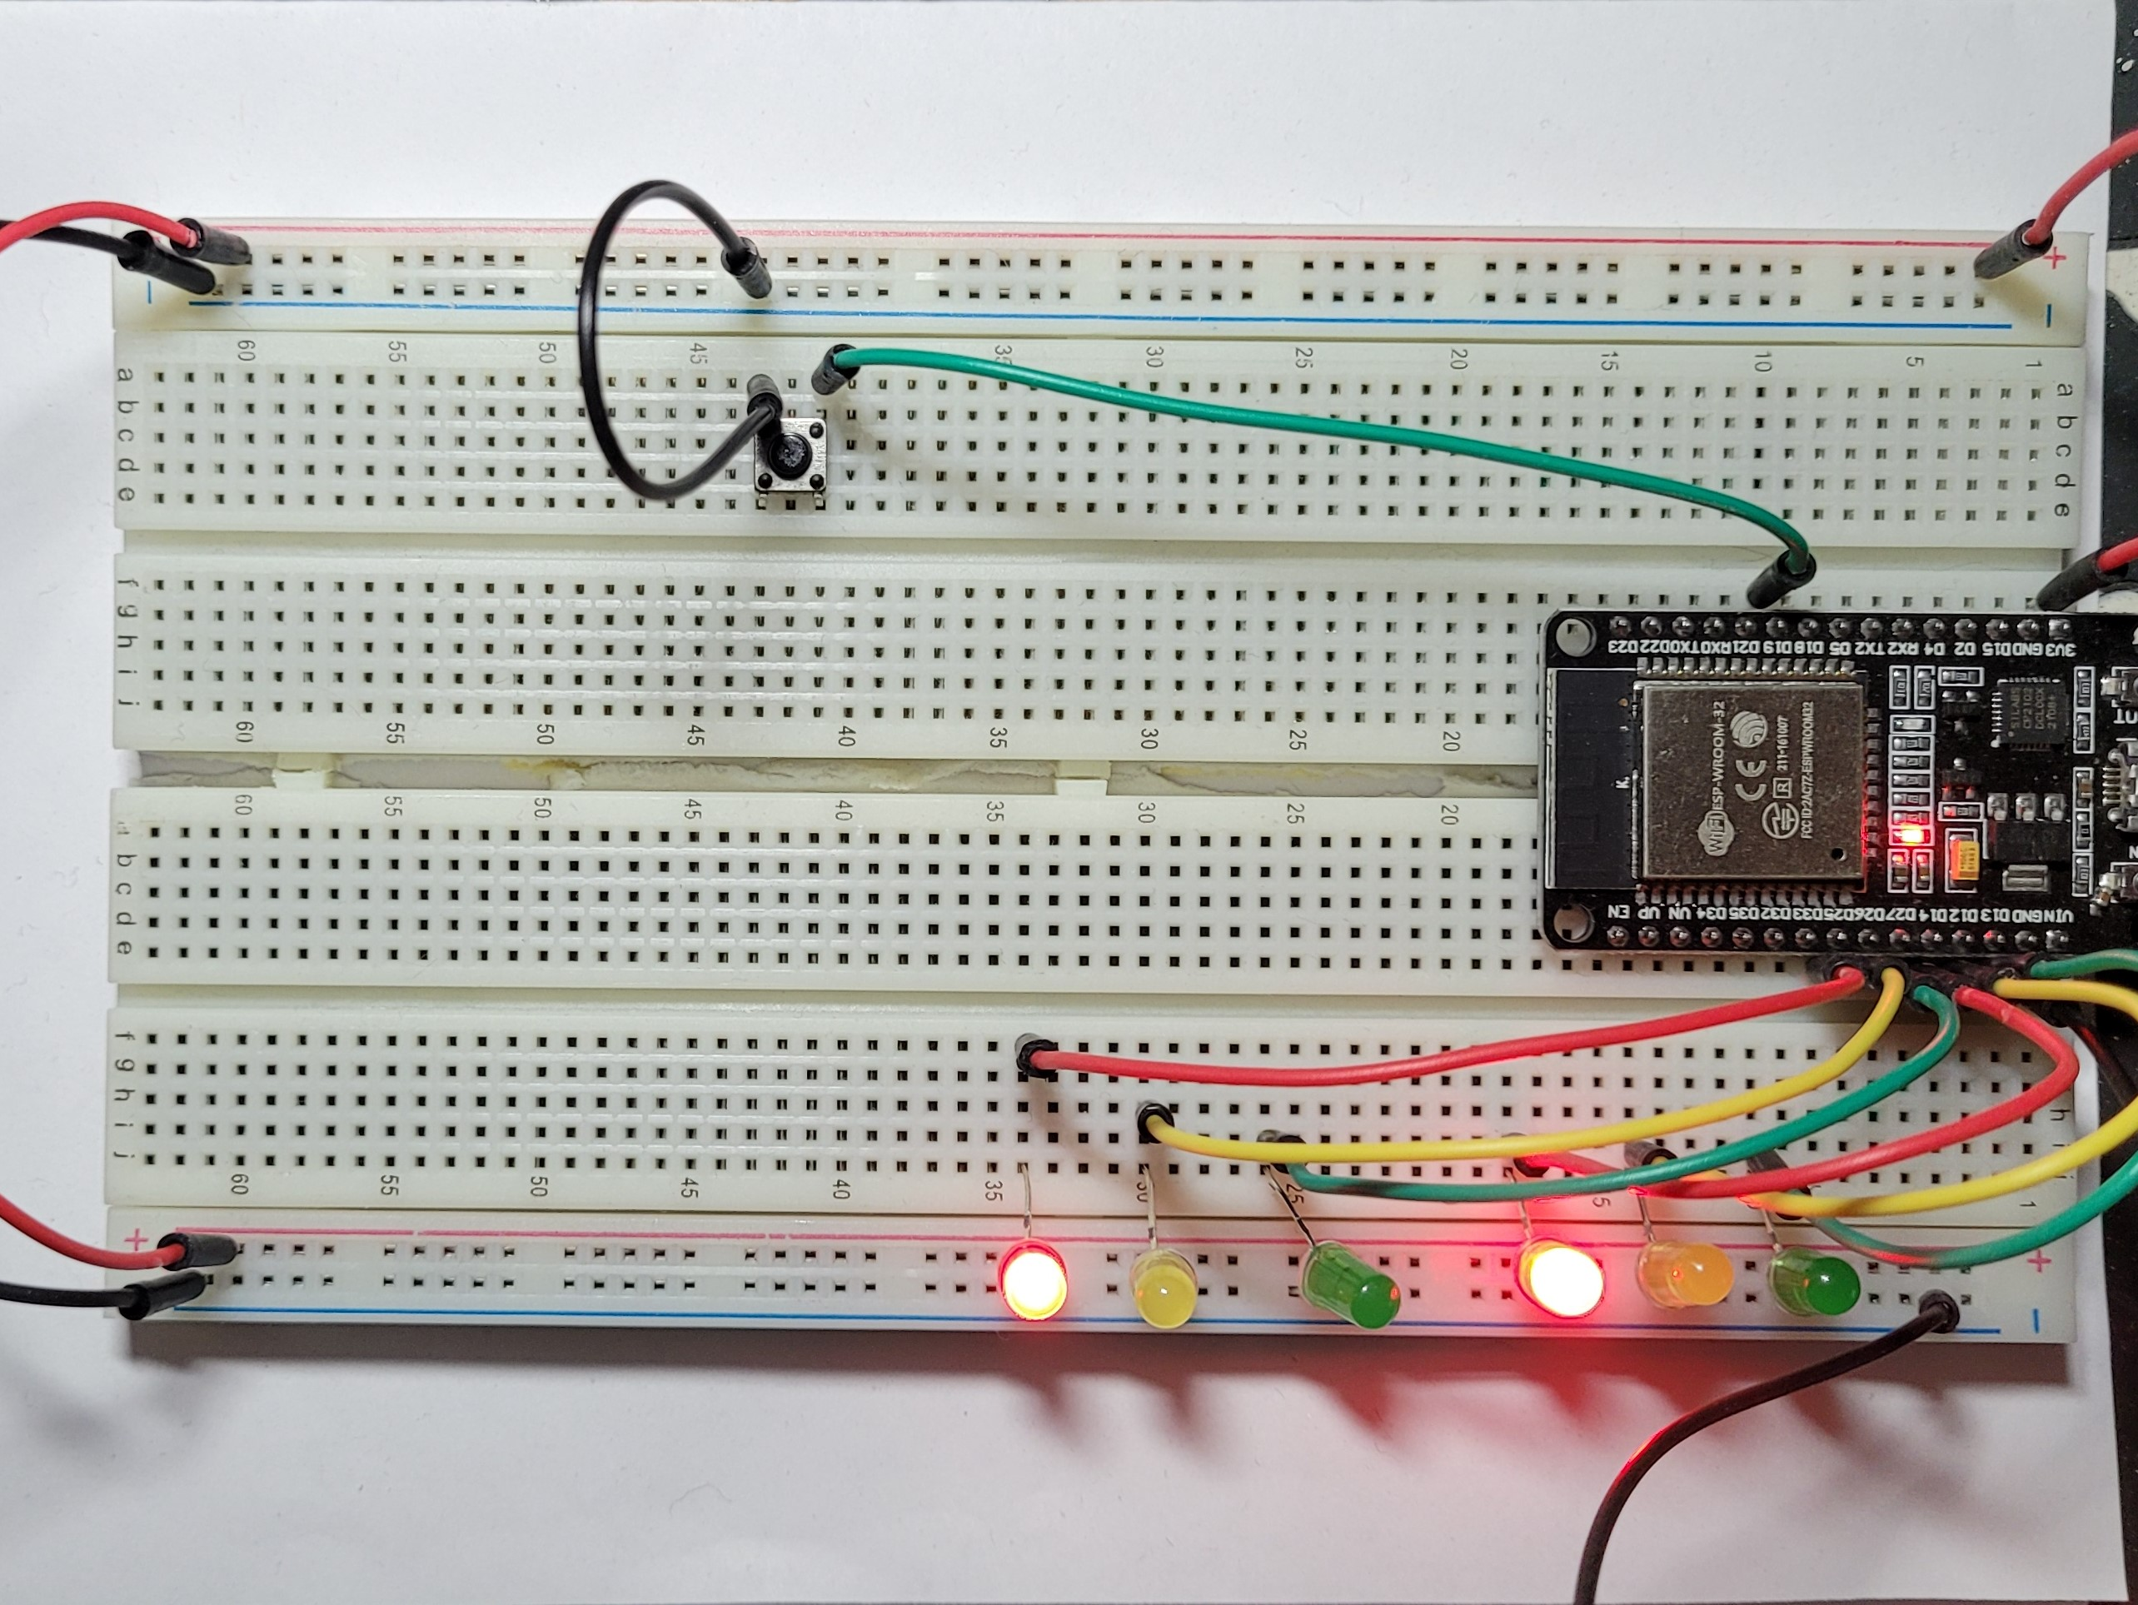
Picture of circuit with working LEDs
ESP 32 Board
Colored LEDs: Red, Yellow and Green (two sets)
Push Button
Wires
Breadboard

Slide 14
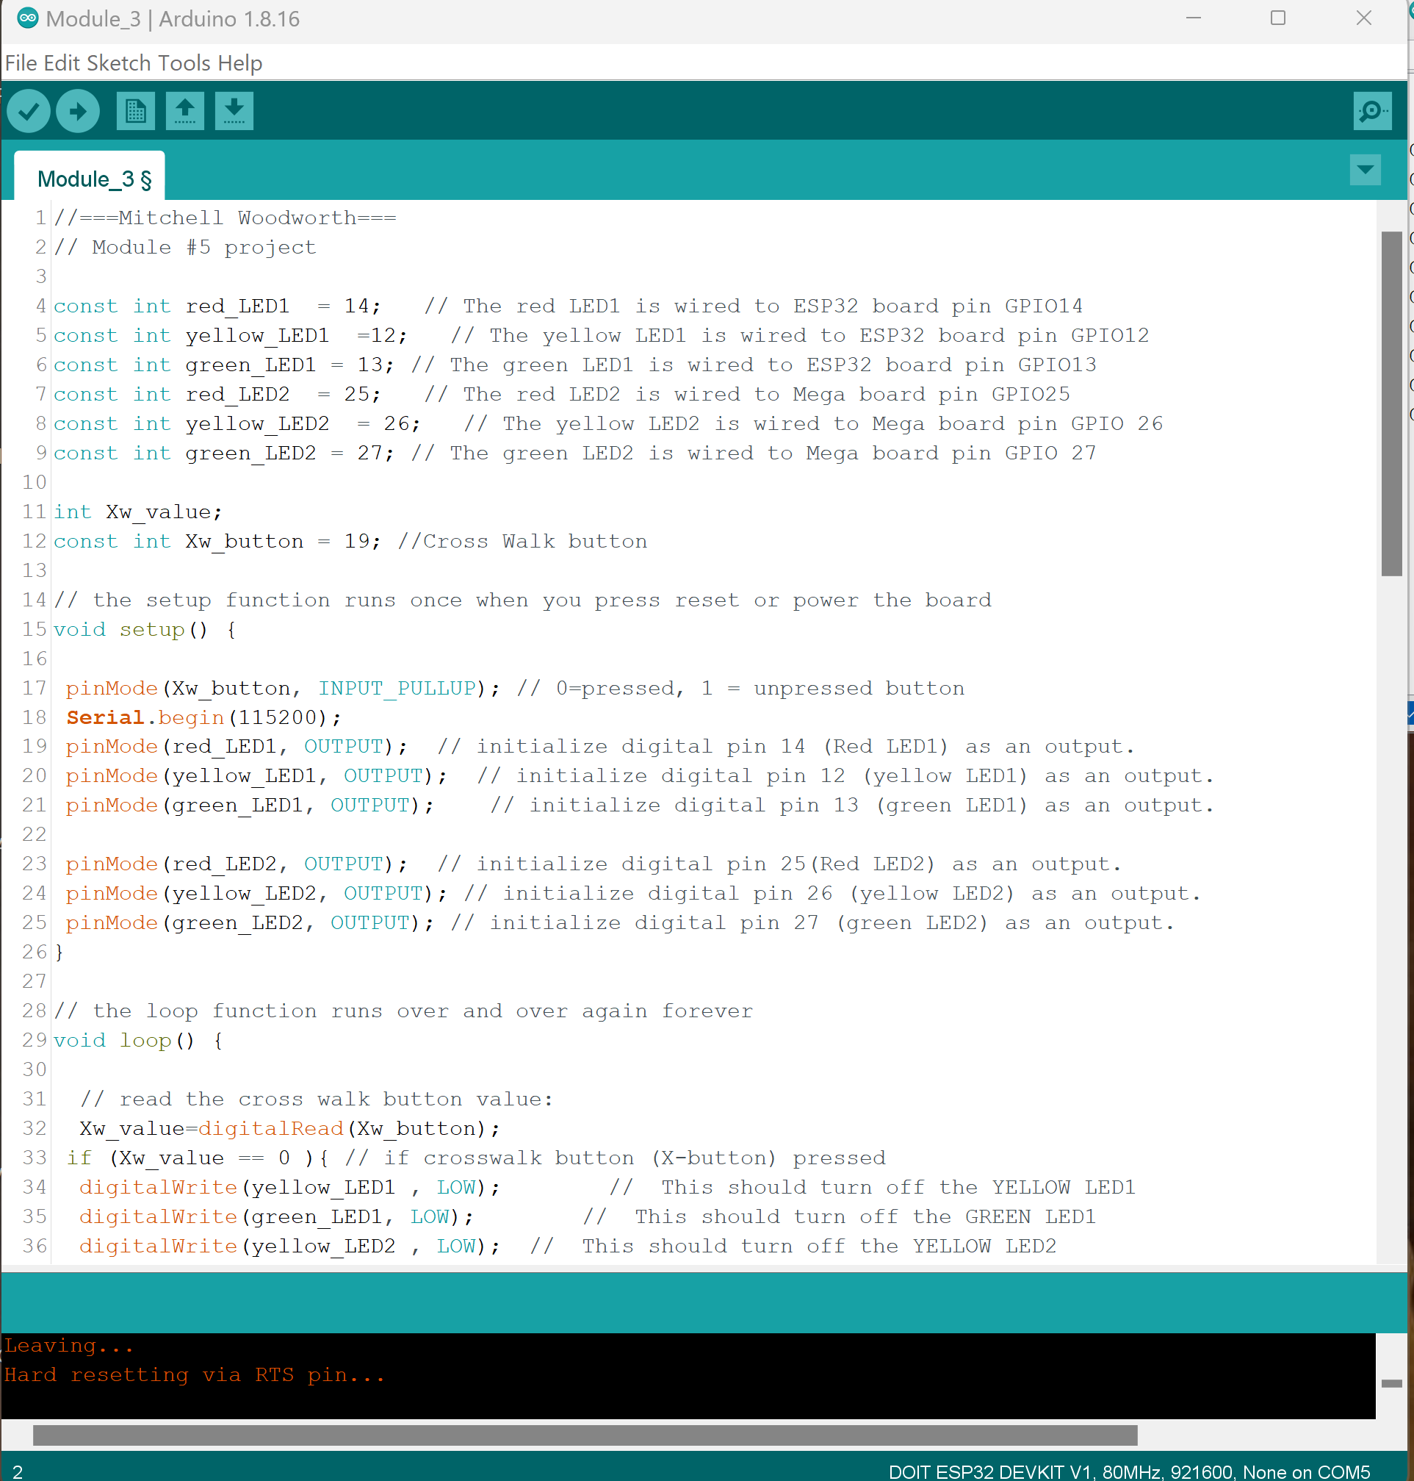
Screenshot of code in Arduino IDE

Slide 15
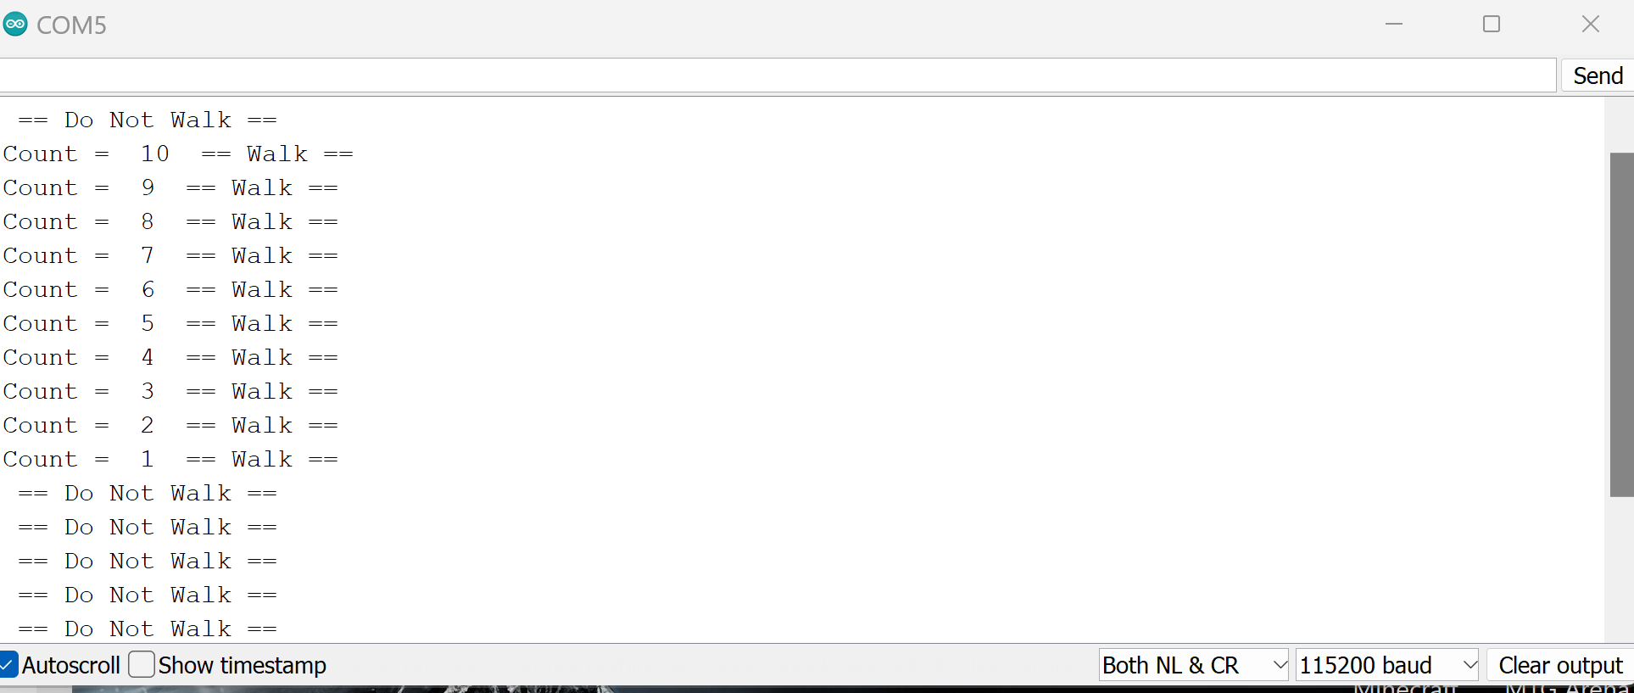
Screenshot of Serial Monitor in Arduino IDE

Slide 16
Adding a Display
Adding a display to show the pedestrian they can walk or not.

Slide 17
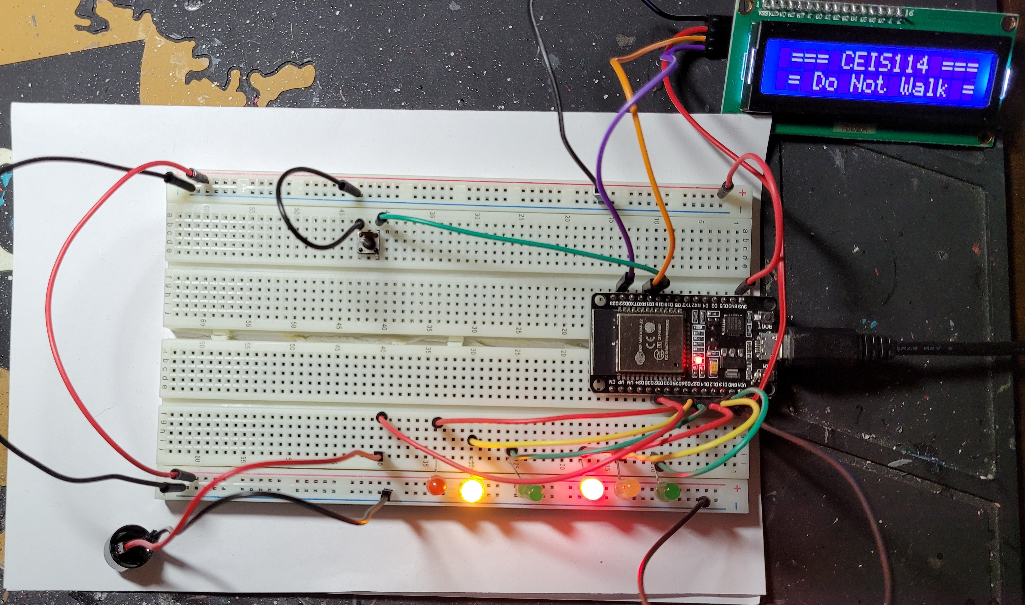
Picture of circuit with working LEDs and LCD display
ESP 32 Board
Colored LEDs: Red, Yellow and Green (two sets)
Push Button
LCD Unit with Message Display
Wires
Breadboard

Slide 18
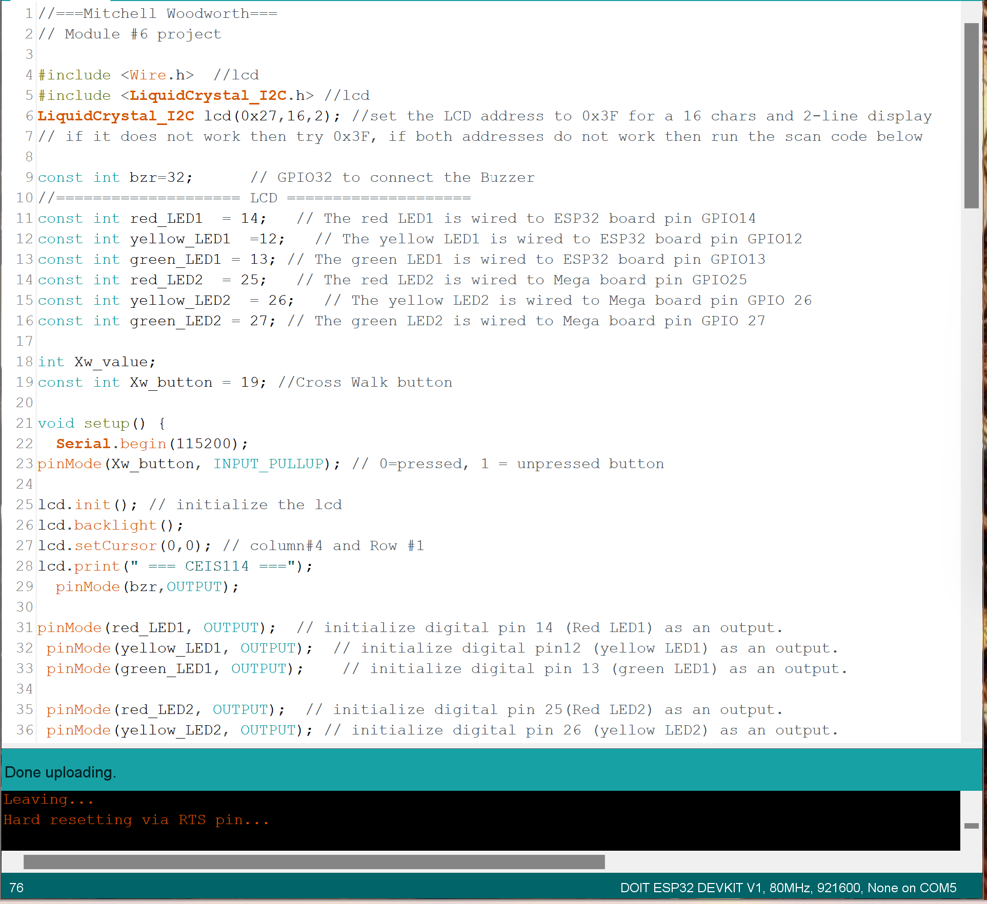
Screenshot of code in Arduino IDE

Slide 19
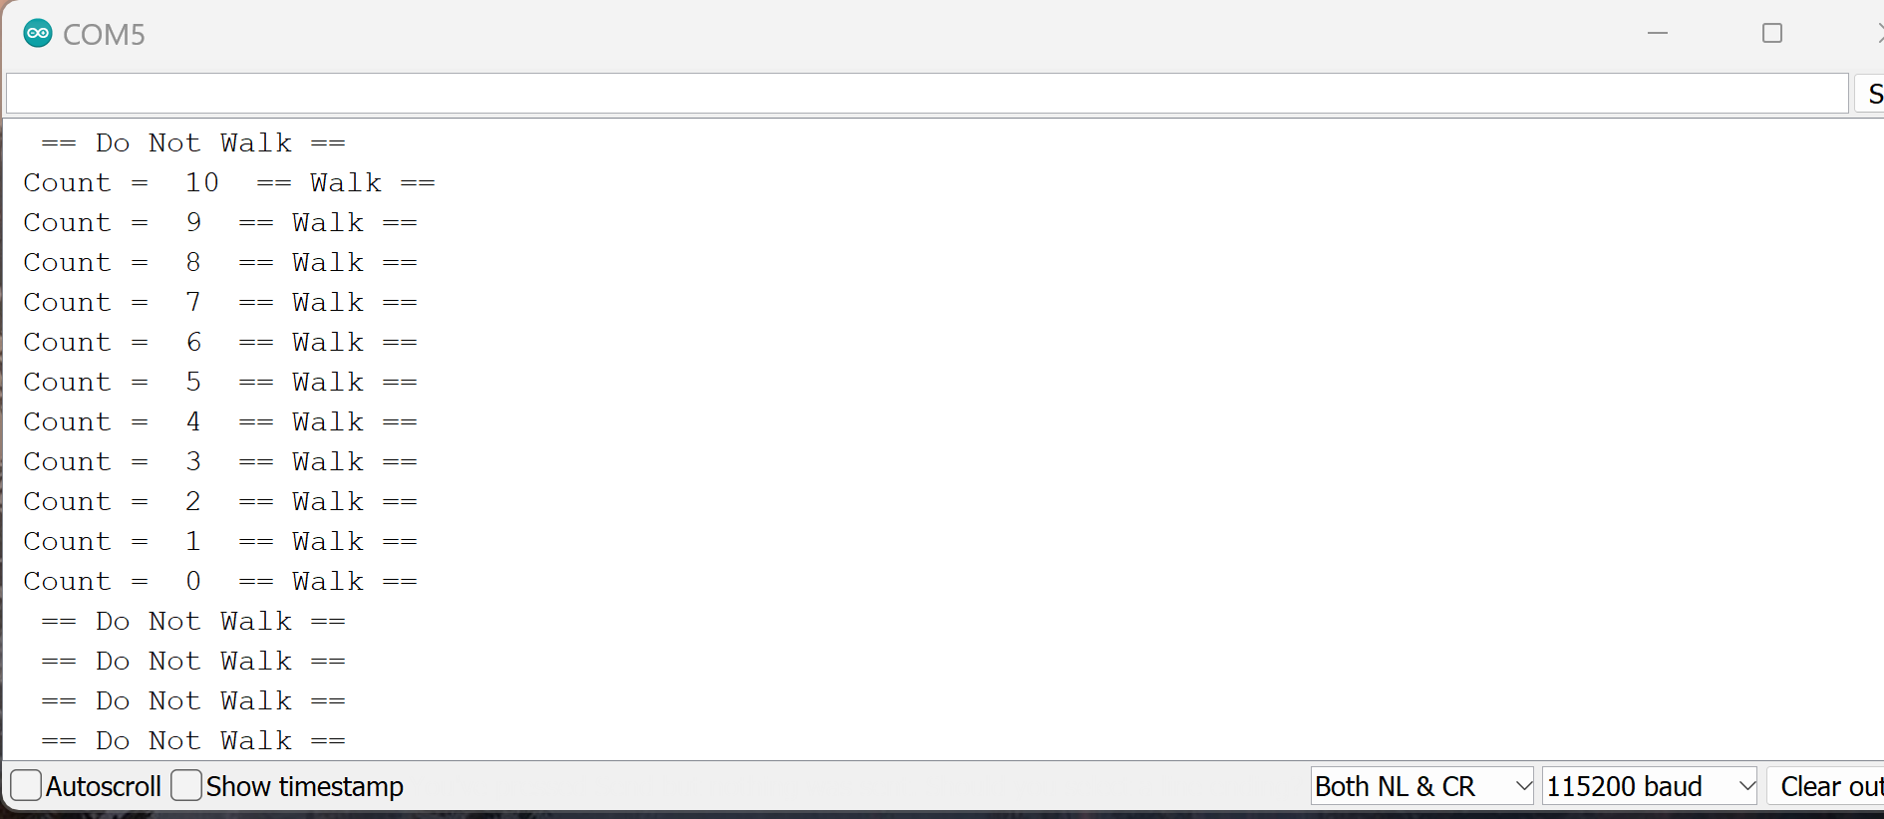
Screenshot of Serial Monitor in Arduino IDE
Screenshot of output in Serial Monitor

Slide 20
Adding an emergency sensor
Adding a motion sensor to the lights as well as a emergency button that will turn on the blue light to show the traffic what is happening.

Slide 21
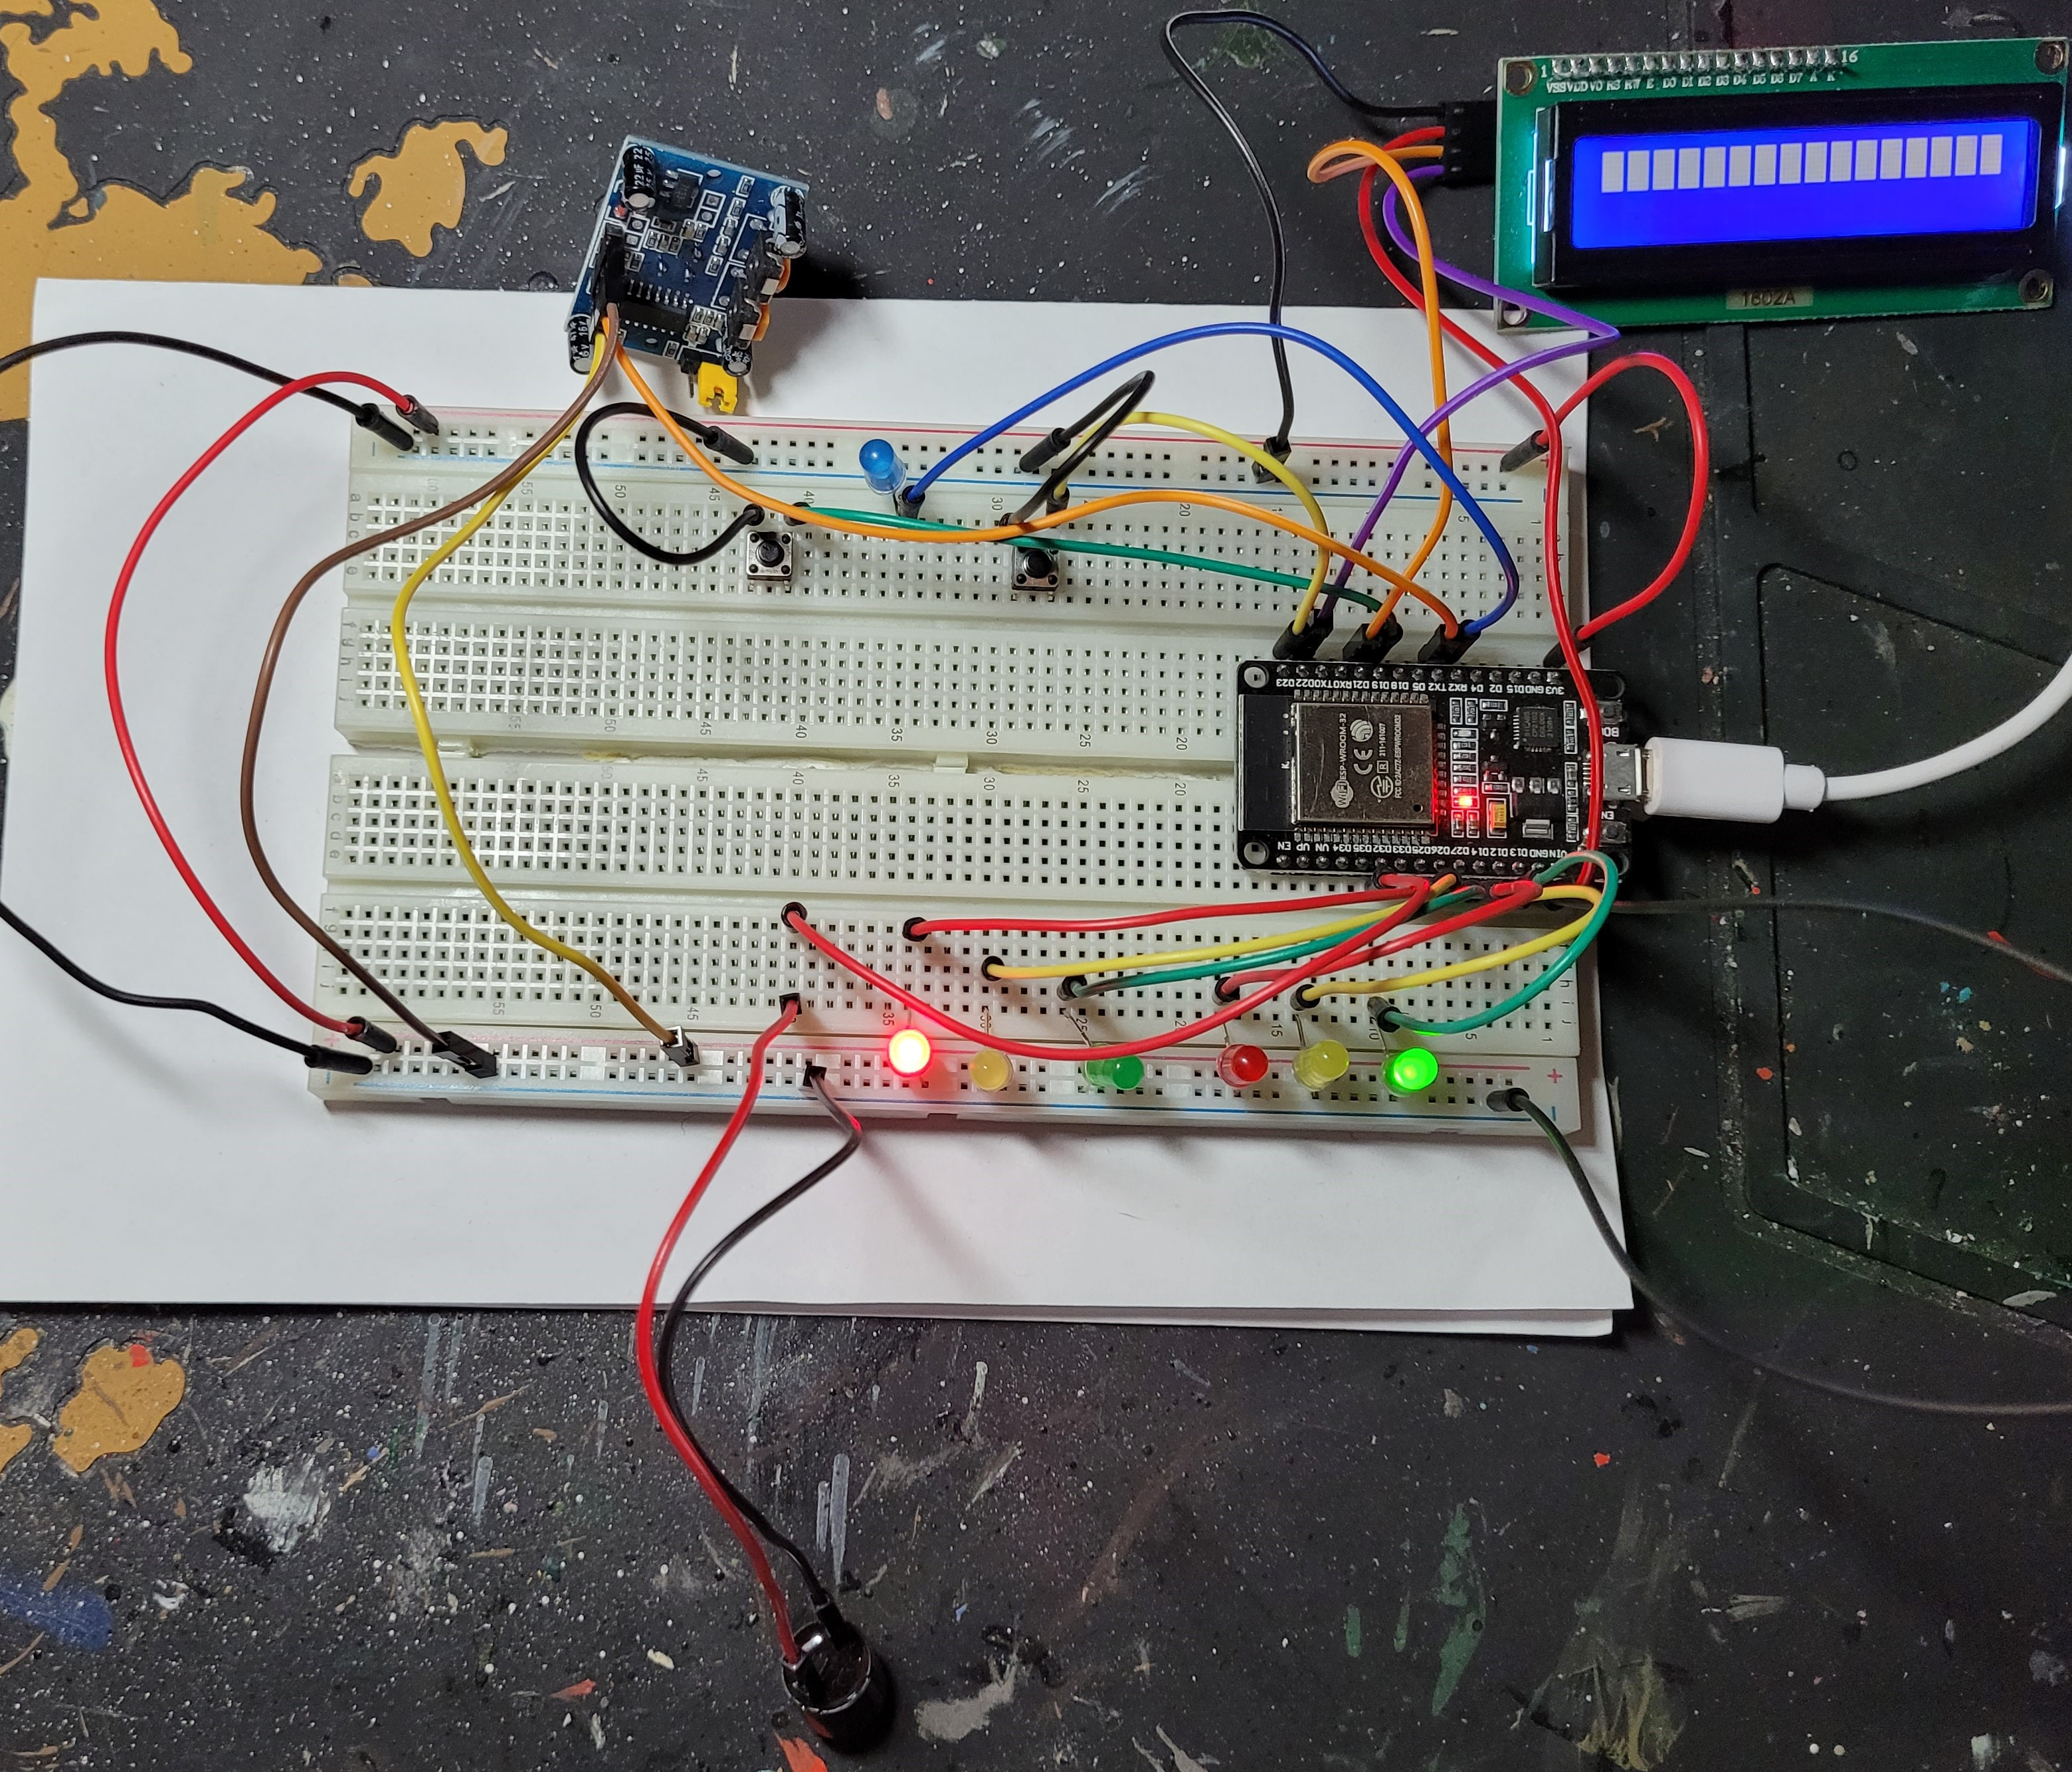
Picture of circuit with working LEDs and LCD display
ESP 32 Board
Colored LEDs: Red, Yellow and Green (two sets)
One Blue LED – Emergency Light
Push Buttons - 2
LCD Unit
Buzzer
PIR Motion Sensor
Wires
Breadboard

Slide 22
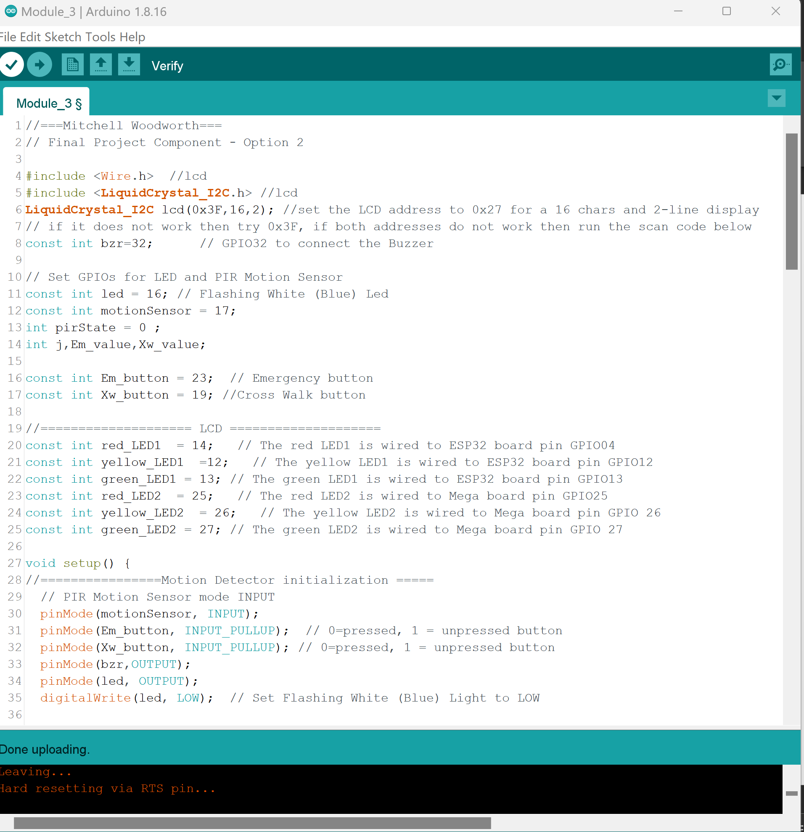
Screenshot of code in Arduino IDE

Slide 23
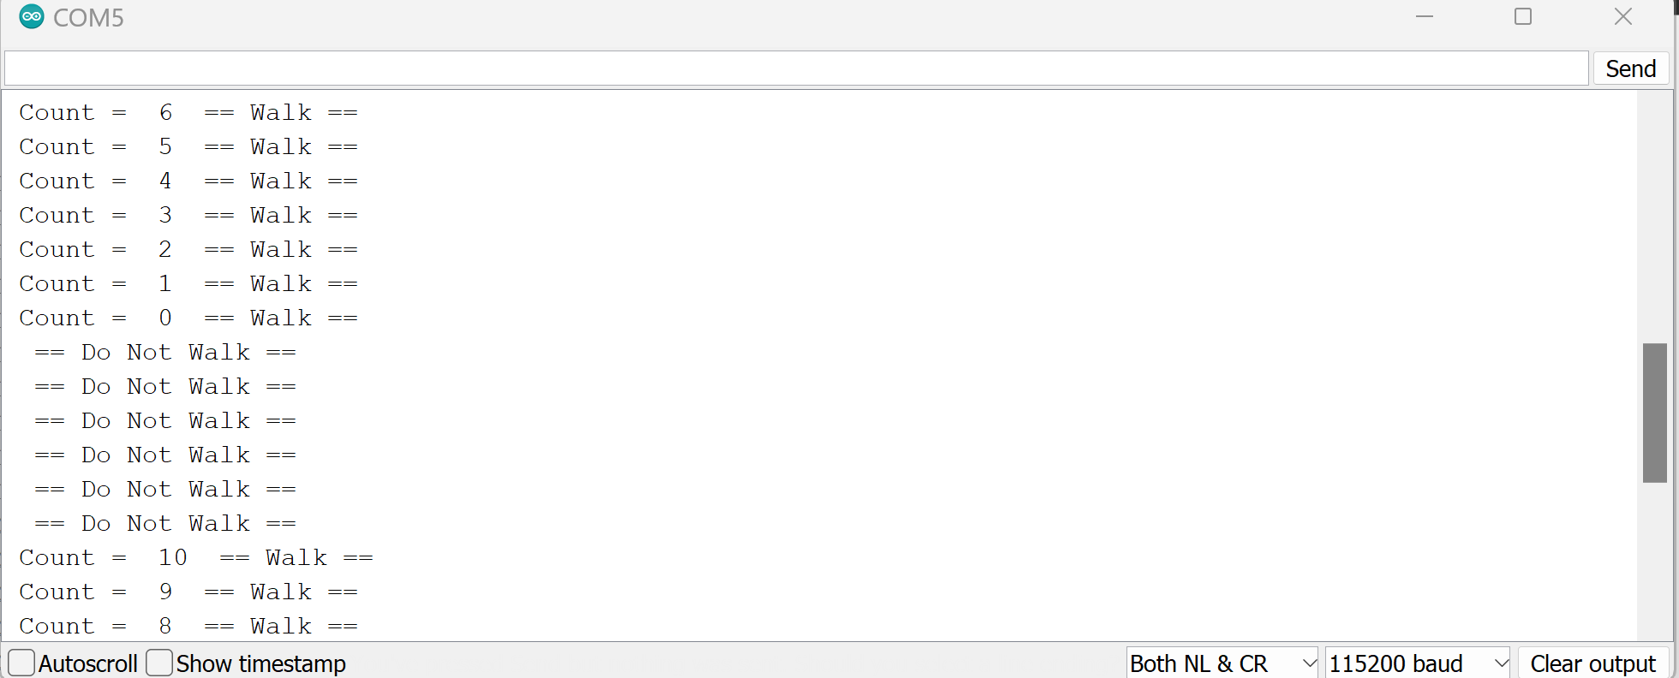
Screenshot of Serial Monitor in Arduino IDE

Slide 24
Peer to peer
After reviewing my peers review of my project I have received praise for my work and received little to no corrective feedback of my work.

Slide 25
Take away from Peer to peer
I feel based on my peers review of my work that I have a good understanding of the material and know that if I put my mind to a task, I can conquer it.

Slide 26
Struggles
Some struggles I have encounter were:
Correctly imputing the code in the correct spot.
Putting the correct wires in the correct place.

Slide 27
Career skills
Better coding skills
More information about the world of IoT
Hardware and Device Management

Slide 28
conclusion
This project has helped me get a better understanding of how the world of IoT device could work and make our current life better.

