Slide 1
Physics and Technology by Mitchell Woodworth
PHYS204 Final Course Project

Slide 2
Introduction
My name is Mitchell Woodworth and currently working towards my bachelor degree in information technology with an emphasis in cloud computing. During my class of physics, I conducted a few test using Arduino and its sub-components. I conducted 4 test to determine the Hall effect, ultrasonic sensor accuracy, gravitational acceleration on a free fall object, as well as linear and rotational motion.

Slide 3
PHYS204
Project
Precision of the Ultrasonic Sensor

Slide 4
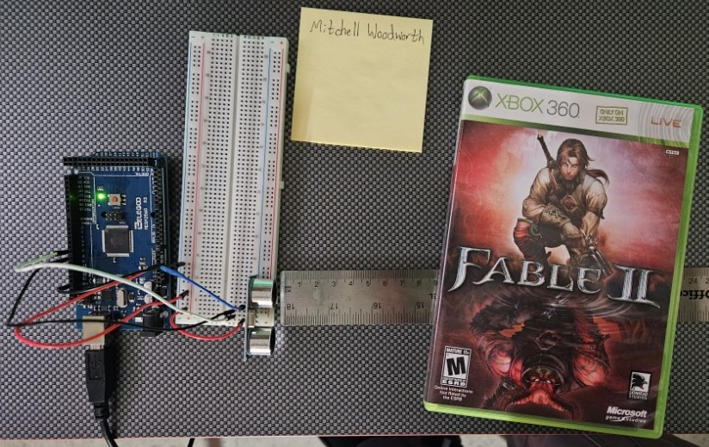
Experimental Set-up
Materials List:
Mega 2560 Board
Ultrasonic sensor HC-SR04
Male to Male Wires
Breadboard
Ruler or tape measurer
Large and flat object to act as obstacle

Slide 5
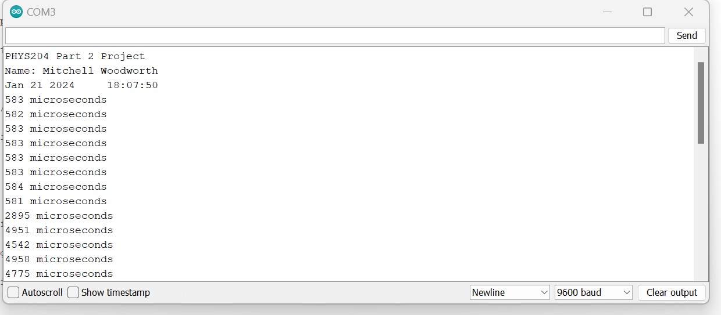
Raw Data
Screenshot of Serial Monitor from Arduino IDE showing raw data.

Slide 6
Data Collection
Trial | Ruler Distance (cm) | Total Roundtrip Distance (m) | Time from Serial Monitor (microseconds) | Roundtrip time (s) | Velocity = distance/time (m/s)
1 | 4cm | 0.08m | 195 microseconds | 1.95x10^{-4} s | 410.27m/s
2 | 6cm | 0.12m | 306 microseconds | 3.06x10^{-4} s | 392.17m/s
3 | 8cm | 0.16m | 488 microseconds | 4.88x10^{-4} s | 327.87m/s
4 | 10cm | 0.20 m | 582 microseconds | 5.82x10^{-4} s | 343.64
5 | 12cm | 0.24m | 671 microseconds | 6.71x10^{-4} s | 357.68

Slide 7
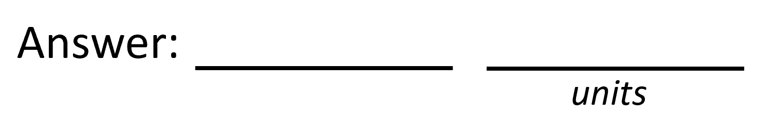

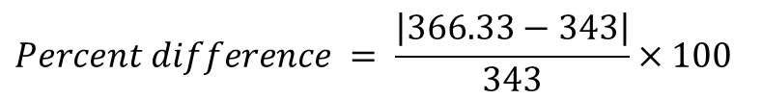
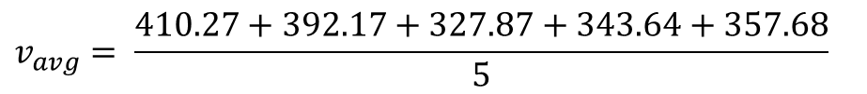
Data Analysis
Average velocity from table
Percent difference where $v_{sound}=343 m/s$
$$v_{avg}= \frac{410.27+392.17+327.87+343.64+357.68}{5}$$
366.33
m/s
$$Percent difference = \frac{\left|366.33−343\right|}{343}×100$$
6.80
m/s

Slide 8
Conclusions
Discuss the results. Comment on the possible source of errors.
  Answer: As I moved the object farther away from the sensor the velocity started being a lessor value. Had a weird result on the 8cm test and even after replicating that distance multiple times I kept getting the same results. Possible sources of error would be the material my object was made of, the gloss plastic of the item. Another one could be the metallic ruler I was using.
What is the dependence of temperature, humidity, and atmospheric pressure on the speed of sound? How does it affect the results?
  Answer: With a higher temperature sound can travel faster, humidity, and air pressure doesn’t have much affect on sound waves but does make sound deviate slightly from normal behavior.

Slide 9
PHYS204
Project
Gravitational Acceleration of a Free-Falling Object

Slide 10
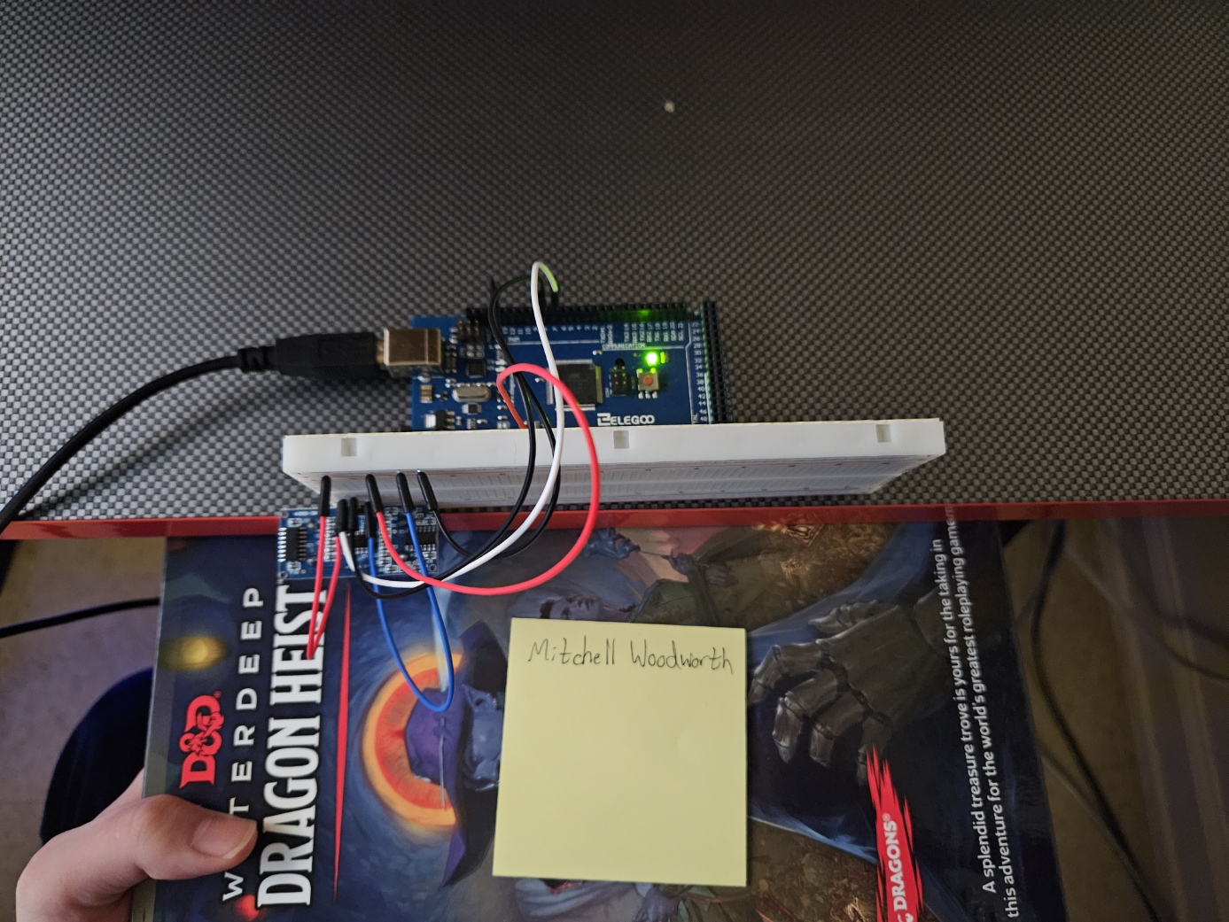
Experimental Set-up
Materials List:
Mega 2560 Board
Ultrasonic sensor HC-SR04
Male to Male Wires
Breadboard
Large and flat object that is not susceptible to air resistance to undergo free fall motion

Slide 11
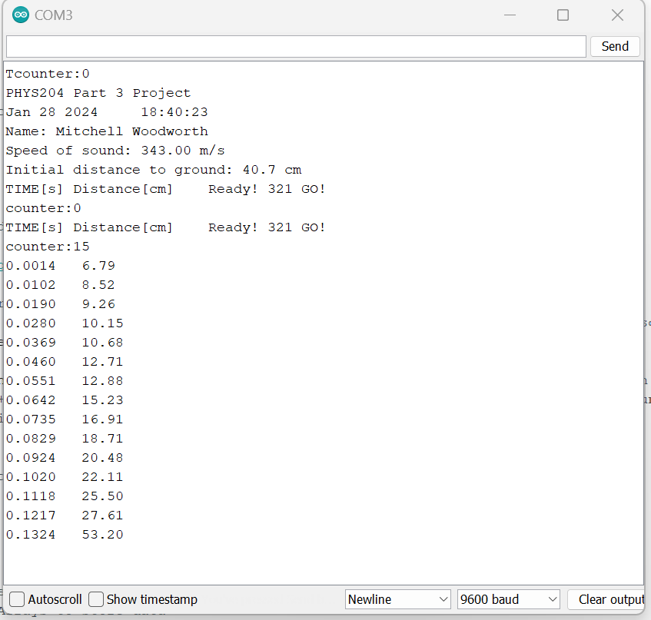
Serial Monitor
Include screenshot of raw data showing the start of the fall and end of the fall of one trial.

Slide 12
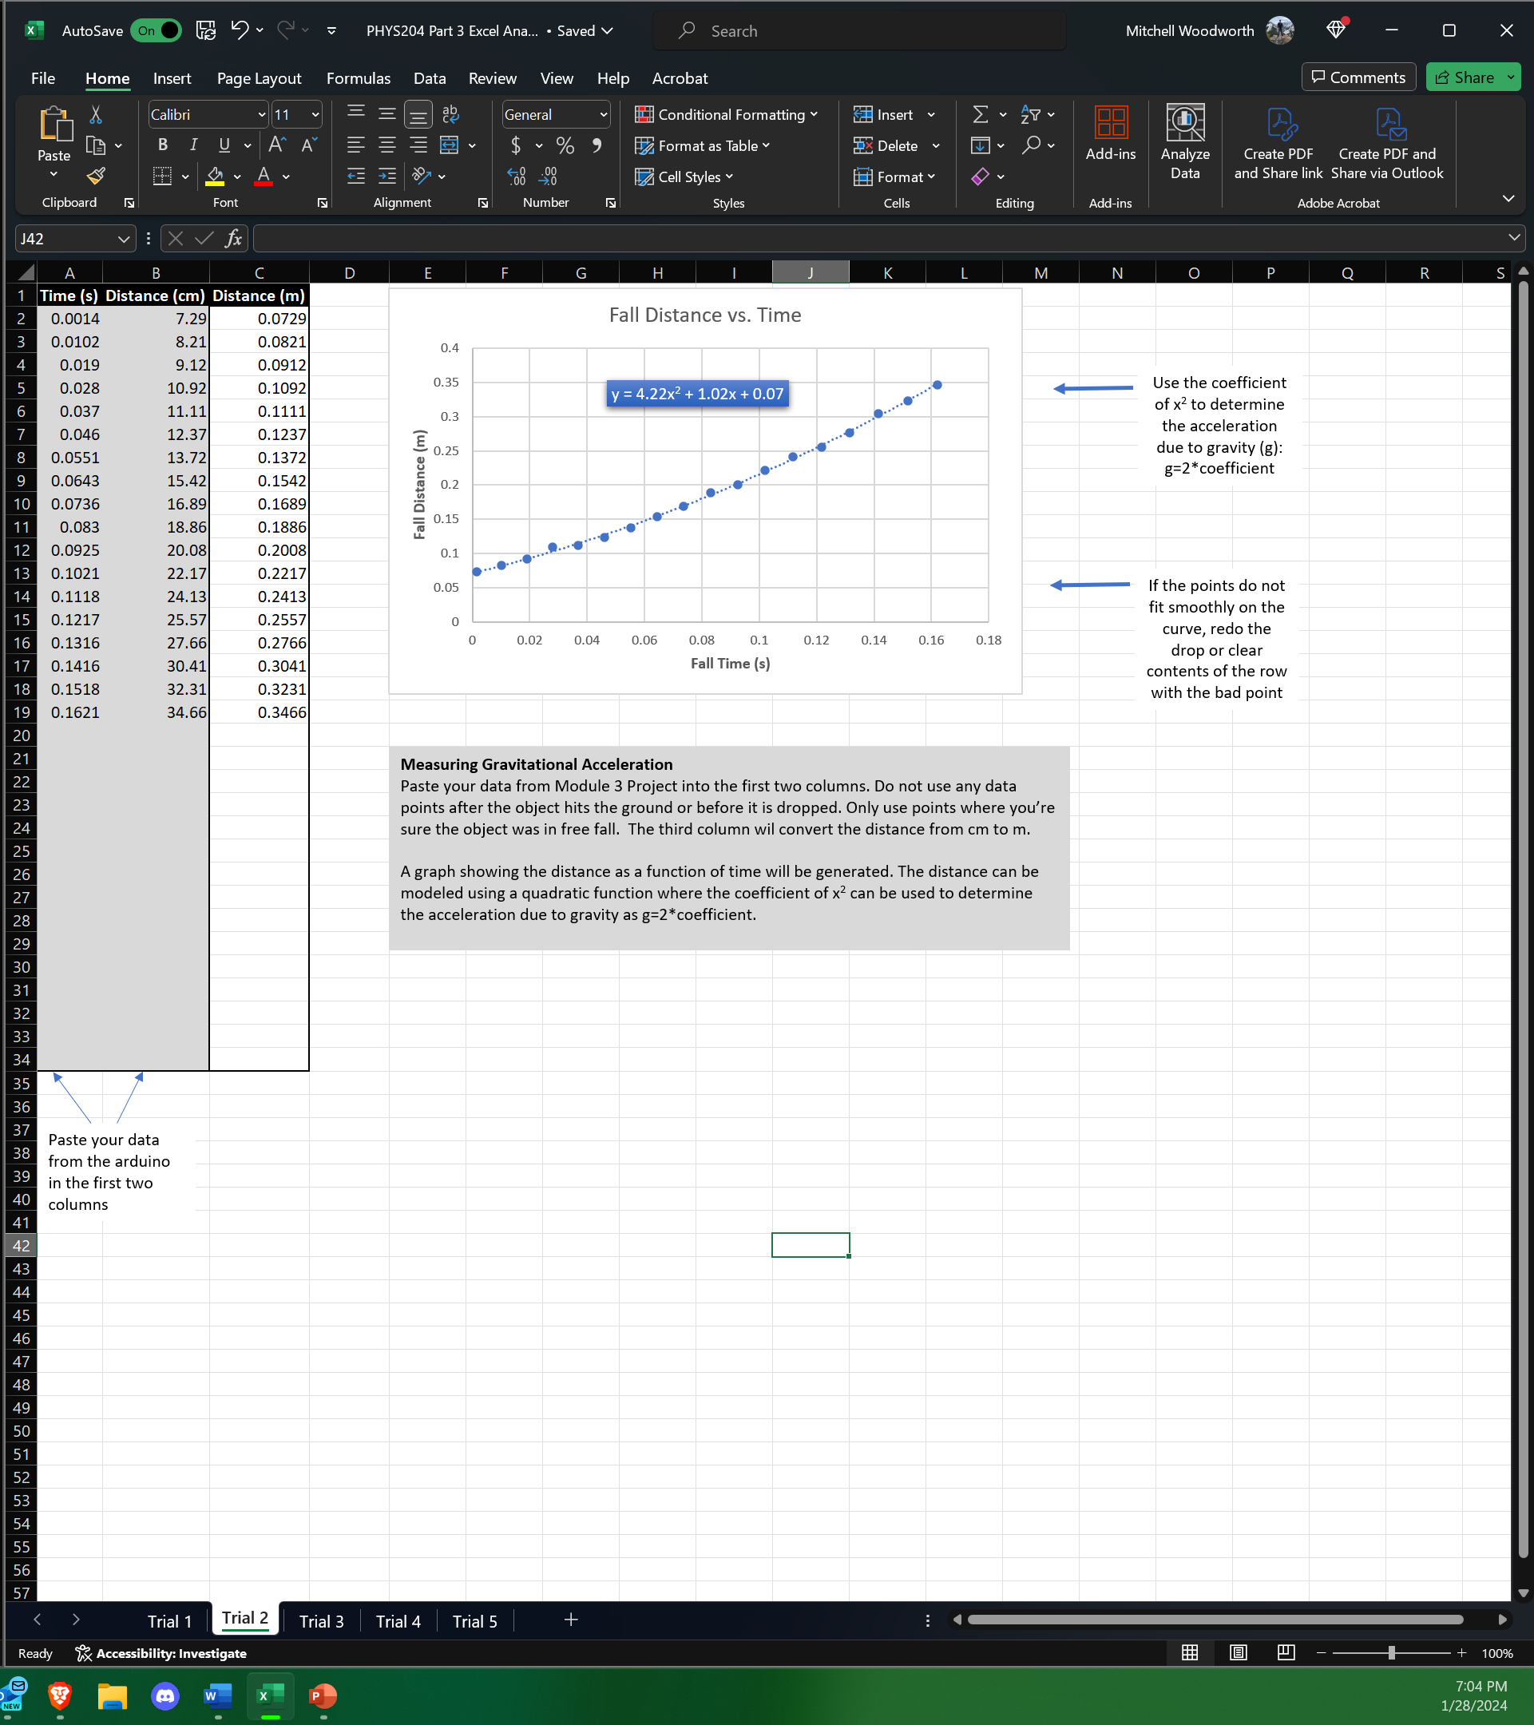
Excel Table
Include all values in the Excel table for a single trial showing the fall distance in centimeters and meters as a function of time

Slide 13
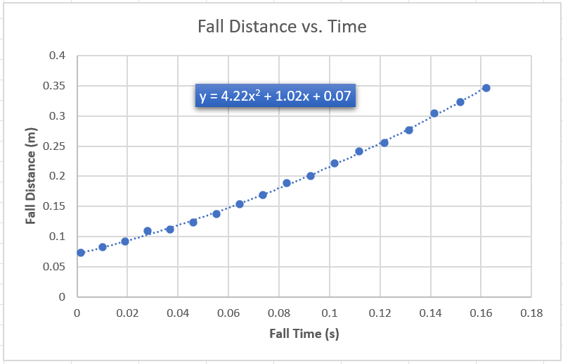
Excel Graph
Include Excel graph for a single trial showing the fall distance as a function of time.

Slide 14
Data Collection
Complete table with data from trails.
Trial | x² coefficient value from curve fitting | Acceleration (m/s²) = 2* (x² coefficient)
1 | 3.99x^2 | 7.98 m/s^2
2 | 4.22x^2 | 8.44 m/s^2
3 | 3.64x^2 | 7.28 m/s^2
4 | 6.29x^2 | 12.58 m/s^2
5 | 6.08x^2 | 12.16 m/s^2

Slide 15
Data Analysis
Average acceleration from table
Percent difference with $g=9.8 m/s^{2}$
$$a_{avg}= \frac{7.98+8.44+7.28+12.58+12.16}{5}$$
9.70
m/s^2
$$Percent difference =\frac{\left|9.70−9.8\right|}{9.8}×100$$
1.02
%

Slide 16
Conclusions
Discuss the results. Comment on the possible source of errors.
  Answer: I had to do 2 retest due to not being in-between the correct values. But the way the book falls can determine the values of the calculations. Such a show close you are to the sensor at the start or the placement of the sensor on the table.
How much variation is there from trial to trial? What does this indicate about the uncertainty of the result?
  Answer: the first three seem close but the last 2 are vastly different. This could screw the results a significant amount.

Slide 17
PHYS204
Project
Conservation of Energy of a Free-Falling Object

Slide 18
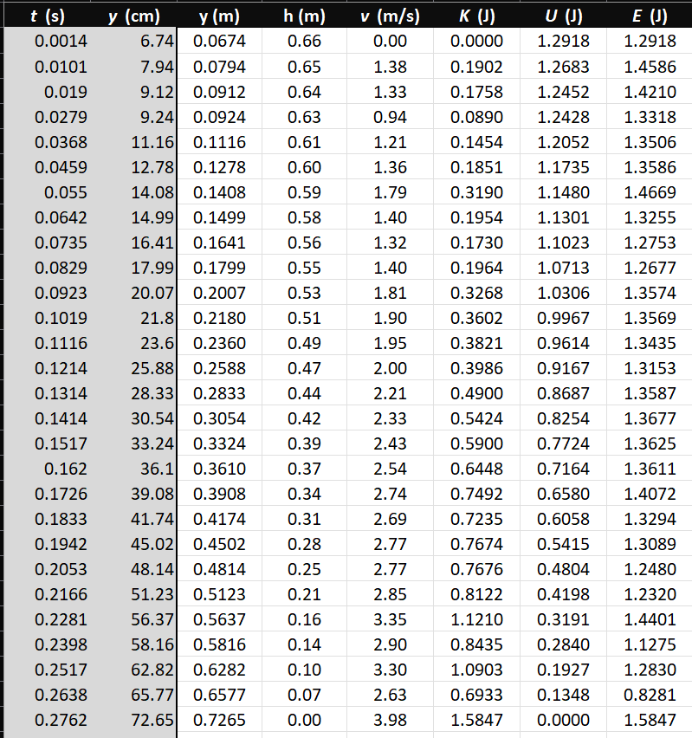
Excel Table
Include all values in the Excel table for a single trial showing the fall distance in centimeters and meters as a function of time with the values generated for kinetic energy K, potential energy U, and total mechanical energy E.

Slide 19
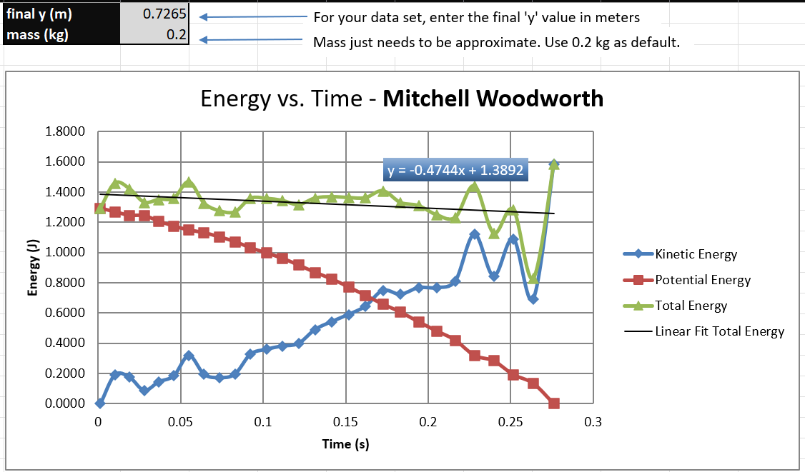
Excel Graph
Include Excel graph for a single trial showing the plots of the kinetic energy K, potential energy U, and total mechanical energy E as a function of time.

Slide 20


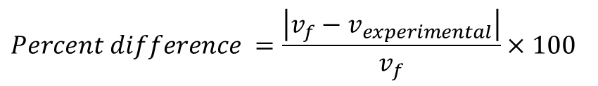

Data Analysis
Theoretical value of final velocity
Final velocity from experimental data (or largest velocity)
Percent difference
$h=y_{final}−y_{initial}=$
0.7265-0.0674 =
0.6591 m
$v_{f}=\sqrt{2gh}=$
3.60
m/s
$v_{experimental}$ =
3.98
m/s
$$Percent difference =\frac{\left|v_{f}−v_{experimental}\right|}{v_{f}}×100$$
10.56
%

Slide 21
Conclusions
Discuss the key characteristics of the plot. Consider the points when potential energy U is maximum, U is minimum, kinetic energy K is maximum, K is minimum and when U and K are the same value. What is the significance of these points?
  Answer: With U and K ending up on the same point in the graph we see the U became K energy at that point of time then shifted back to U

Slide 22
Conclusions
What is the trend of the best fit line for the total energy E in your data? If the data is accurate, the total mechanical energy should decrease slightly. Why is that?
  Answer: The best fit line is staying consistent with the total energy except towards the end when the energy fluctuates. It could decrease due to air resistance affecting the big surface area of the book.

Slide 23
PHYS204
Project
Relationship between Linear and Rotational Motion

Slide 24
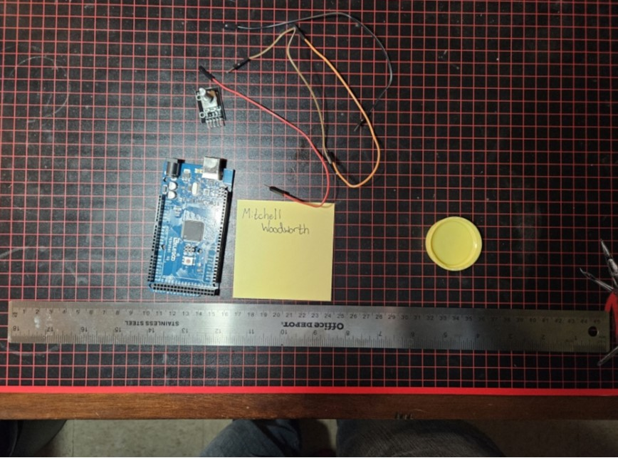
Experimental Set-up
Materials List:
Mega 2560 Board
Rotary Encoder Part KY-040
Male to Female Wires
Object to attach onto rotary encoder
(e.g. cork, bottle cap, ball)
Ruler or tape measurer

Slide 25
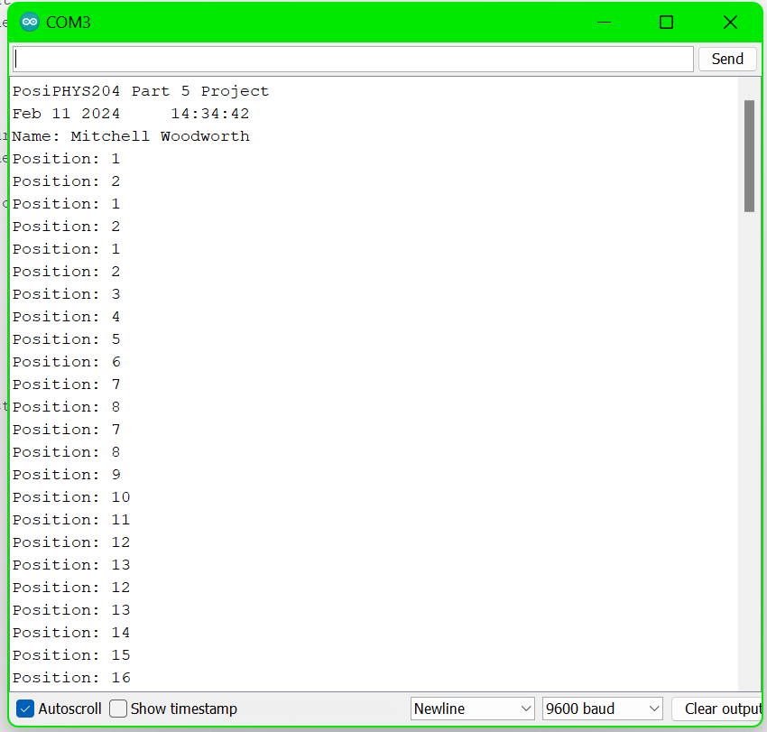
Raw Data
Screenshot of Serial Monitor from Arduino IDE showing raw data.

Slide 26
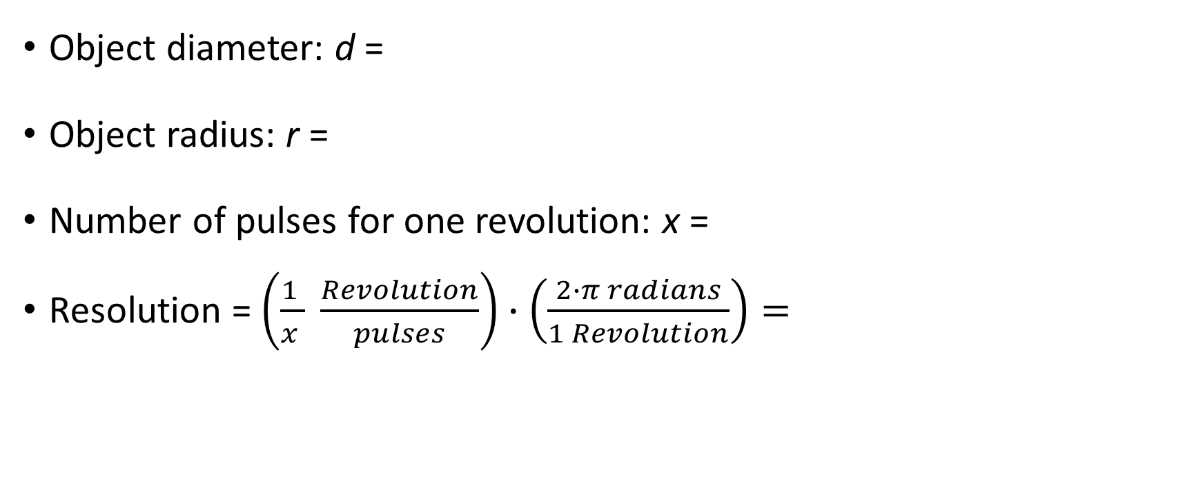
Data Collection
4
cm
Object diameter: d =
Object radius: r =
Number of pulses for one revolution: x =
Resolution = $\left(\frac{1 }{x } \frac{Revolution}{pulses}\right)∙\left(\frac{2∙π radians}{1 Revolution}\right)=$
2
cm
40
0.157
Radian/pulses

Slide 27
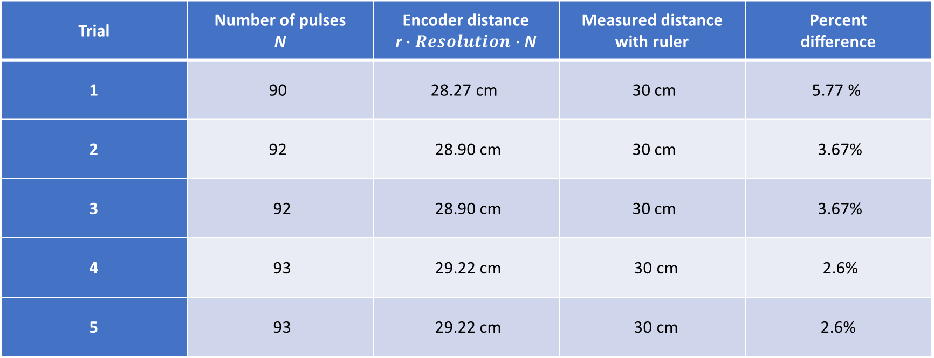
Data Analysis
Trial | Number of pulses N | Encoder distance r$∙Resolution∙$ N | Measured distance with ruler | Percent difference
1 | 90 | 28.27 cm | 30 cm | 5.77 %
2 | 92 | 28.90 cm | 30 cm | 3.67%
3 | 92 | 28.90 cm | 30 cm | 3.67%
4 | 93 | 29.22 cm | 30 cm | 2.6%
5 | 93 | 29.22 cm | 30 cm | 2.6%

Slide 28
Conclusions
Discuss the results. Comment on the possible source of errors.
  Answer: The results were constant. I had a three separate results two test were consistent. I would say some issue that could screw my results is of course the human error of not starting and stopping in the right spot every time. Another issue would be not having the circular item not snug and tight on the encoder. This caused my object to wobble which could screw the results by not being consistently on the flat surface.
What are some applications of this measuring technique? Could this measuring system be used to measure surfaces that are not flat?
  Answer: Yes, this could defiantly help measure not flat surfaces. We would have to run multiple test and add some more math to the project in or to straighten the surface out so we could make the rough sourface into a flat surface to fully measure the surface out.

Slide 29
PHYS204
Project
Observing the Hall Effect

Slide 30
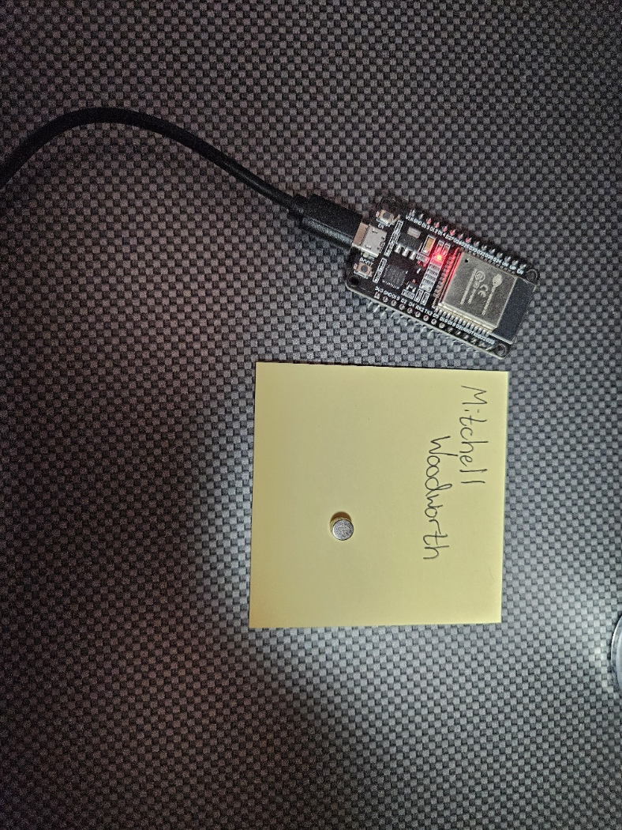
Experimental Set-up
Materials List:
ESP32 microprocessor
Micro-USB cable
Magnet

Slide 31
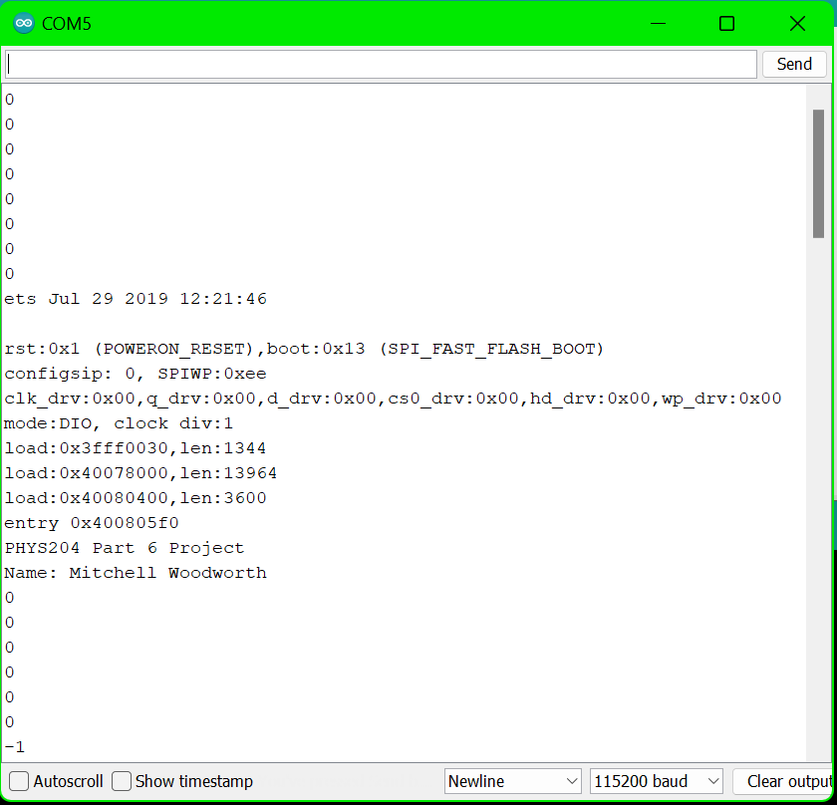
Raw Data
Screenshot of Serial Monitor from Arduino IDE showing raw data.

Slide 32
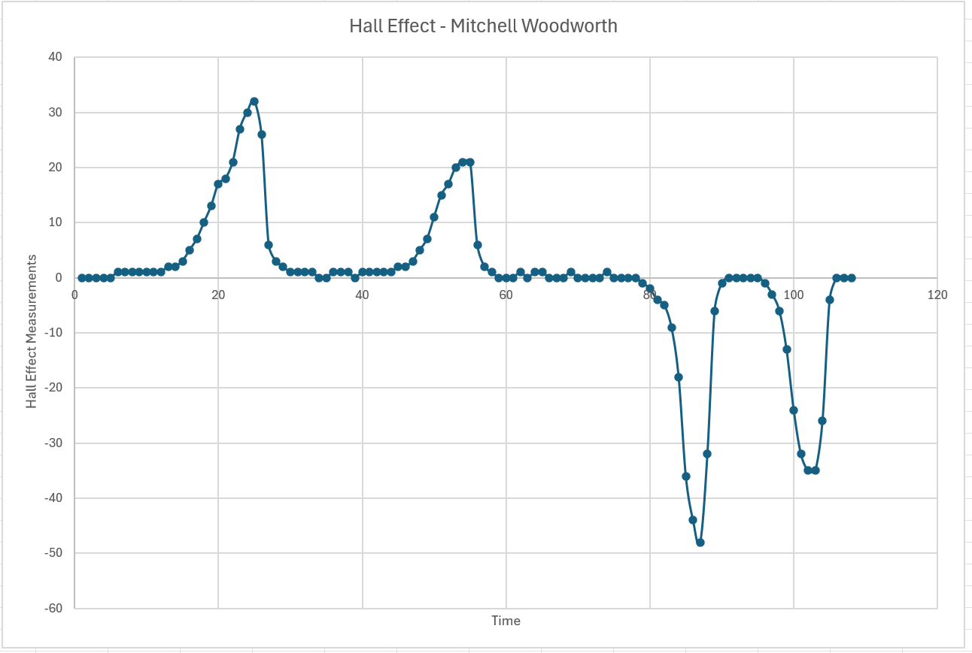
Excel Graph
Include Excel graph for a single trial of data plotted as a function of time.

Slide 33
Conclusions
Discuss the results. Comment on the possible source of errors.
  Answer: The results of this test vary but are consistent roughly. I would say there are two sources of possible errors. One would be the type of magnet or size of the magnet. Another is of course the human error of not being consistent on moving the magnet near the transducer.
Describe how the Hall sensor works. What are some applications for the Hall effect sensor?
  Answer: The transducer that’s on the board varies its output based on the magnetic field near it. One use of the Hall sensor is a tachometers, detecting the spinning of the wheel on a vehicle to monitor the miles on the vehicles.

Slide 34
Challenges
What challenges did you face and overcome?
  Some challenges I faced during these projects is making sure my calculations were correct as well as making sure that I configure my Arduino board correctly.
What parts of the project created the most difficulty?
  The hardest part I dealt with was making sure I read the data correctly and making sure my book I was dropping truly hit free fall.

Slide 35
Career Skills
What skills were developed that will benefit your career?
  I learned during these projects is to make sure to double and triple check my work whether be data collecting or configuring my Arduino set up.
What competencies will help you gain the opportunities to advance your career?
  Dedication and perseverance will help me move forward and still with my goals.

