Slide 1
SEC290 Course Project:
Fundamentals of Infrastructure Security
Presented by:
Mitchell Woodworth

Slide 2
Introduction
Today I will be taking you through the ways to detect security issues and ways to find them.

Slide 3
Intrusion Analysis using Wireshark

Slide 4

Basic attack analysis
Look at captures no. 20 and 22. (You can use the “Go” link at the top of the Wireshark screen to quickly go to a specific capture) Both packets are ICMP traffic but there are subtle differences between them. Compare the time-to-live and data field sizes in the two packets. What differences do you see? Looking at the two captures we see that capture 20 has a time to live of 64 and is 84 bits in length. This capture is coming from 192.168.25.1. Capture 22 is a length of 60 and a time to live of 128. The source of this packet is 192.168.25.50.
Do a little Internet research to discover which operating systems use the specific values in their ping commands. What operating system generated the echo request in capture 20? Found that the all of the OS’s available use the specific commands. I also located the operating system that generated the echo request which came from a Linux based OS.
Review packet no. 37 and beyond, what do you think is taking place here? 192.168.25.200 is getting port scanned.
Look at capture 22846. What is suspicious about the flag settings in this packet? This capture is in a long sequence of opening and closing ports.
What is the IP address of the host being targeted? 192.168.25.200

Slide 5
Open SSL

Slide 6
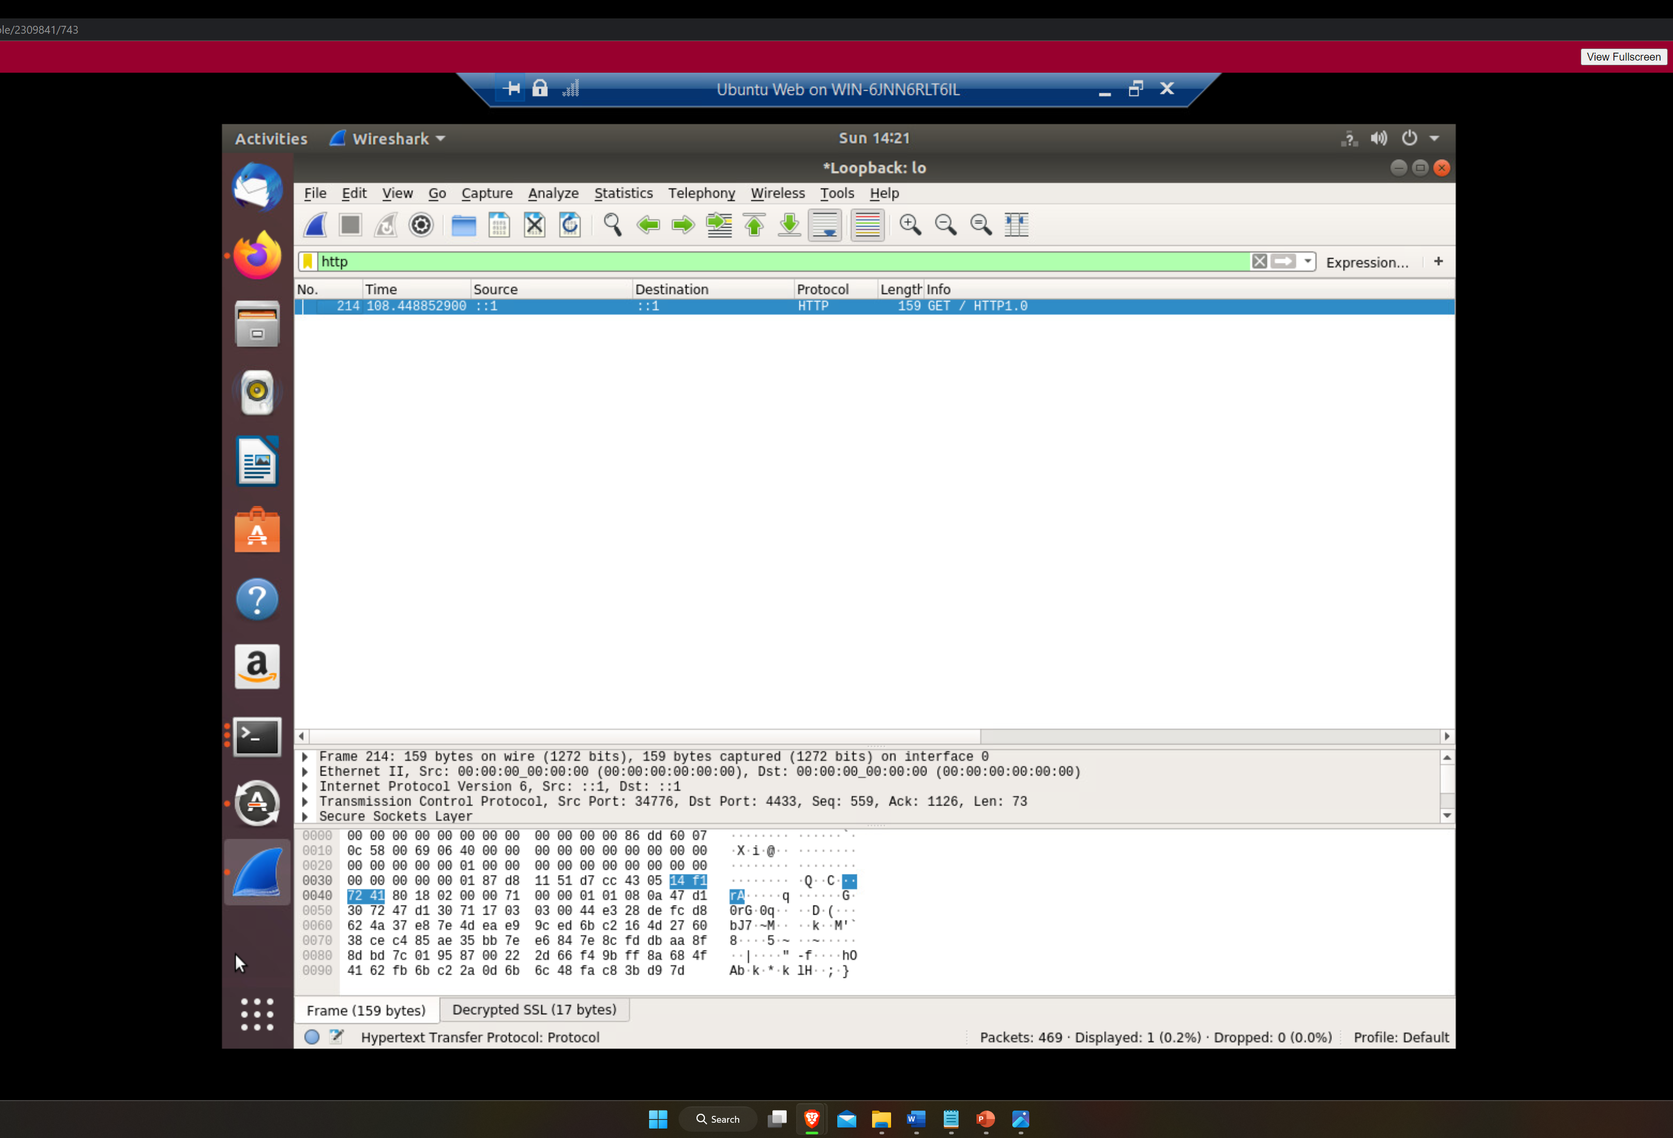
Creating and testing an SSL/TLS file

Slide 7
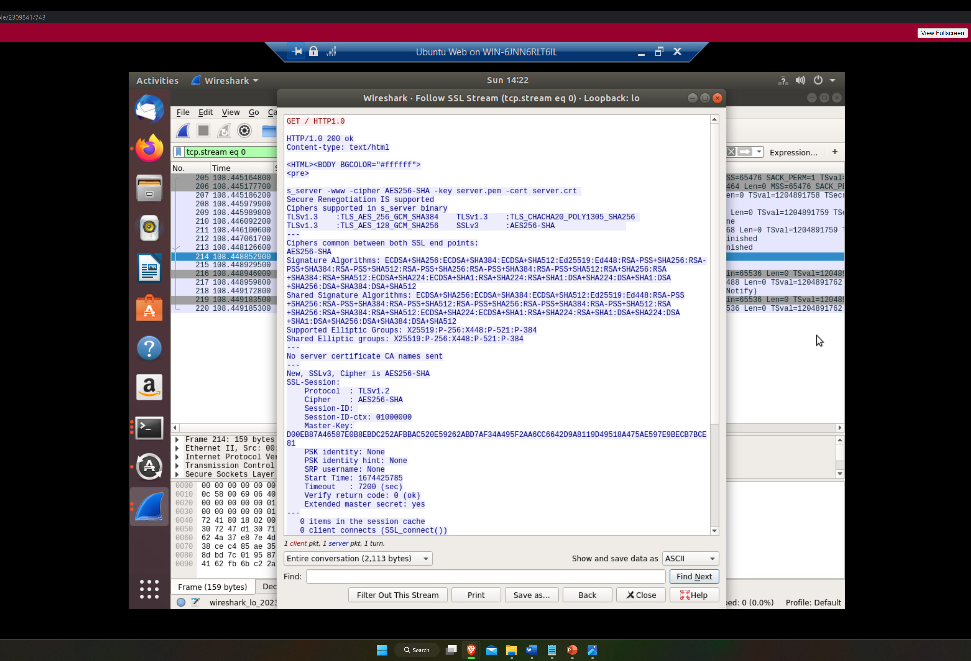
Creating and testing an SSL/TLS file cont’d

Slide 8
Snort

Slide 9
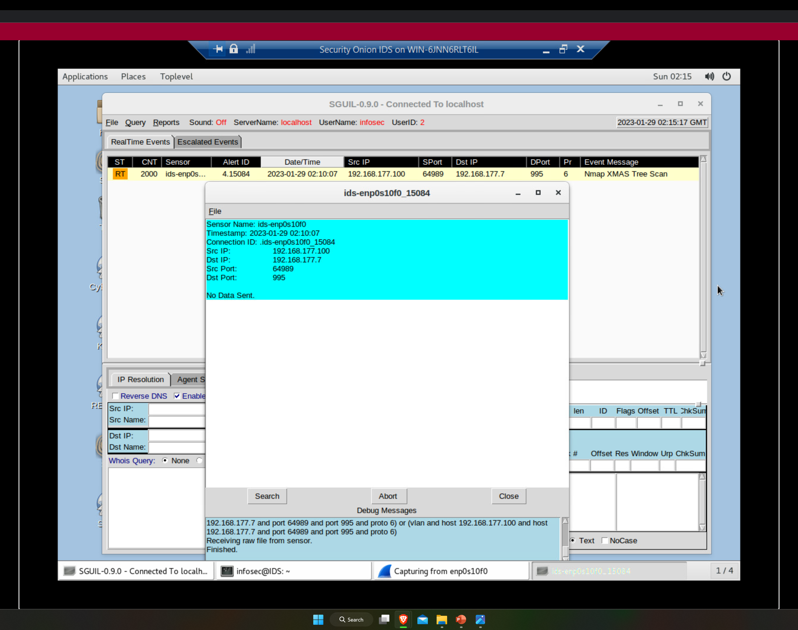
Testing Snort rules

Slide 10
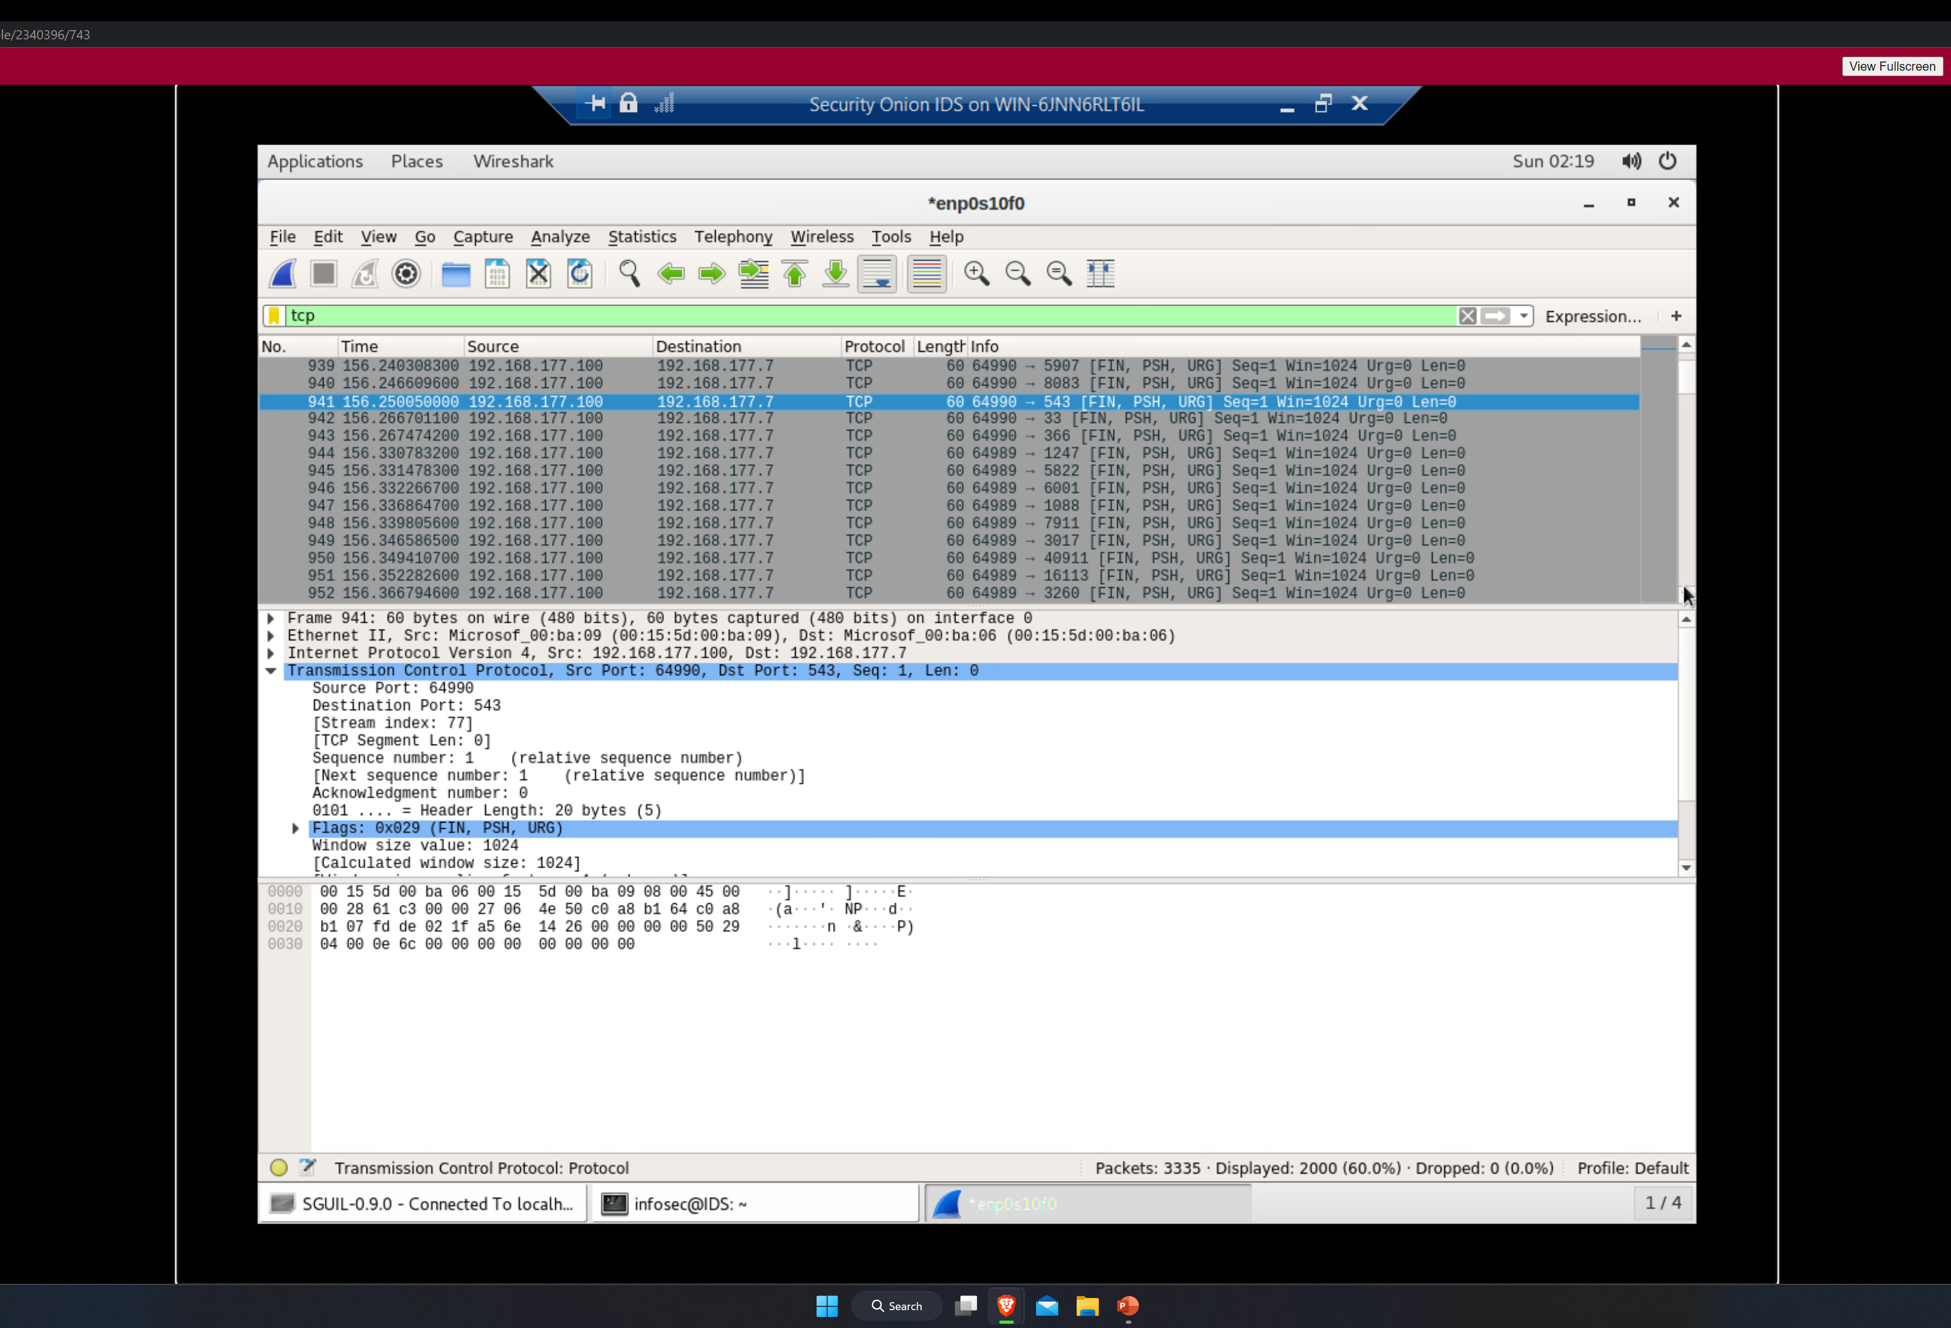
Testing Snort rules cont’d

Slide 11
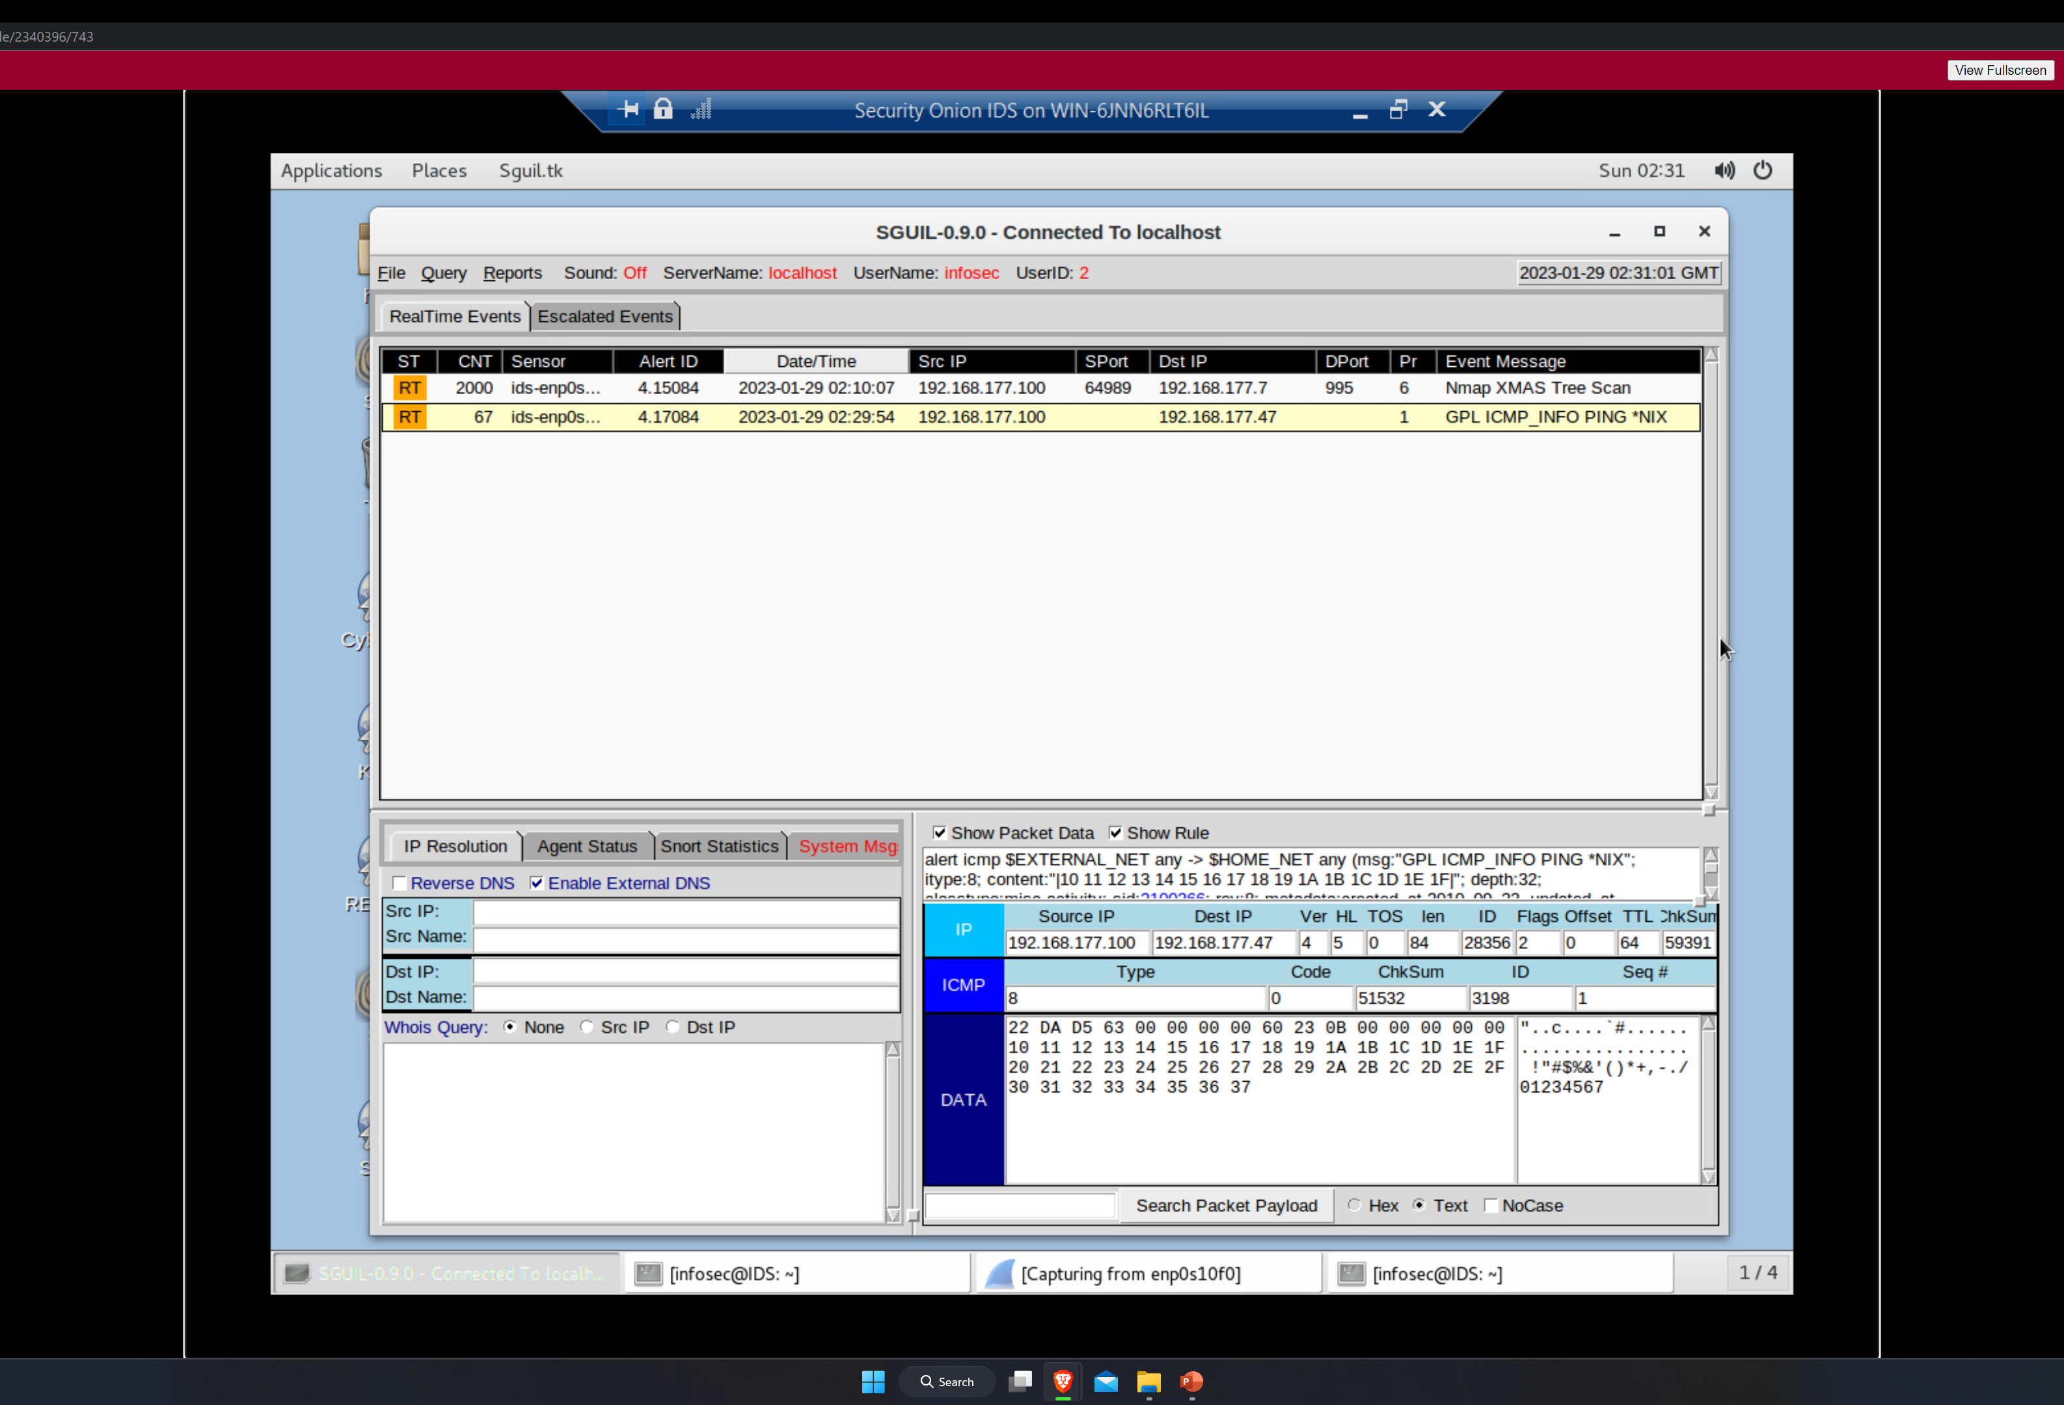
Creating Snort rules

Slide 12
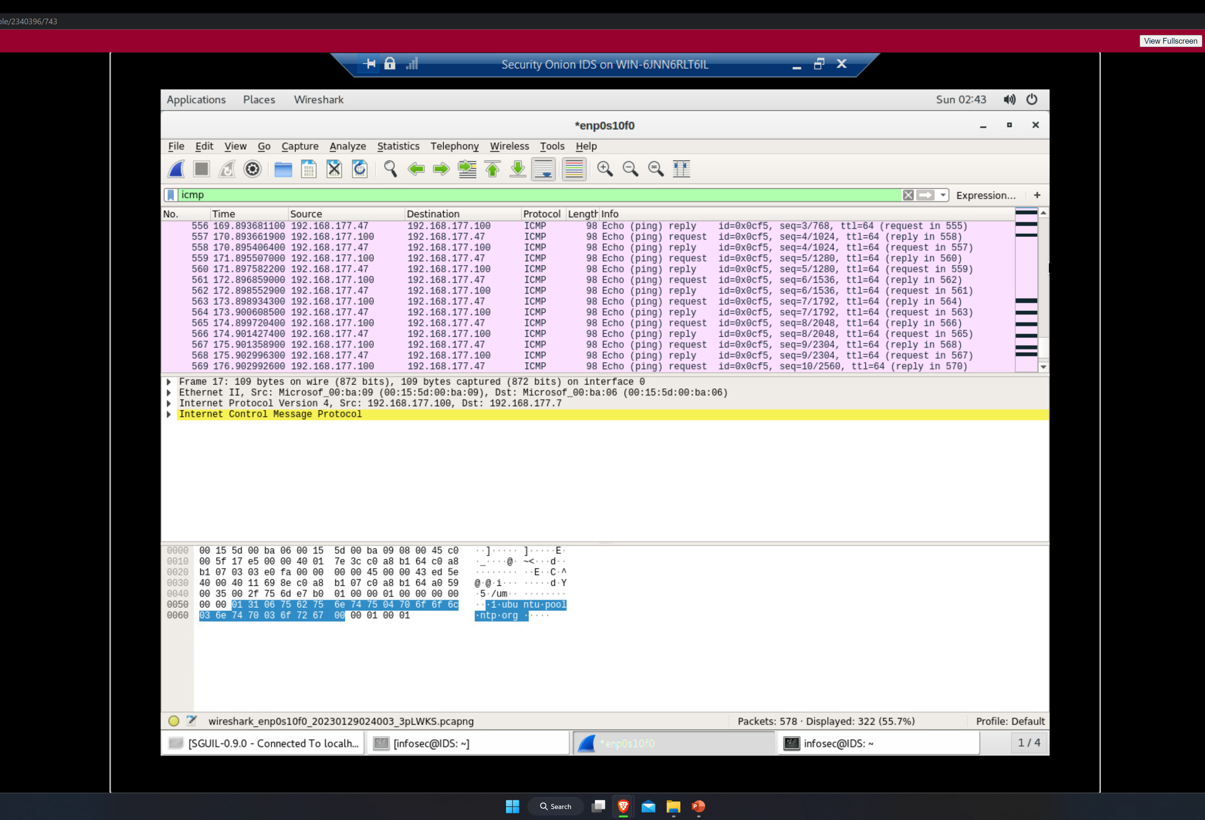
Creating Snort rules cont’d

Slide 13
Live Memory Analysis

Slide 14
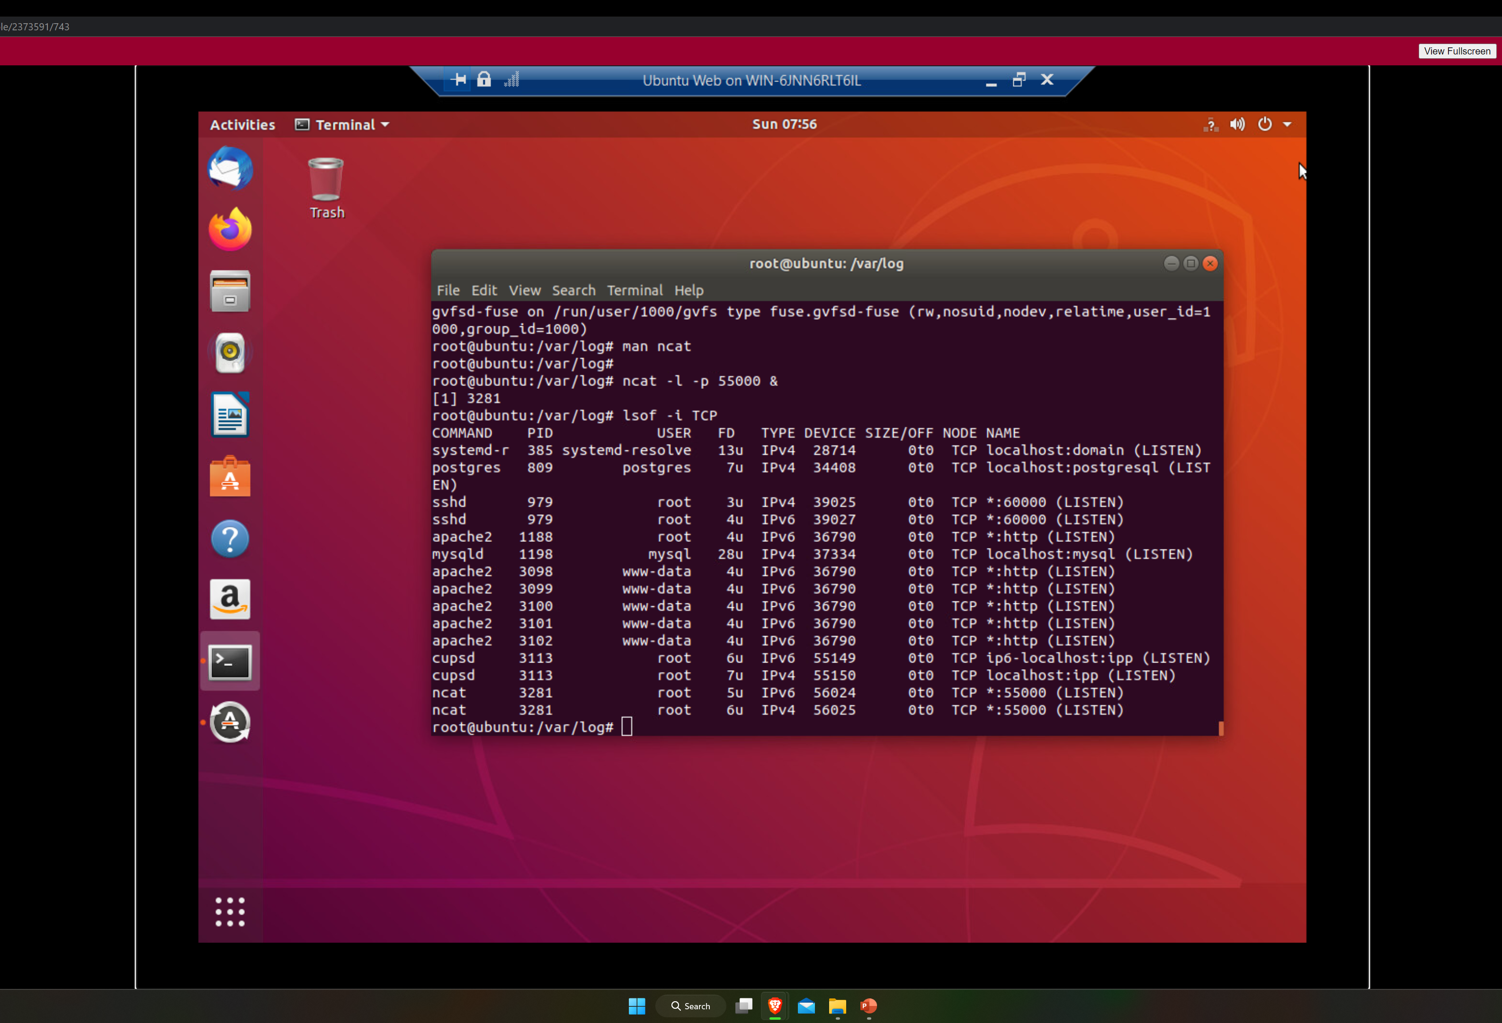
Linux Processes

Slide 15
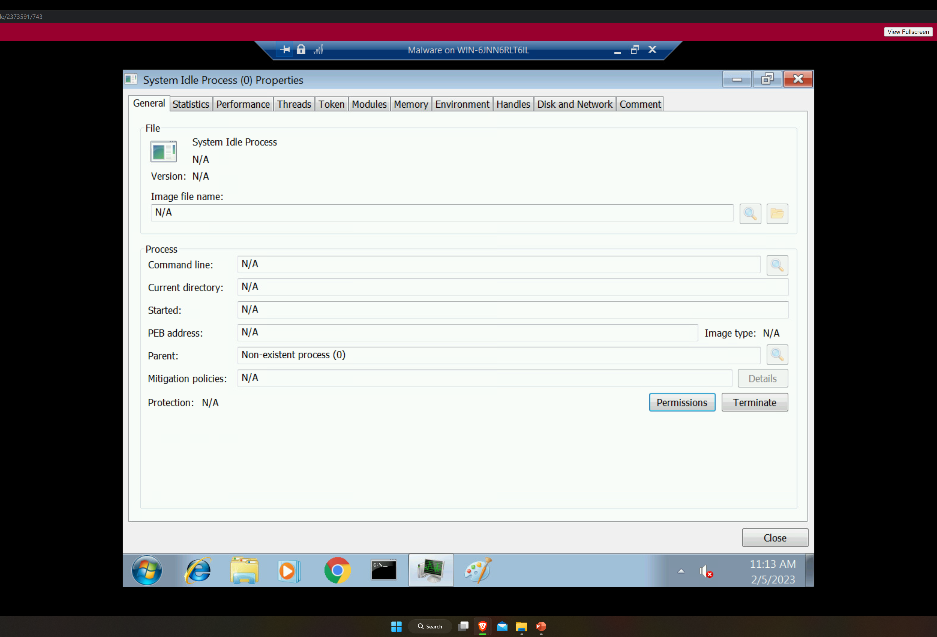
Process Hacker

Slide 16
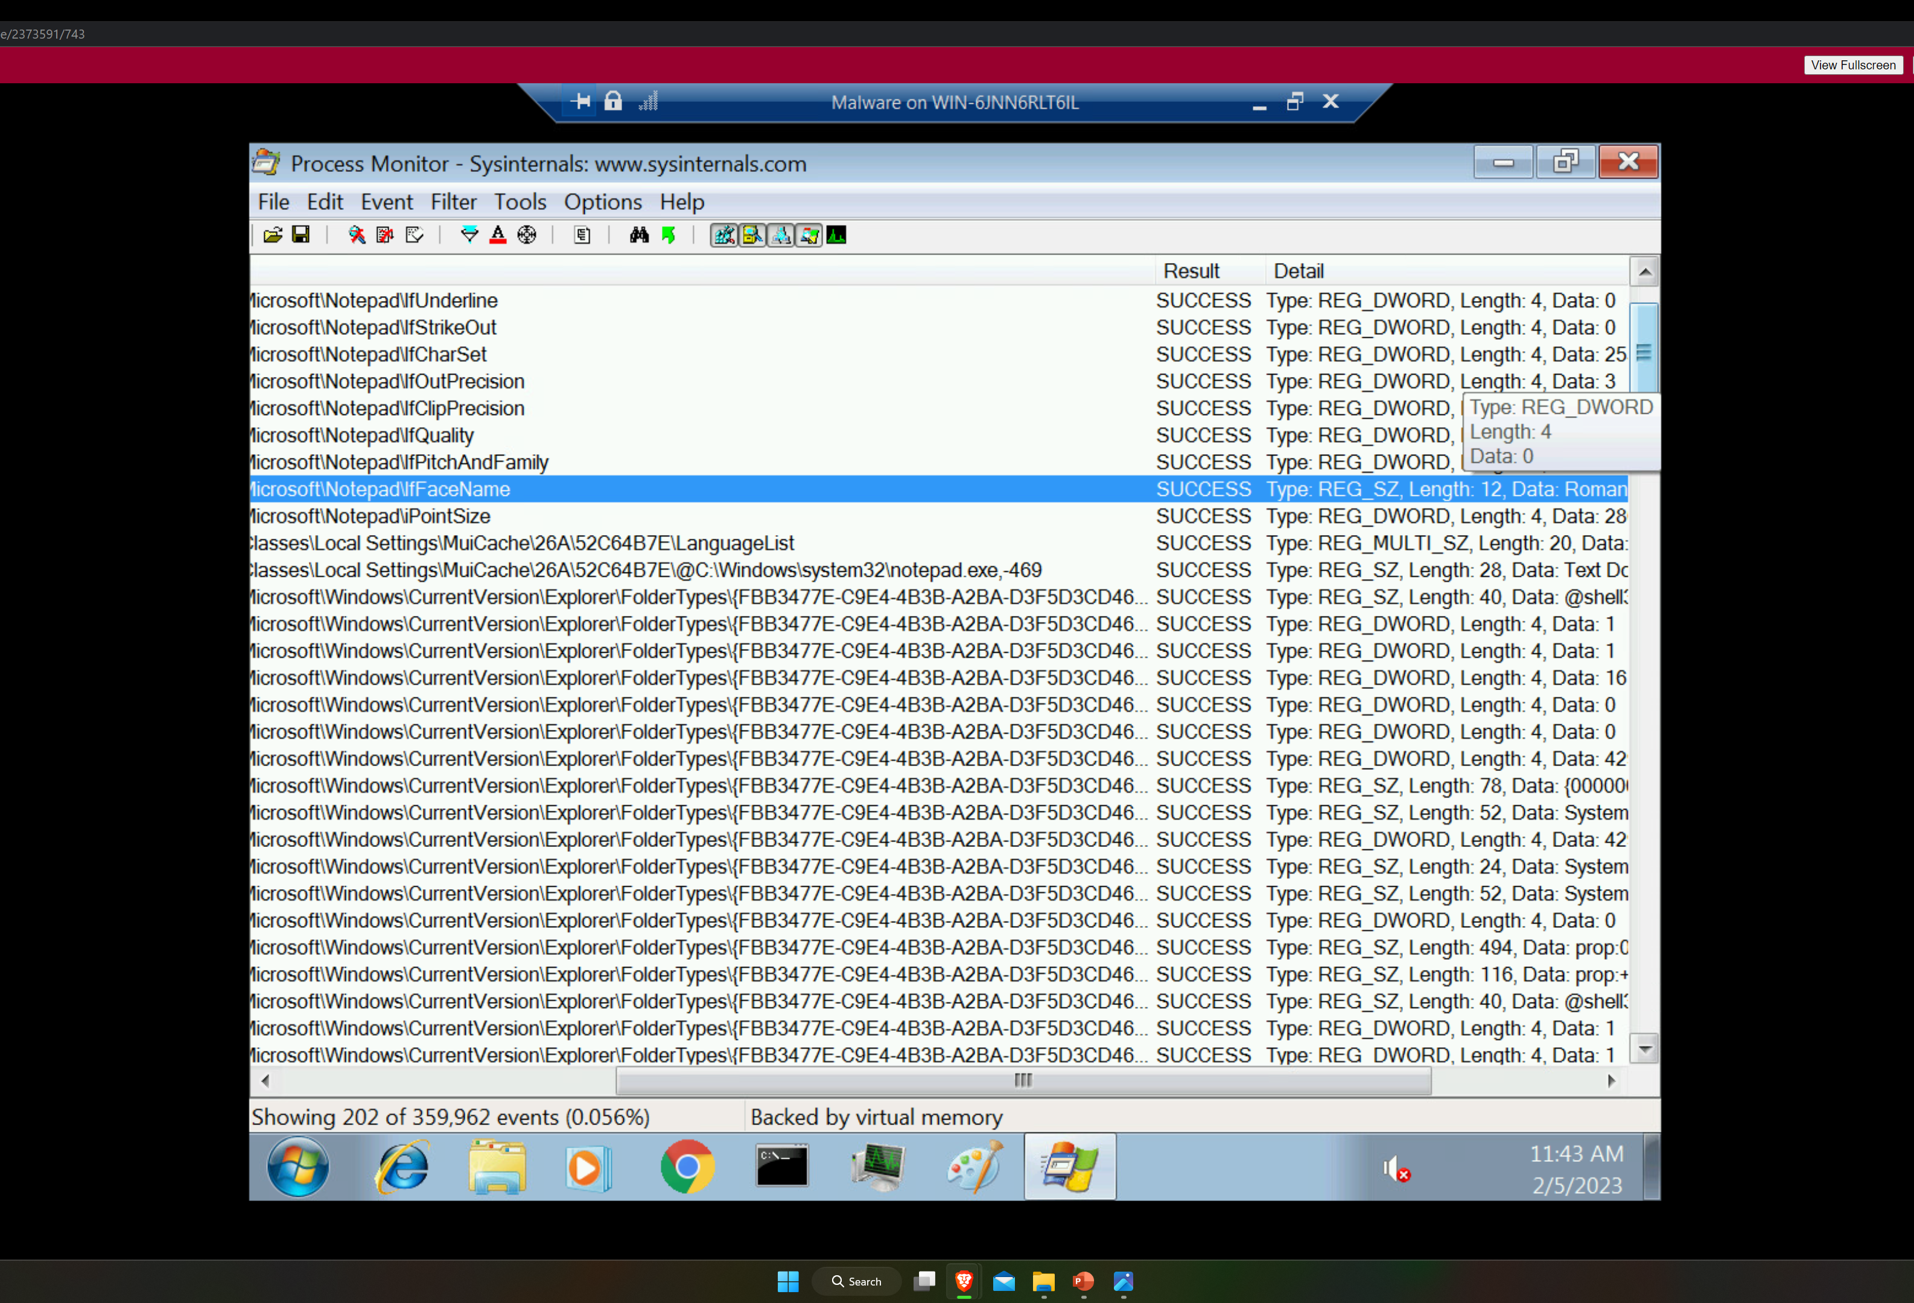
Process Monitor

Slide 17
Firewall

Slide 18
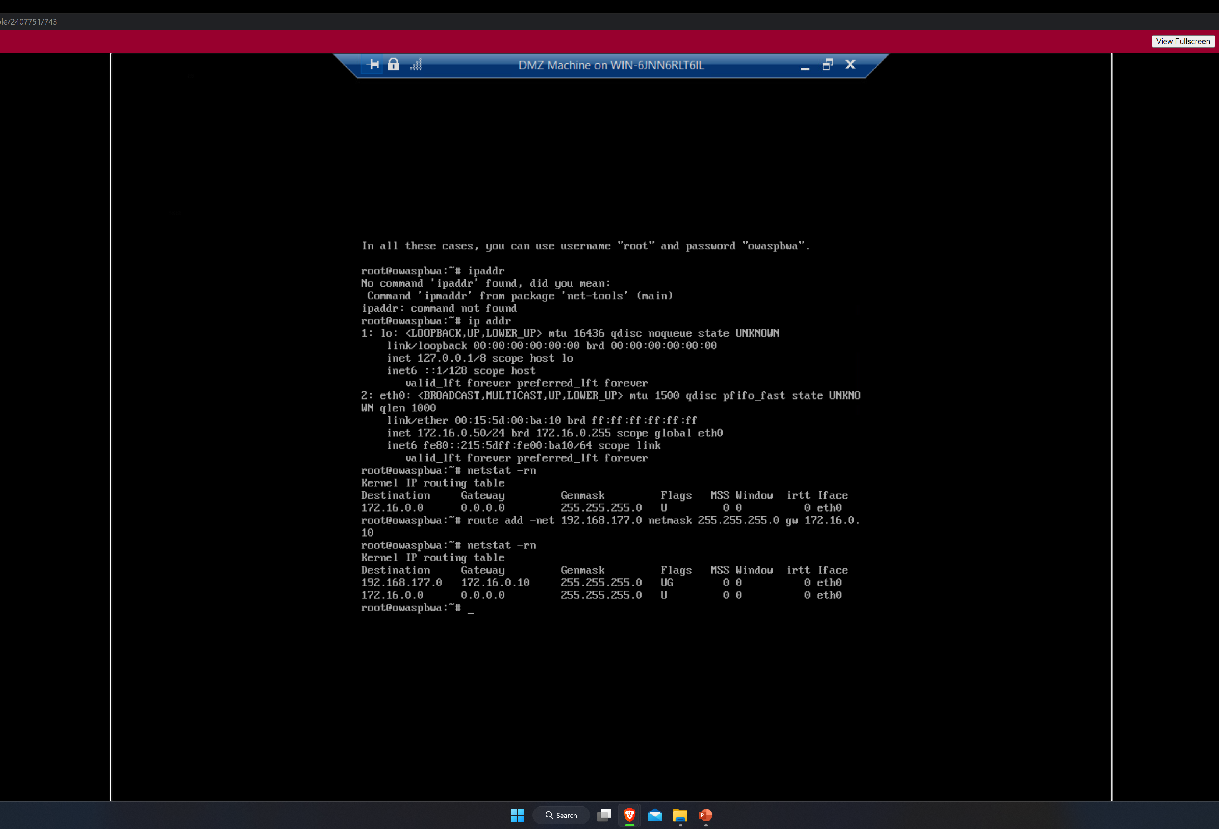
Time-based Access

Slide 19
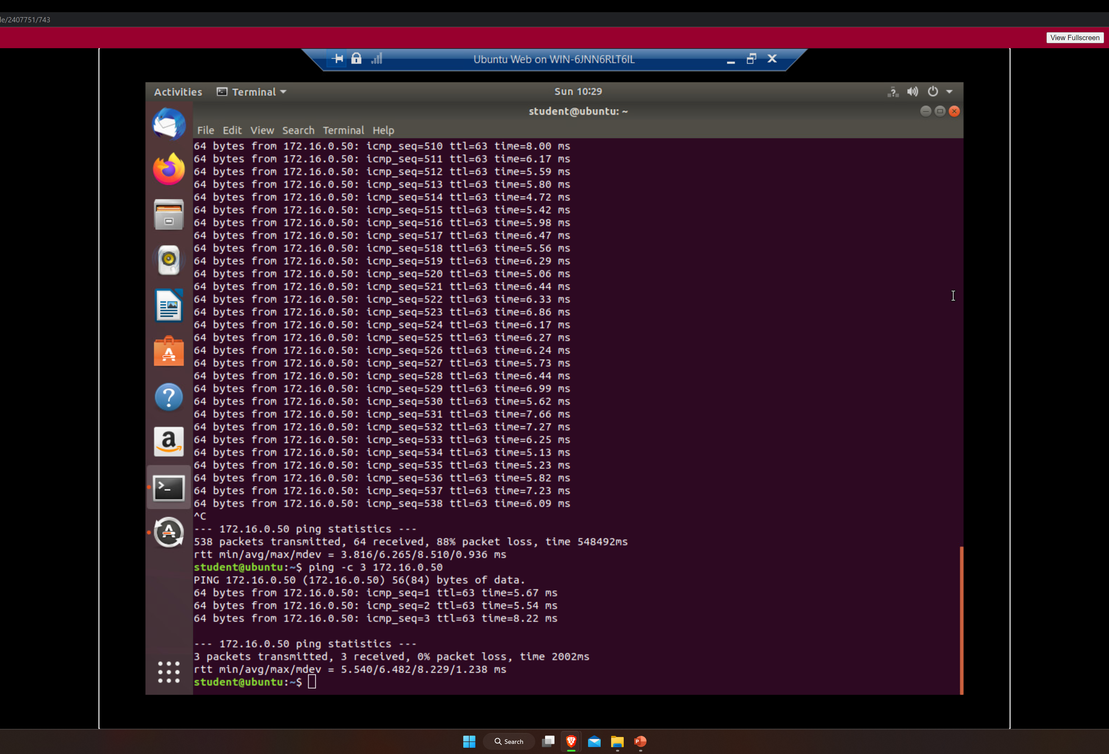
Time-based Access

Slide 20
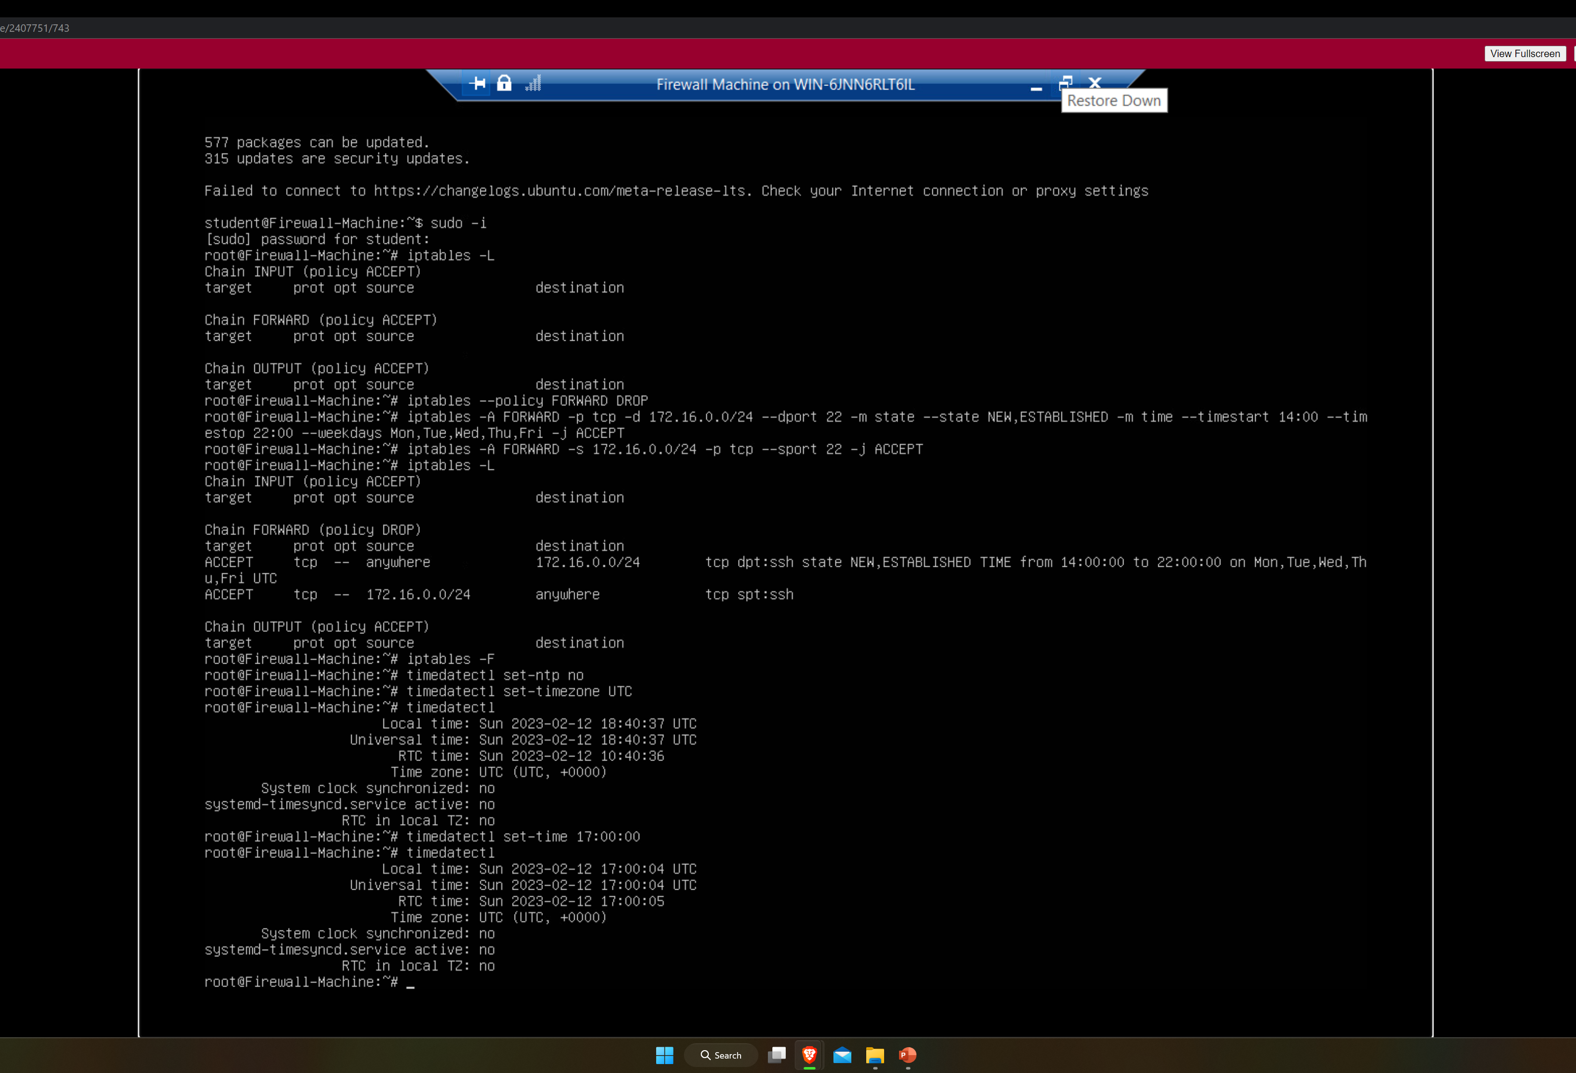
Time-based Access

Slide 21
Challenges
Through out this projects I faced a few challenges. One major challenge I faced was having connectivity issues to the virtual server.

Slide 22
Career Skills Acquired
Hardware/device knowledge
Networking/connectivity ability
Coding/programming
Operating system fundamentals
Automation
Security awareness (at a minimum)

Slide 23
Conclusion
This projects was a great to get more information about network security.
Got great practice using the Wireshark program in a safe environment.

