Slide 1
NETW310 Course Work
Mitchell Woodworth

Slide 2
Introduction
We will be going through the fascinating world of communication. We will be talking about how communication is handle through different means and how we can diagnose issue with communication devices.

Slide 3
Baseband Signals and AM/FM Signals
NETW310 Course Work

Slide 4
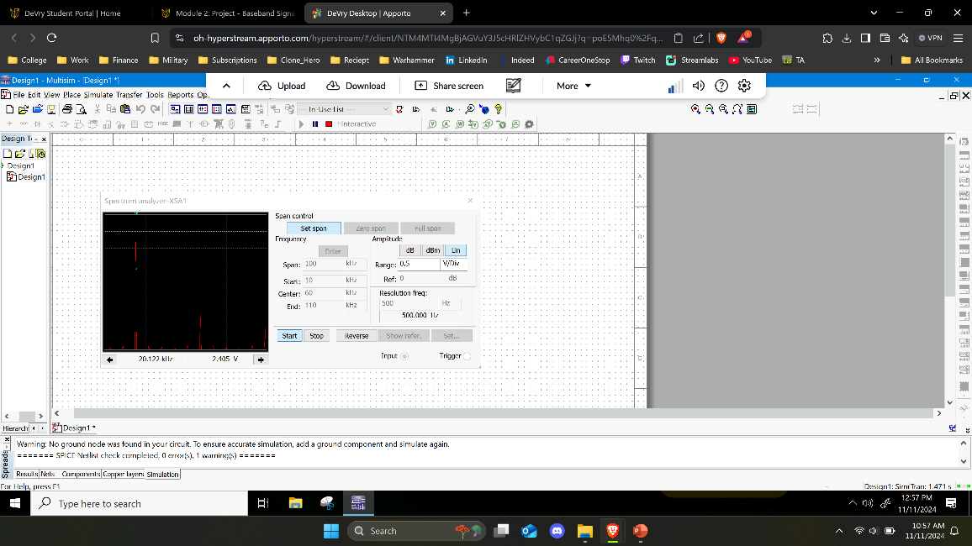
Baseband Signals
The screenshot should show the spectrum analyzer displaying the signal’s harmonic spectrum and its panel settings. Record the signal voltage at each of the frequencies in the table.
Harmonic Frequency | Signal (Volts)
20 kHz | 2.405 V
40 kHz | 0.000 V
60 kHz | 868.903 mV
80 kHz | 0.000 V
100 kHz | 562.194 mV

Slide 5
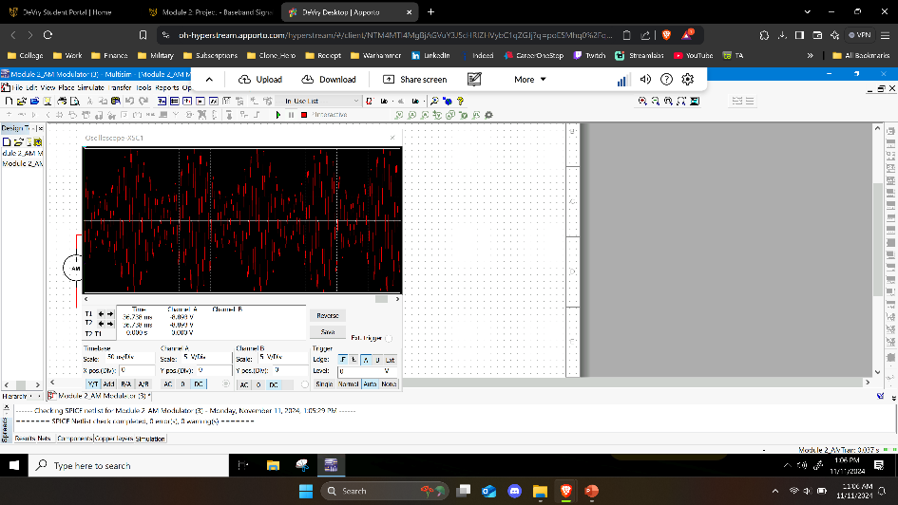
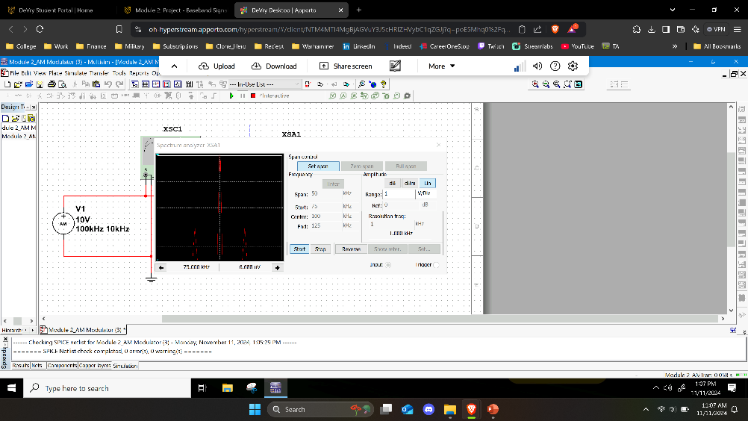
AM Signals
The screenshot of the Oscilloscope should include the signal and the panel settings of the oscilloscope. The screenshot of the Spectrum Analyzer should include the signal and the panel setting of the analyzer.
Oscilloscope screenshot here
Spectrum Analyzer screenshot here
AM Modulation | Frequency (kHz)
Lower side band | 89.969 kHz
Carrier | 100.157 kHz
Upper side band | 109.953 kHz

Slide 6
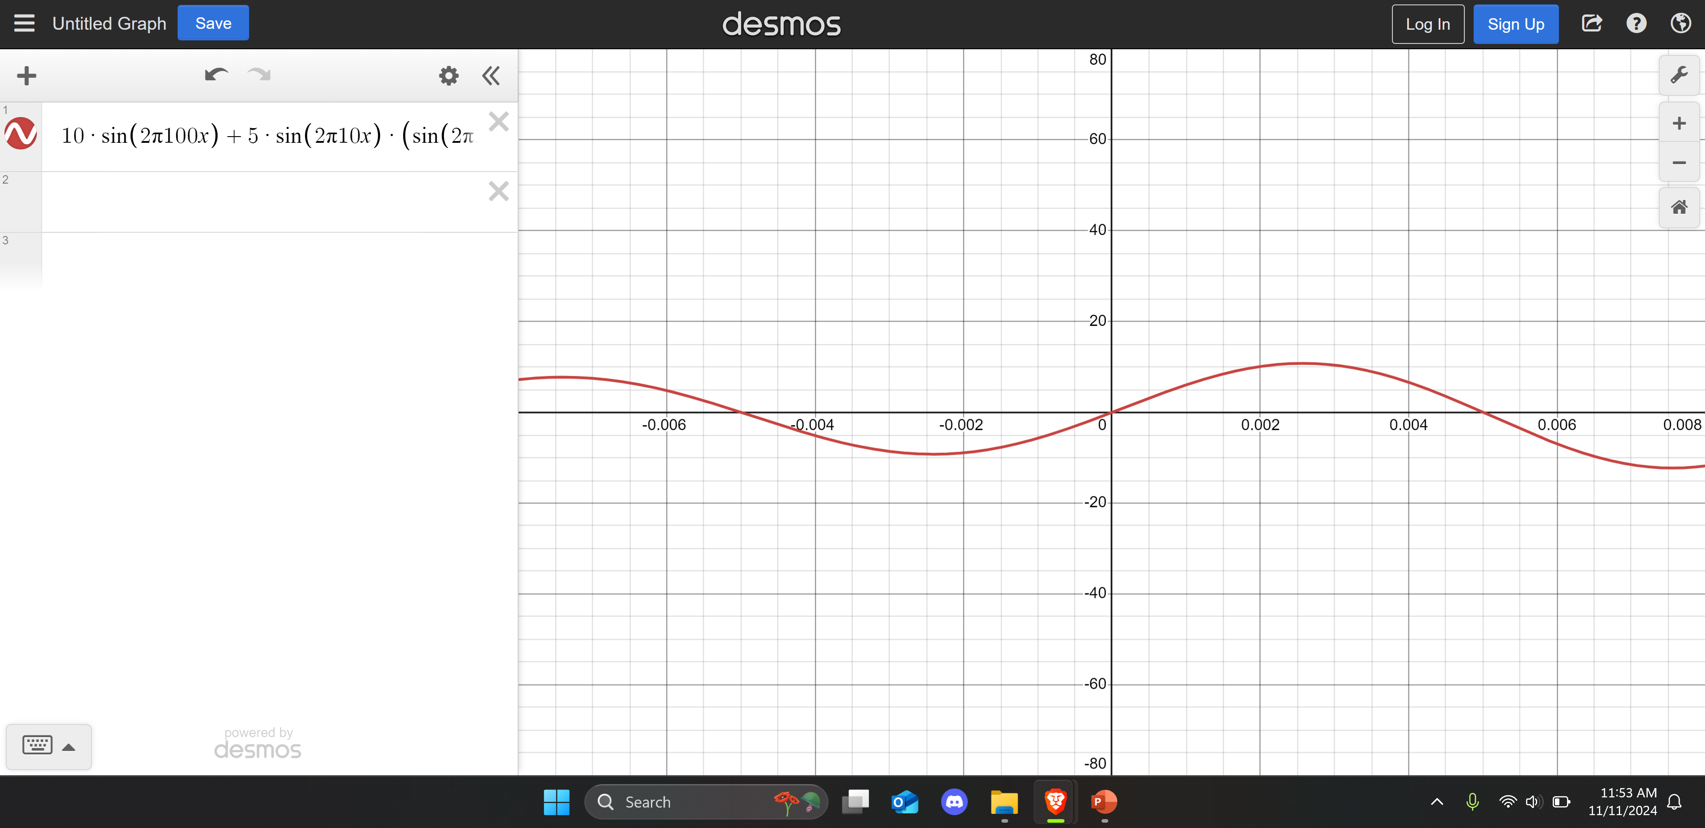
AM Signals Cont.
Develop equations for the carrier and modulating signals and plot the equation for the composite modulated signal V_{AM .}
Equations here:
vc=10sin(2Pi100t)
vm=5sin(2Pi10t)
Plotted diagram screenshot here:

Slide 7
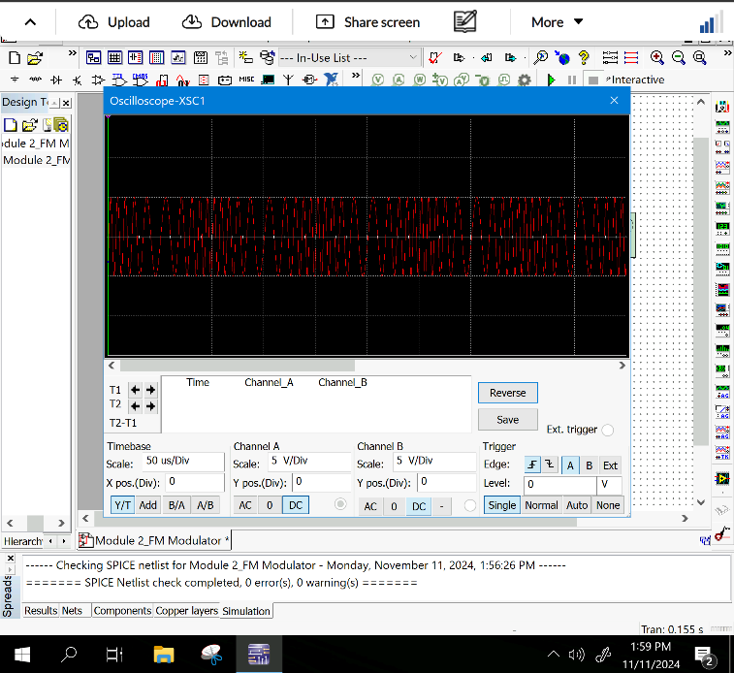
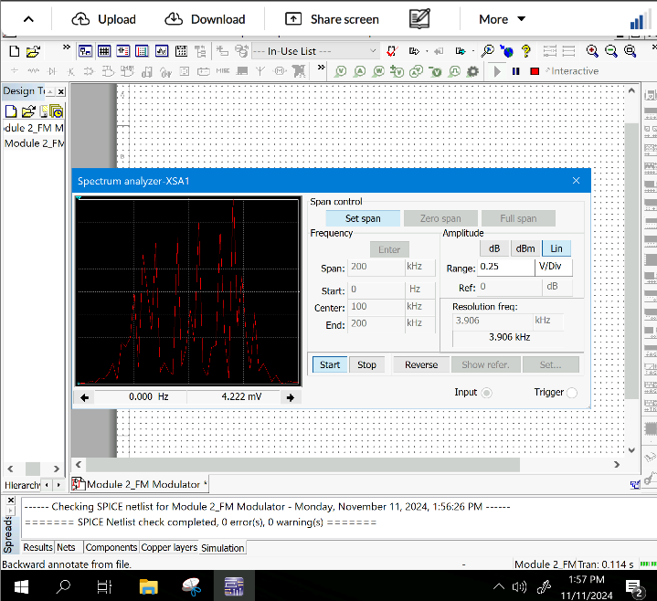
FM Signals
The screenshot of the Oscilloscope should include the signal and the panel settings of the oscilloscope. The screenshot of the Spectrum Analyzer should include the signal and the panel setting of the analyzer.
Oscilloscope screenshot here
Spectrum Analyzer screenshot here
What’s the carrier frequency?
69.906 kHz

Slide 8
Pulse Code Modulation (PCM) and Line Codes
NETW310 Course Work

Slide 9
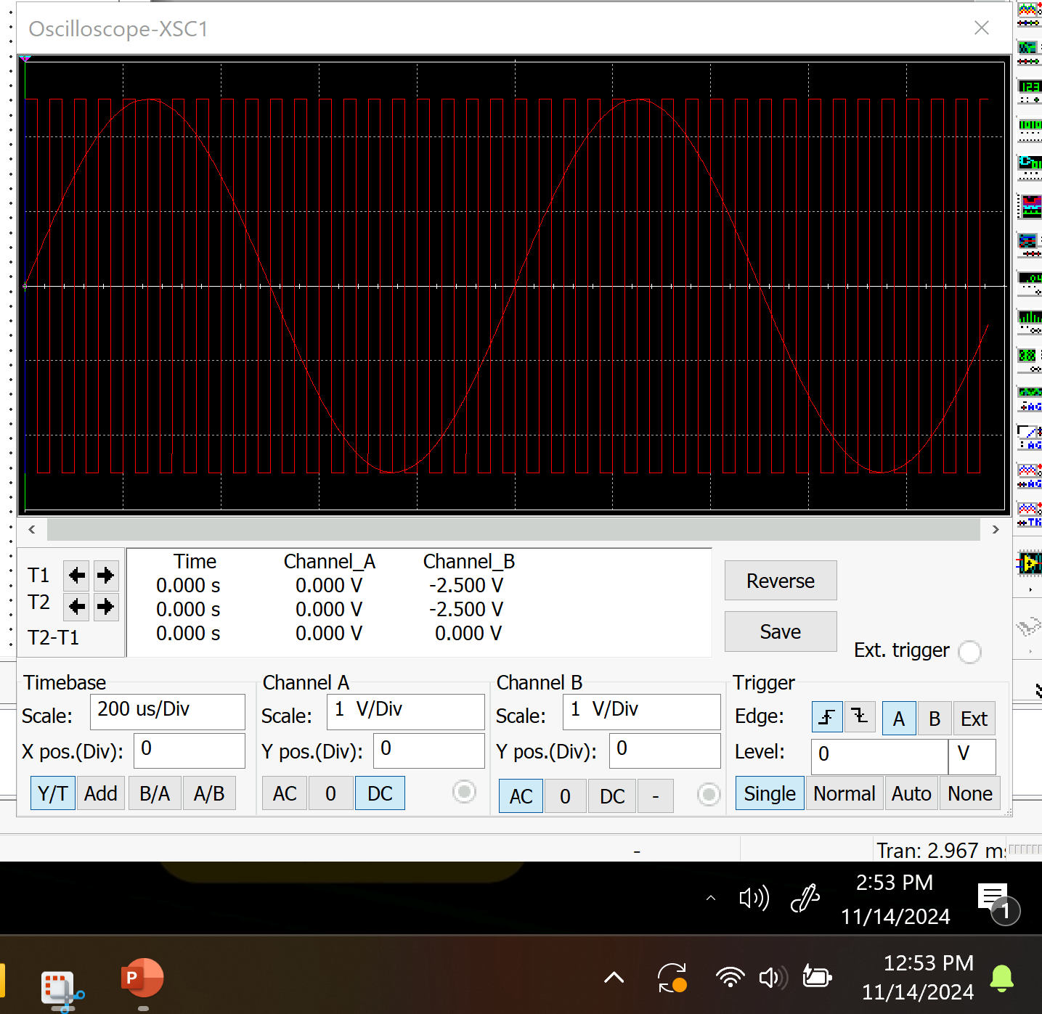
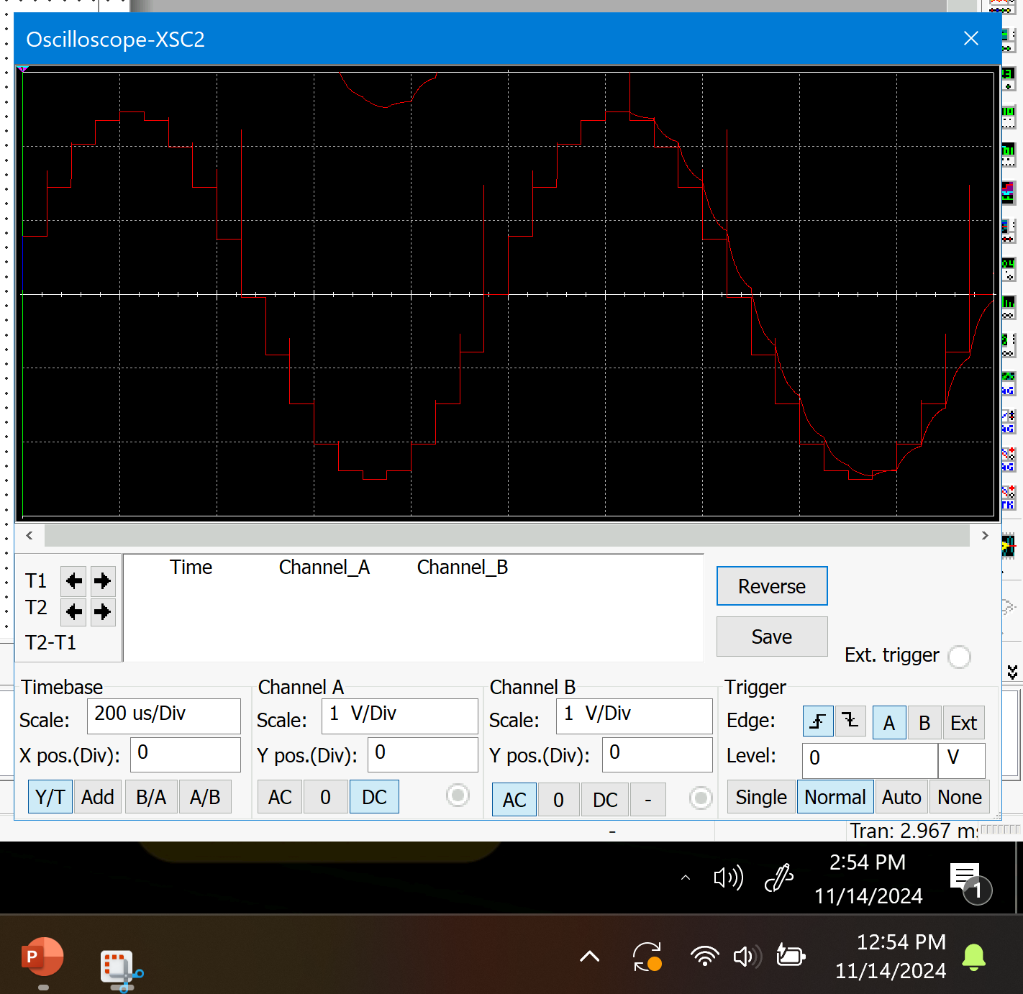
Pulse Code Modulation (PCM)
The first screenshot should show the Oscilloscope-XSC1 display with the analog input signal and sampling clock at the input to the ADC. The second screenshot should show the Oscilloscope-XSC2 display with the output of the DAC.

Slide 10
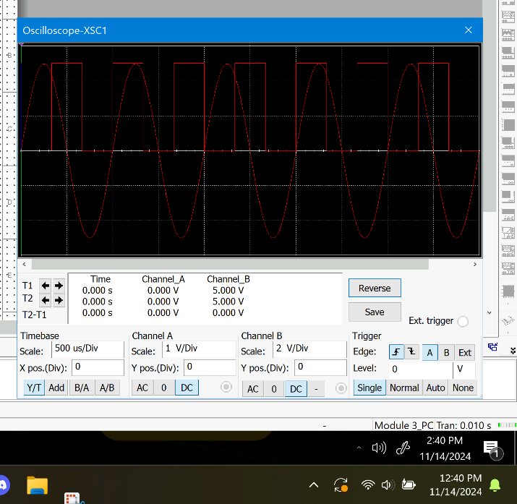

Pulse Code Modulation (PCM)
The first screenshot should show the Oscilloscope-XSC1 display with the analog input signal and sampling clock at the input to the ADC. The second screenshot should show the Oscilloscope-XSC2 display with the output of the DAC.
What are the effects of increasing or decreasing the sampling rate?
Answer: If we change the sample rate the wavelength will space out more or get closer to each other. Resulting in sound being less likely to hear.

Slide 11
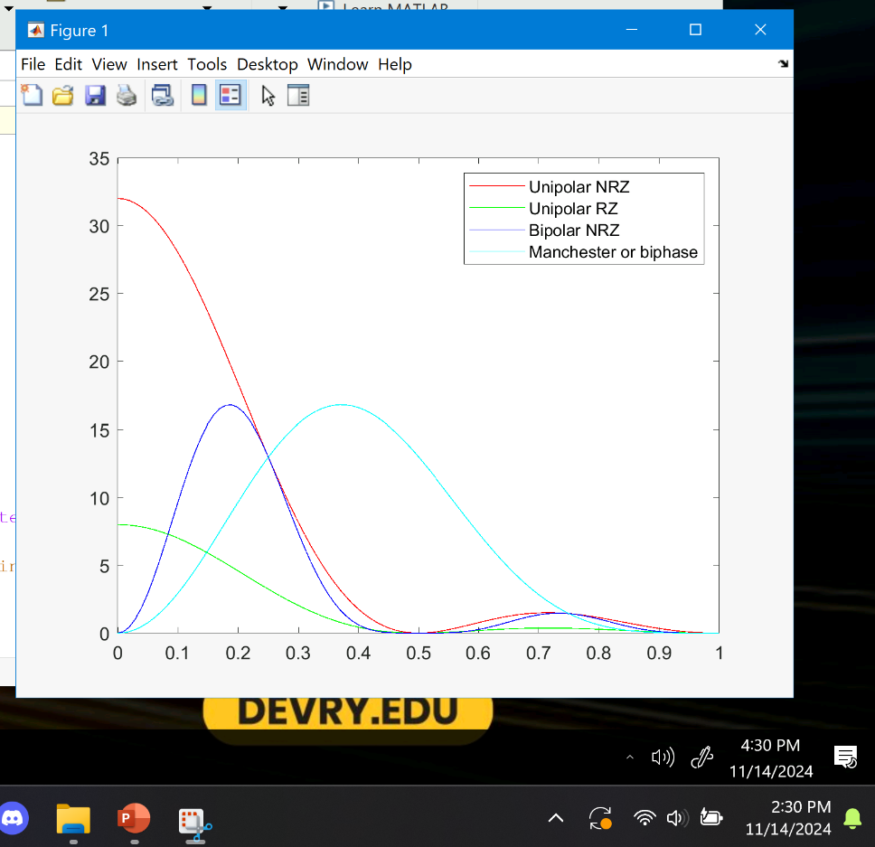
Line Codes
This screenshot should show the power spectral densities of four-line codes: NRZ-Polar, NRZ-Unipolar, NRZ-Bipolar, and Manchester-Polar.
MATLAB Diagram Here
Compare the NRZ-Bipolar and Manchester polar codes in the diagram.
Which one requires more bandwidth?
Answer: NRZ-Bipolar needs to have more bandwidth.

Slide 12
Cables and Structured Cabling
NETW310 Course Work

Slide 13
Questions
1. Why must the twisting in the individual wires be maintained in a UTP cable?
Answer:
Having the wires in a UTP cable are important to help reduce interference, induction and crosstalk between the wires.
2. How many inches should UTP cable be separated from 110 volts electrical cable?
Answer:
Electrical cables should be 12-inches away from UTP cables.
3. Horizontal cabling connects what areas to each other?
Answer:
We see horizontal cabling connect servers in telecommunication rooms through out the building to individual workstation ports.

Slide 14
Questions
4. What is a plenum rated cable?
Answer:
Plunum Rated cables are UTP cables that are made specifically for crawl space installation. The cables are made to be more fire-resistant and low-smoke producing materials. These cables are the most expensive kind.
5. What is a riser tube used for?
Answer:
Riser tubes are what help transfer cables between floors and will reduce interference from moving between floors.
6. Is the grounding of equipment mostly a safety or a performance concern?
Answer:
Grounding of equipment is very crucial as it will prevent injuries. Electrical injuries is common if not cautious when working with electrical. So it’s important to make sure your equipment is grounded.

Slide 15
Antenna Gain and Free Space Path Loss
NETW310 Course Work

Slide 16
Antenna Gain
1. What is the maximum theoretical antenna gain of a common dish antenna at the 2.4 GHz band?
Answer: 22.379 dBi
2. What is the maximum theoretical antenna gain of a common dish antenna at the 5 GHz band?
Answer: 29.070 dB
3. Given the same sized reflector, which signals, high-frequency, or low-frequency, can be more efficiently focused by a common dish antenna (i.e., result in a higher antenna gain)?
Answer: A High-Frequency signal
4. What is the maximum theoretical antenna gain of the dish antenna used in the VLA radio telescopes in New Mexico at the 5 GHz band?
Answer: 63.059 dBi 5
5. Given the same signal frequency, which dish antennas, large-sized or small-sized, are more efficient at focusing the signal (i.e., result in a higher antenna gain)?
Answer: Larger Dish

Slide 17
Free Space Path Loss
What is the free space path loss in dB at the 2.4 GHz band?
Answer: 40dB
2. What is the free space path loss in dB at the 5 GHz band?
Answer: 45 dB
3. How does the free space path loss at a higher frequency (e.g., the 5 GHz band) compare with that at a lower frequency (e.g., the 2.4 GHz band)?
Answer: They experience greater free space loss due to the expansion of the signal.
4. What is the free space path loss in dB over 20 meters at the 2.4 GHz band?
Answer: 66.07 dB
5. What is the free space path loss in dB over 40 meters at the 2.4 GHz band?
Answer: 72.09 dB
6. What is the free space path loss in dB over 80 meters at the 2.4 GHz band?
Answer: 78.10 dB
7. When the distance doubles, how does free space path loss in dB change approximately?
Answer: 6 dB

Slide 18

Free Space Path Loss Cont.
8. Use a scientific calculator to calculate Delta $L_{fS}$ for D1 = 20 meters and D2 = 40 meters.
Answer: Delta $L_{fS }$= -6.02
9. Is your calculation approximately the same as the result from Part 1 Step 2?
Answer: No it’s off by a lot.

Slide 19
Bit Error Rate of Fading Channels
NETW310 Course Work

Slide 20
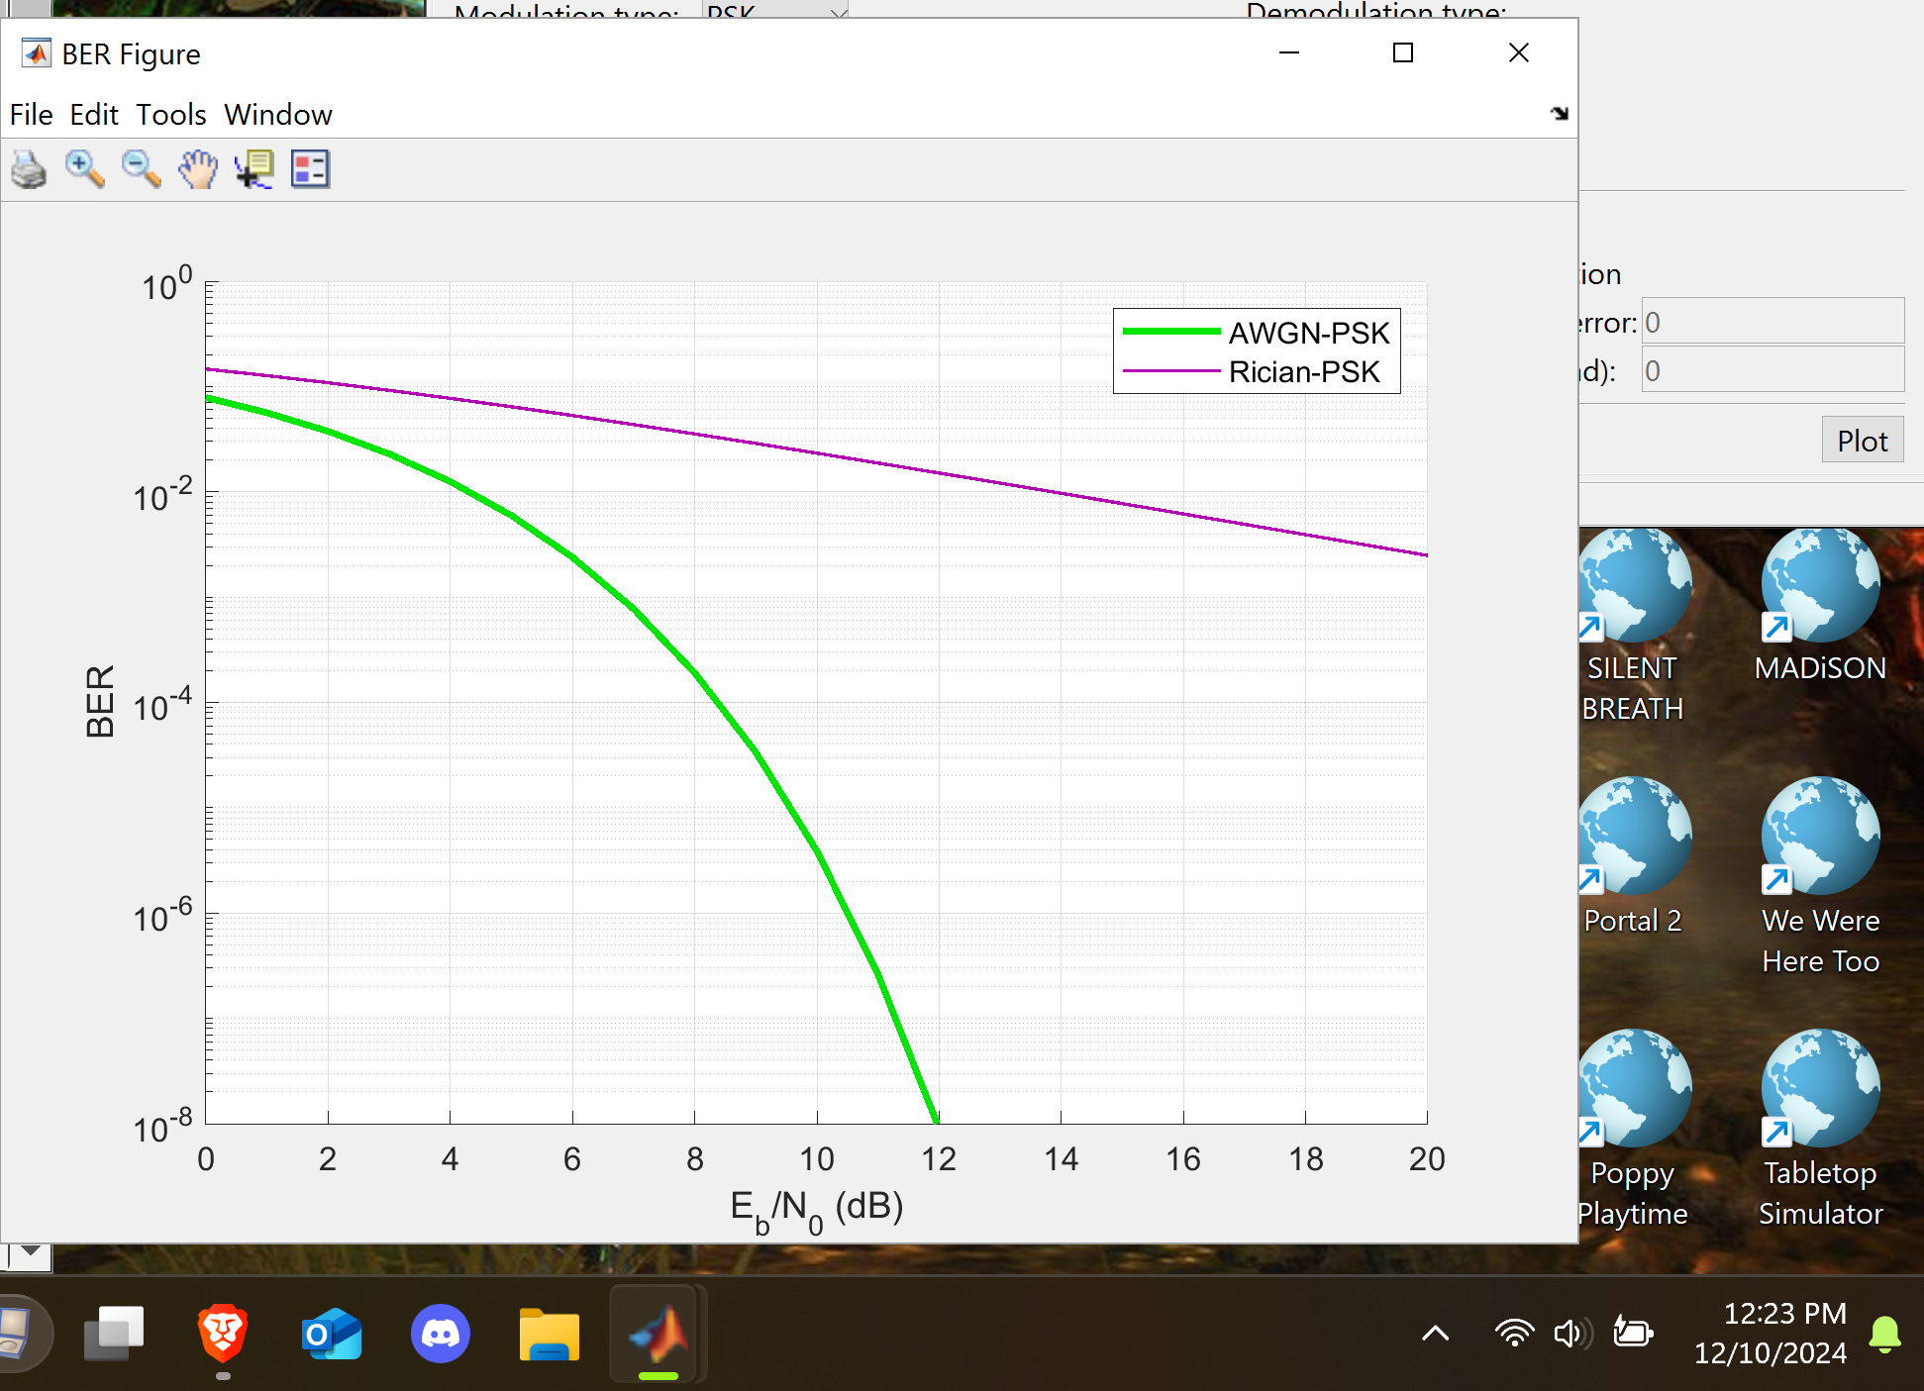
AWGN Channel and Rician Channel
This screenshot should show the bit rate error performance of both AWGN and Rician fading channels.

Slide 21
AWGN Channel and Rician Channel
Compare and contrast the BER performance of PSK over a noise limited (AWGN) transmission channel to the performance of PSK over a Rician channel at 5- and 10-dB Signal to Noise Ratio (E_{b}/N₀), respectively.
Is there a significant difference in BER performance of PSK between the AWGN channel and Rician channel?
Answer:
At a low dB their will be a noticeable difference between the two channels, their will be higher error rate between them. Rician will have a higher error rate. At 10dB the difference isn’t as bad but there is still a higher error rate then that of the AWGN channel.

Slide 22
Challenges
Biggest challenged I faced was doing some of the calculations involved with figuring out the ranges and frequency of some of the signals. But, overall I enjoyed going through these and learning more about communication signals.

Slide 23
Career Skills
Frequency equations
Determination during difficult situations
Knowing more about different communication methods.

Slide 24
Conclusion
Communication as involved very rapidly since Tesla invented wireless communication. With all the improvements and discoveries it’s important we know how to properly implement it and know what to do doing outages.

Slide 25
References:
https://www.allaboutcircuits.com/technical-articles/understanding-digital-oscilloscope-sample-rate-analog-bandwidth
https://producerhive.com/ask-the-hive/sample-rate-bit-depth-explained/
https://www.geeksforgeeks.org/difference-between-unipolar-polar-and-bipolar-line-coding-schemes/
https://www.truecable.com/blogs/cable-academy/why-are-wires-twisted-inside-an-ethernet-cable
https://www.truecable.com/blogs/cable-academy/running-ethernet-and-power-cable
https://www.waveform.com/a/b/guides/plenum-cable-why-and-when
http://www.swisswireless.org/wlan_calc_en.html

Slide 26
References cont’:
https://www.everythingrf.com/rf-calculators/free-space-path-loss-calculator
https://antenna-theory.com/basics/gain.php
https://www.mathworks.com/help/comm/ug/fading-channels.html
https://wirelesspi.com/additive-white-gaussian-noise-awgn/

