Slide 1
CEIS101 Course Project
Smart Home Automation and Security System
Presented by:
Mitchell Woodworth

Slide 2
Introduction
Develop a smart home automation and security system by:
designing the prototype in Tinkercad
building the hardware with Tech Core Kit
programming with Arduino IDE
The smart home system will encompass various devices to monitor the condition of the home. The door sensor checks whether the door is open or closed. The distance sensor monitors for possible home intruder. The automated lights will turn on when the room is dark.

Slide 3
Circuit Simulation in Tinkercad

Slide 4

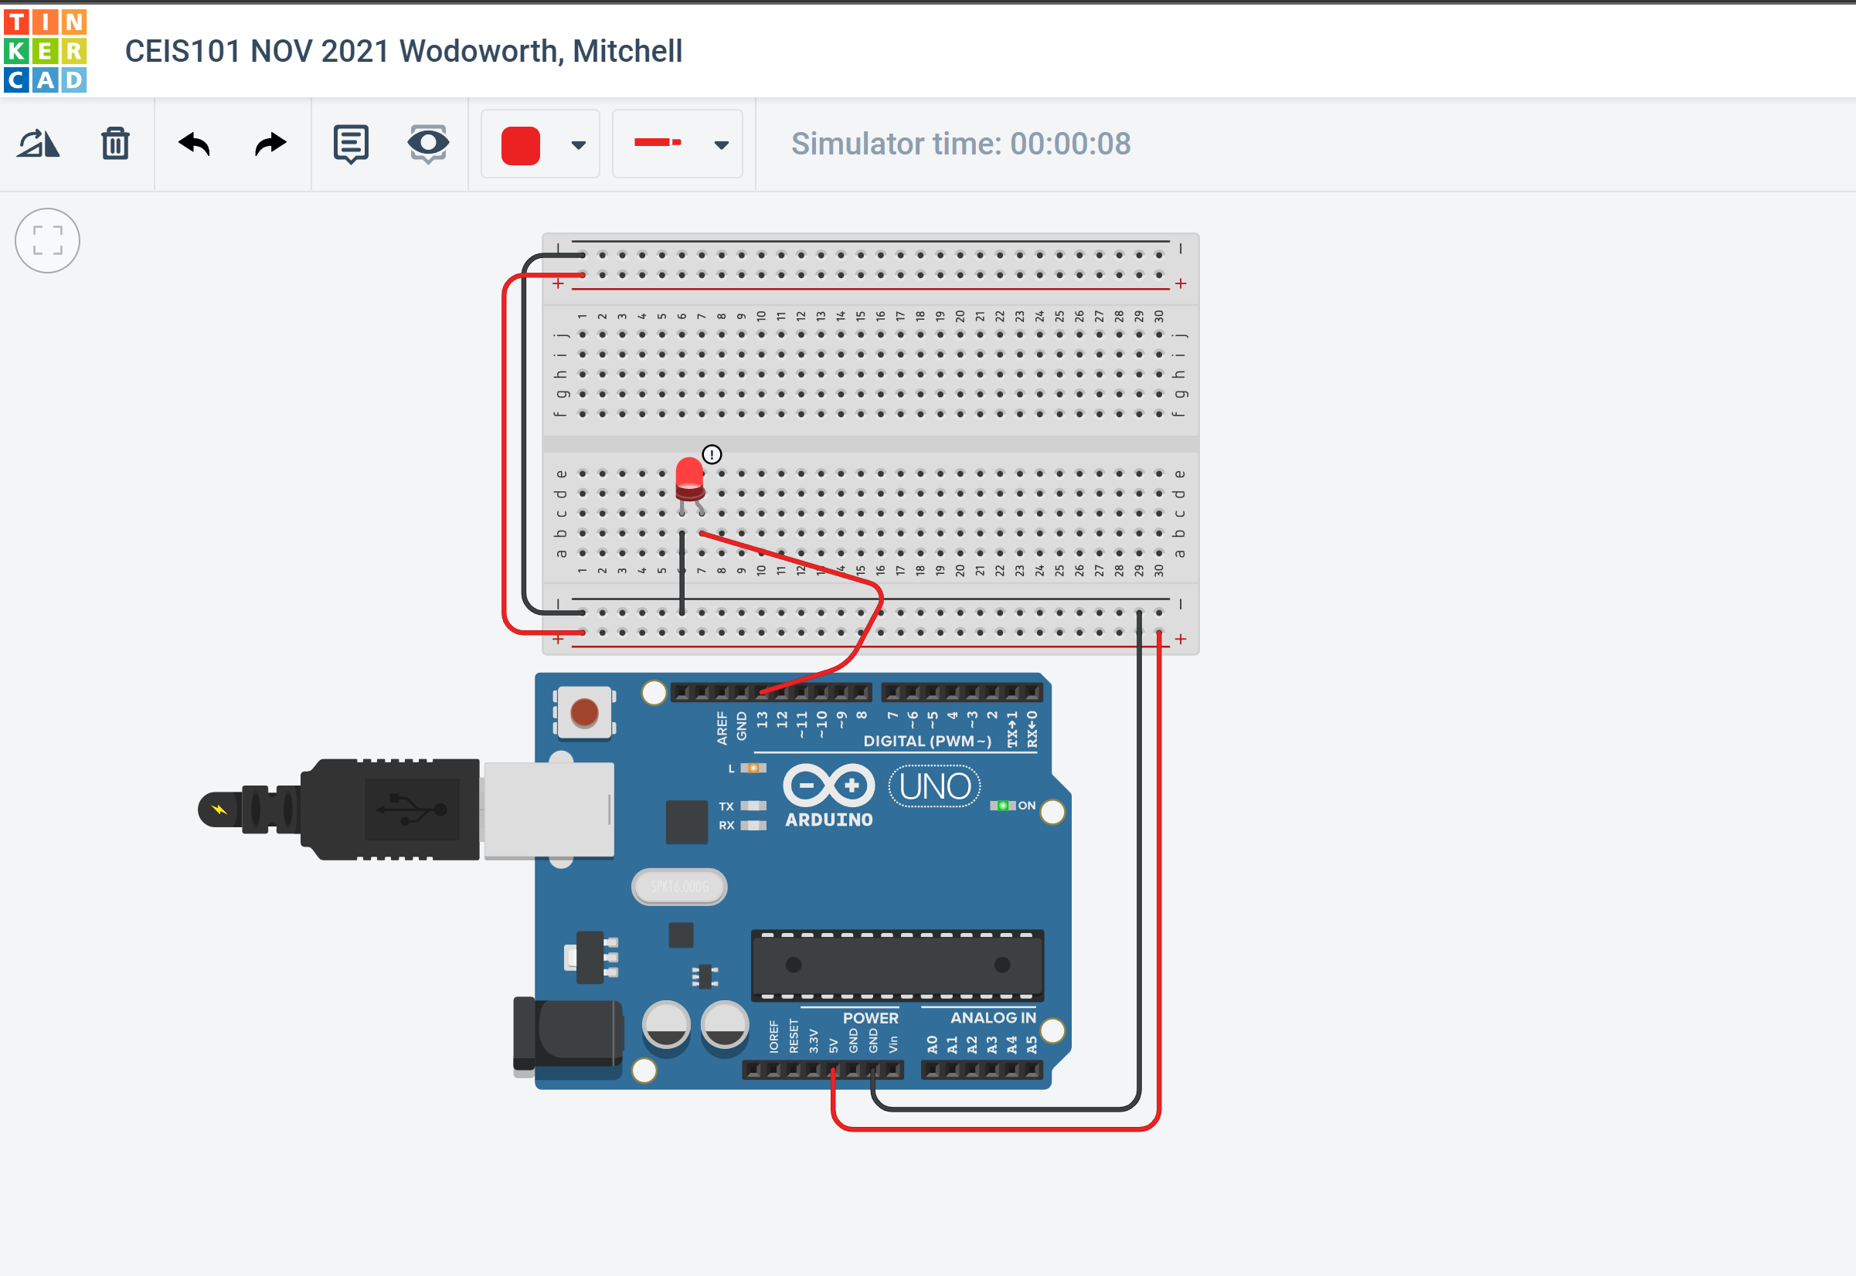
Circuit

Slide 5
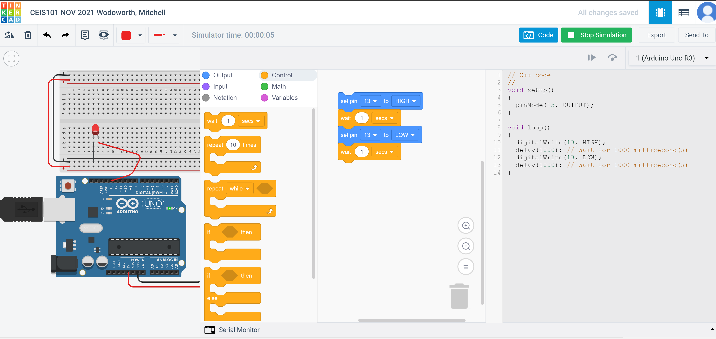
Code

Slide 6
Inventory of Parts, Circuit Building, and Displaying Messages

Slide 7
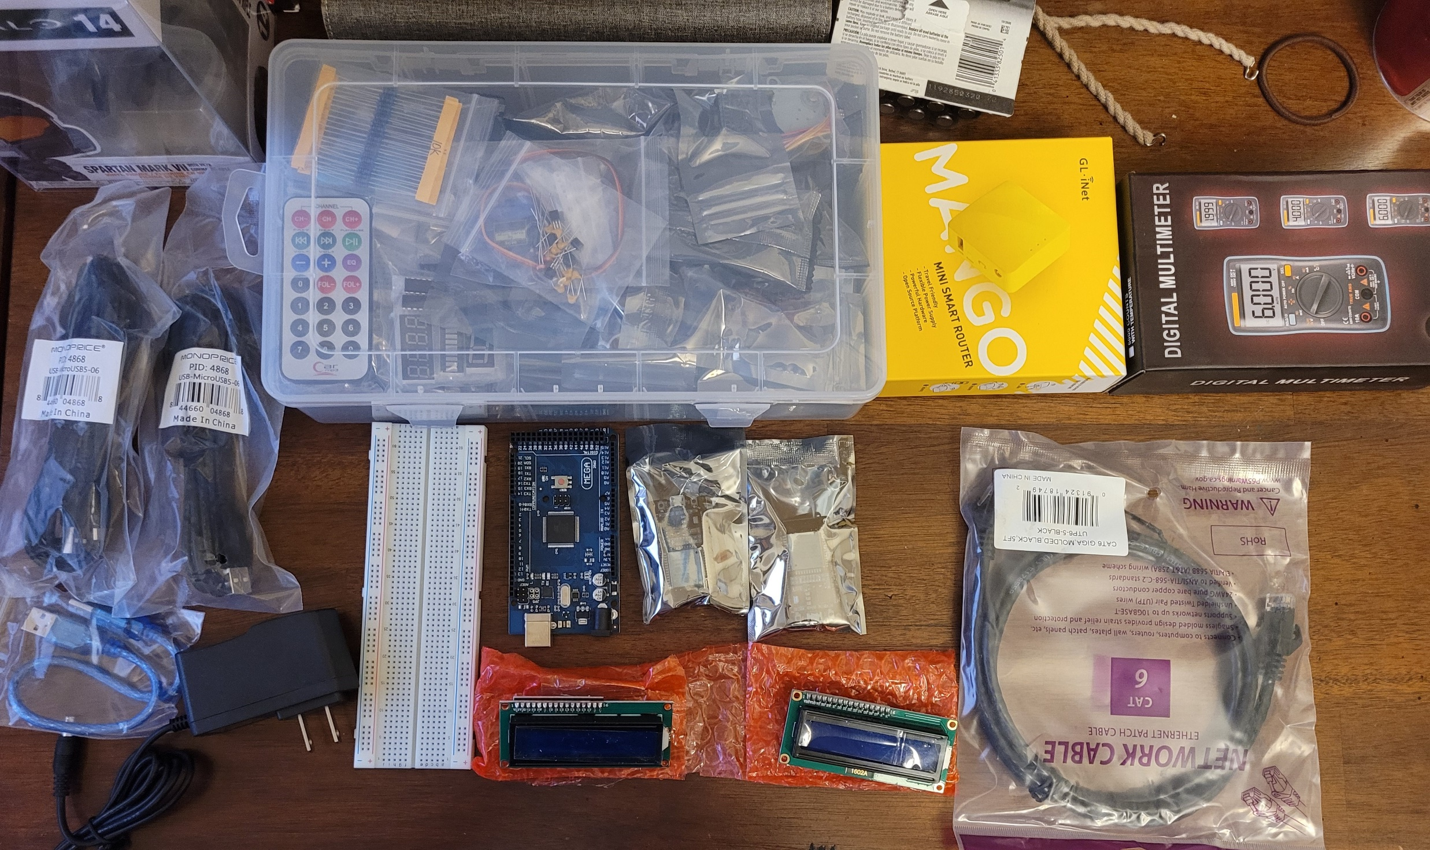
Inventory of IoT Kit
UCTRONICS Kit
ESP32 (2)
LCD Modules (2)
Breadboards (3)
Mini Router
Patch Cable
Digital Multi Meter
USB to Micro USB (2)

Slide 8
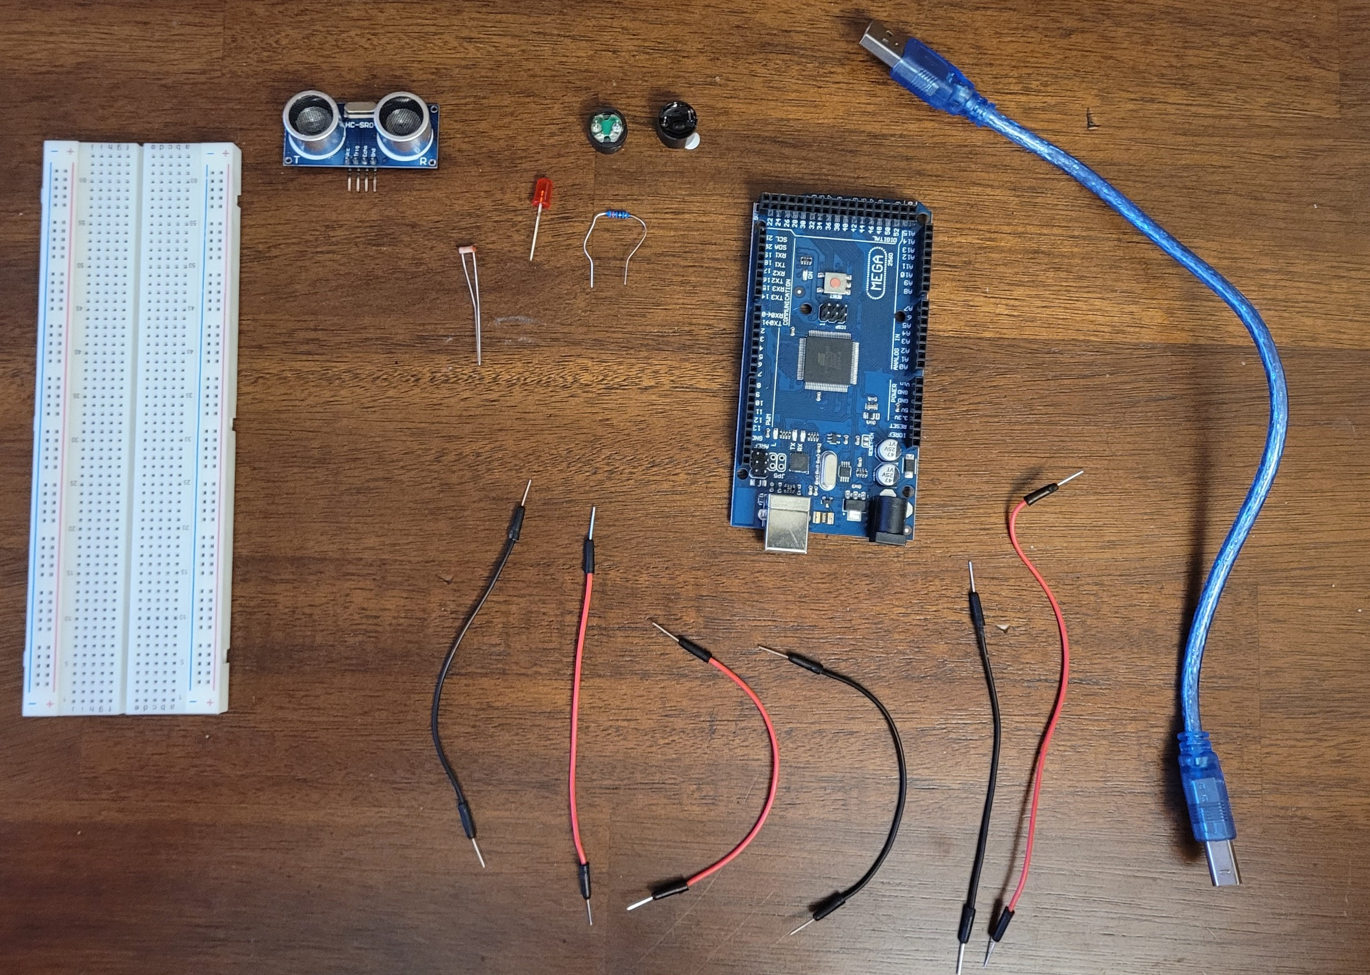
Organization of Project Components
Arduino Mega 2560
Breadboard
Resistor 10kΩ
LEDs
Ultrasonic Sensor
Active Buzzer
Photoresistor
Wires
USB Type B cable

Slide 9
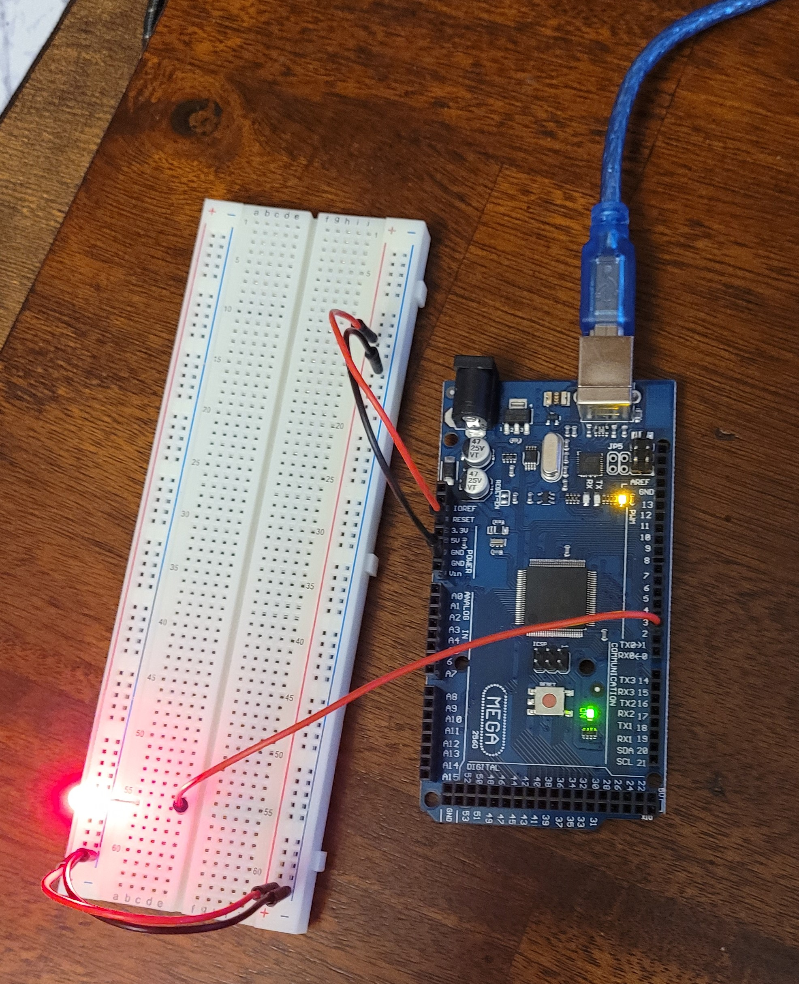
Circuit with red LED on

Slide 10
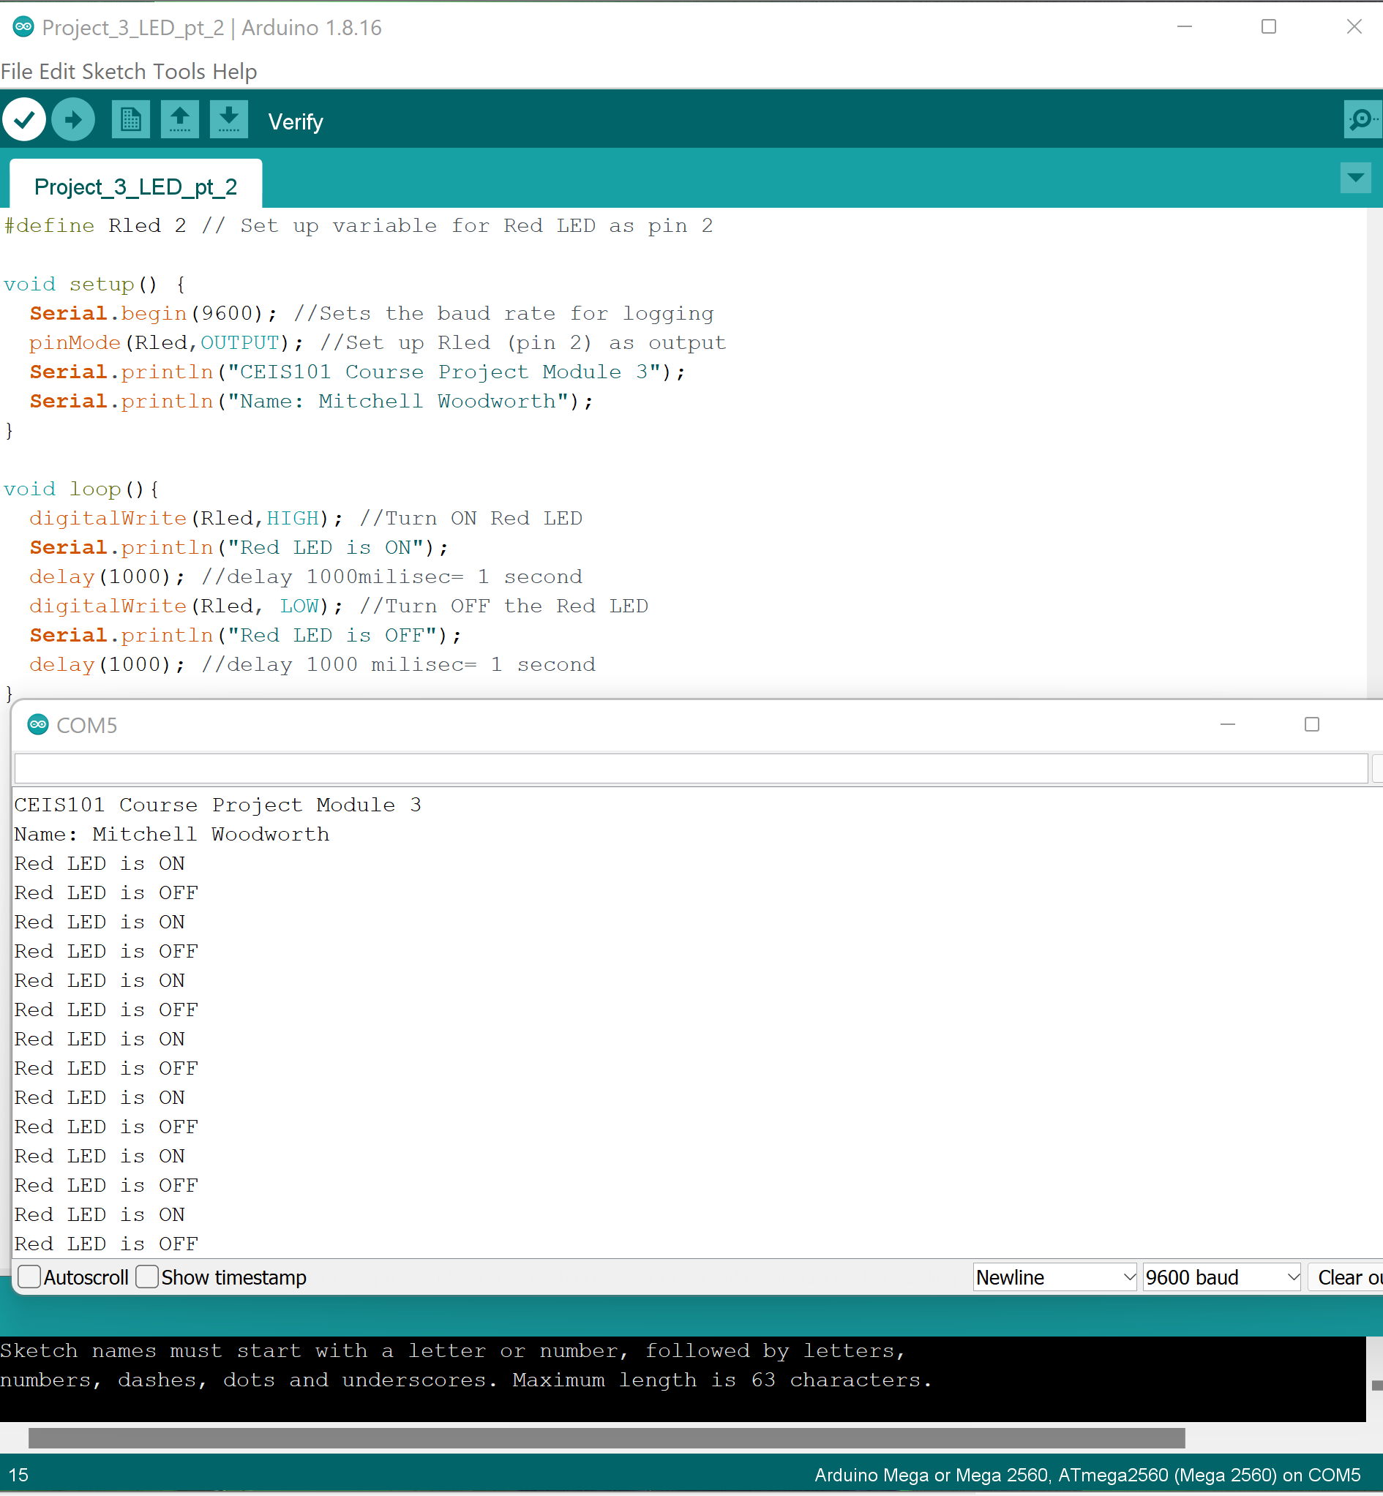
Serial Monitor

Slide 11
Adding Door Sensor to Smart Home System

Slide 12
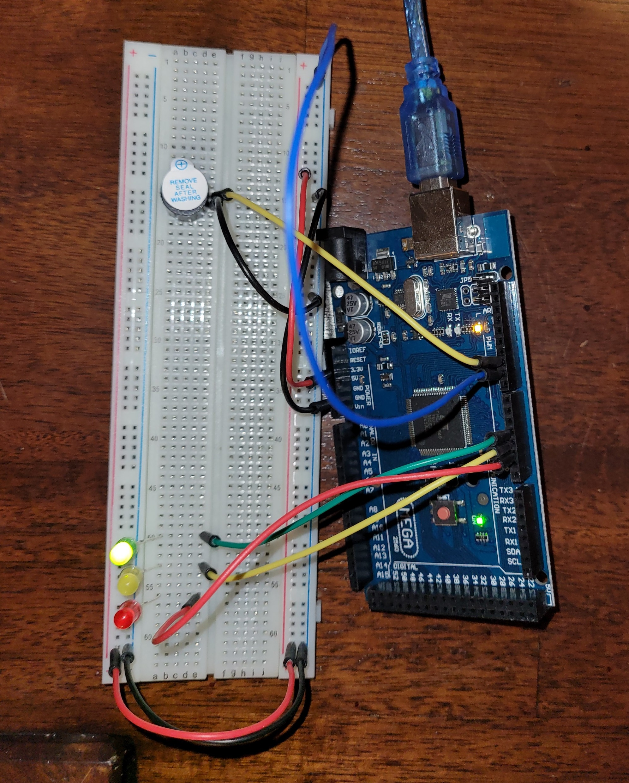
Circuit of door closed with Green LED ON

Slide 13
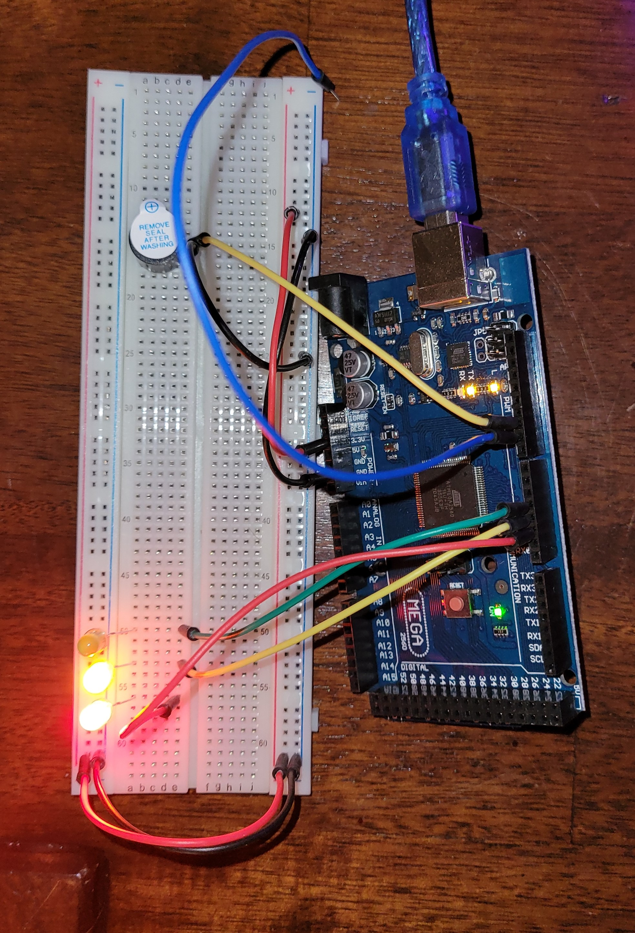
Circuit of door open with Green LED OFF

Slide 14
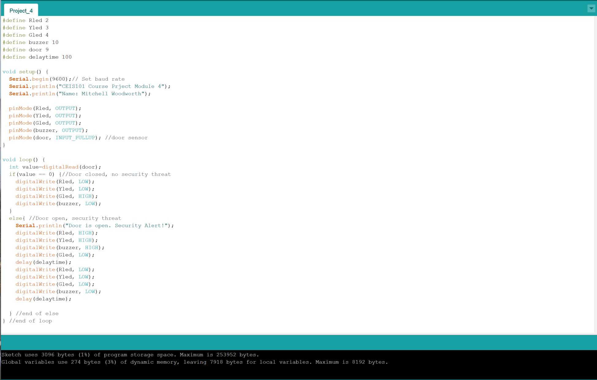
Arduino Code

Slide 15
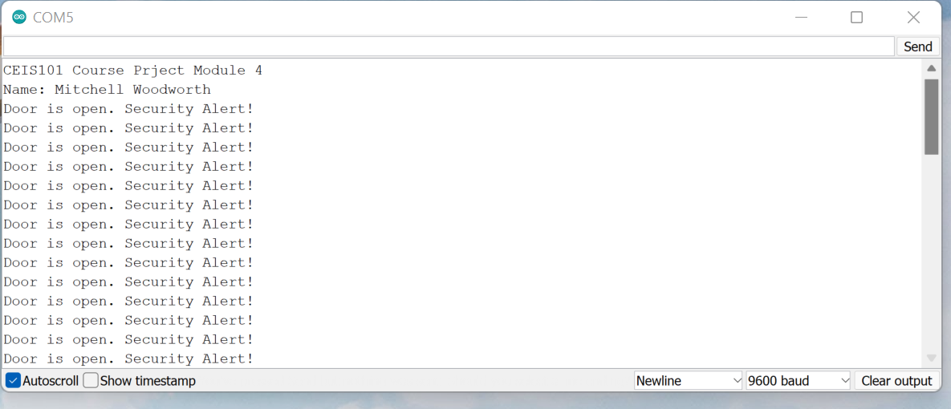
Serial Monitor

Slide 16
Adding Distance Sensor to Smart Home System and Conducting Data Analysis

Slide 17
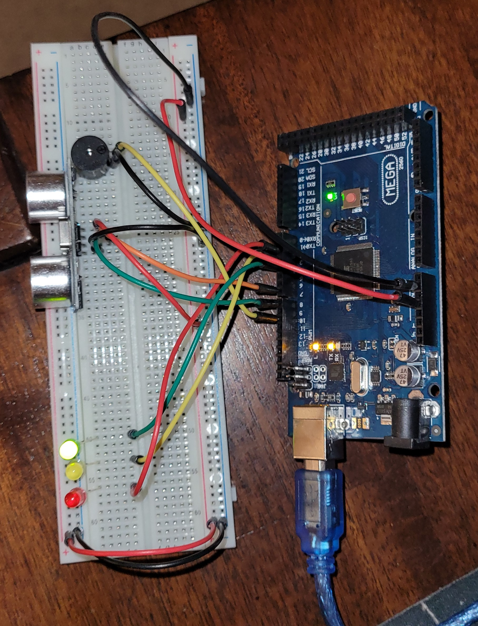
Circuit with green LED on

Slide 18
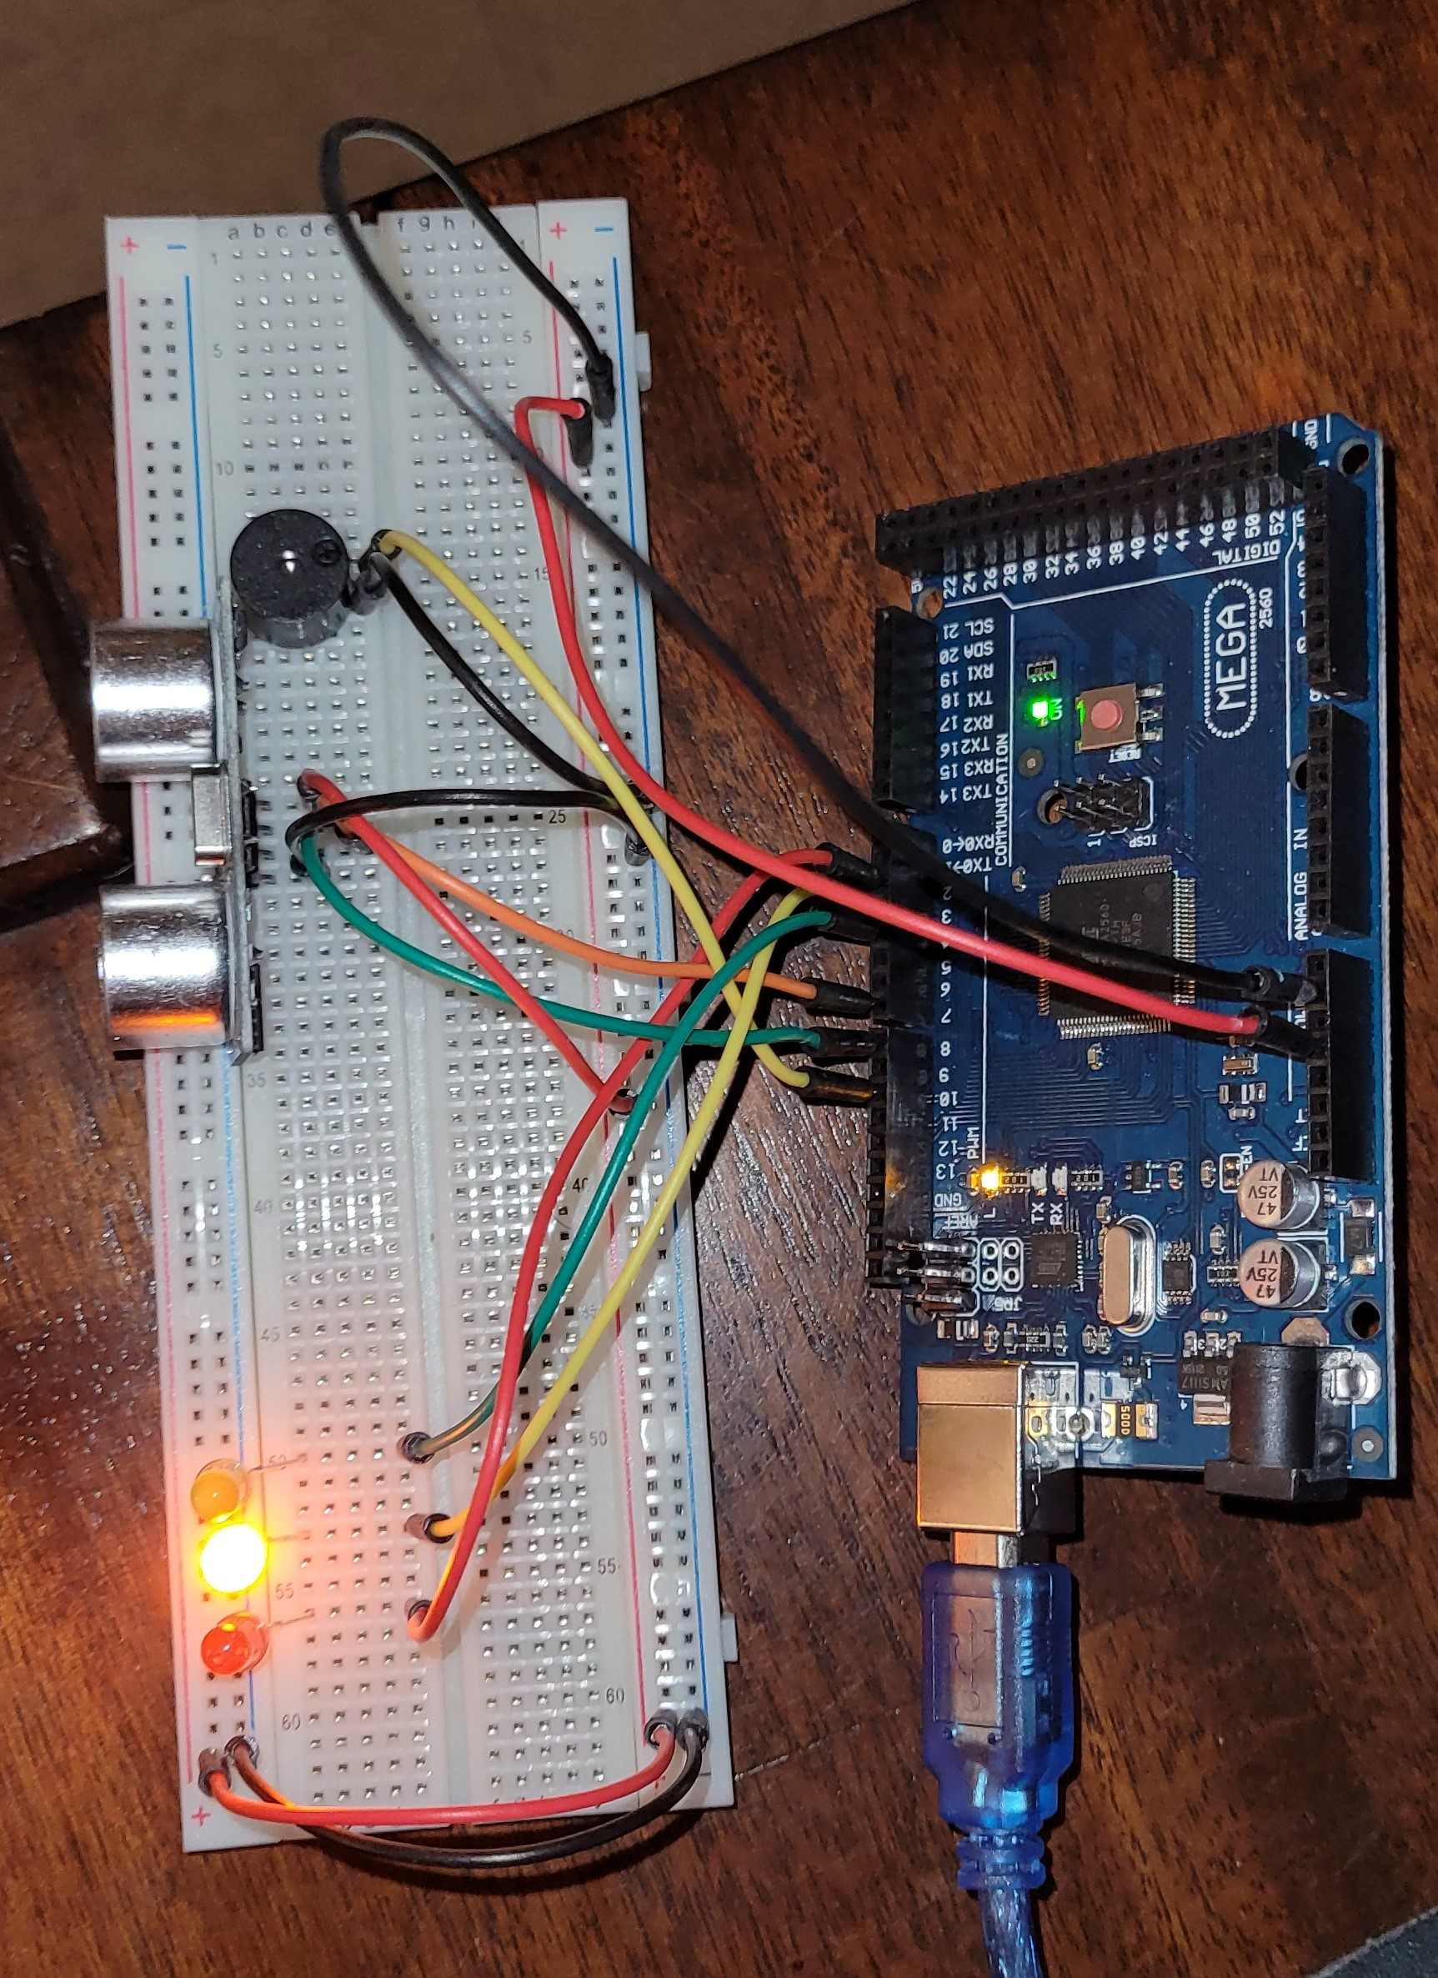
Circuit with yellow LED on

Slide 19
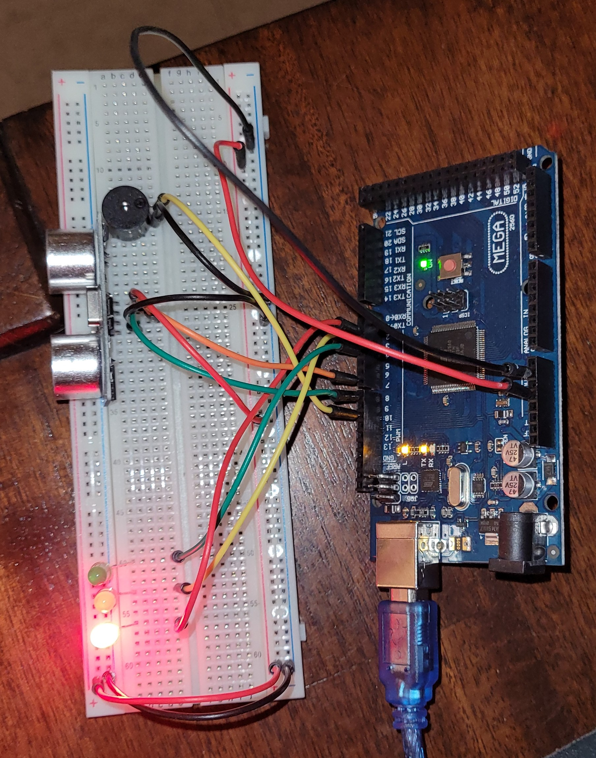
Circuit with red LED on

Slide 20
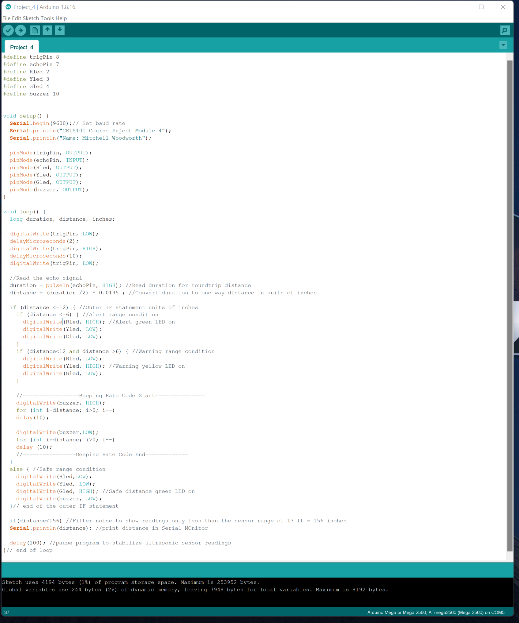
Arduino Code

Slide 21
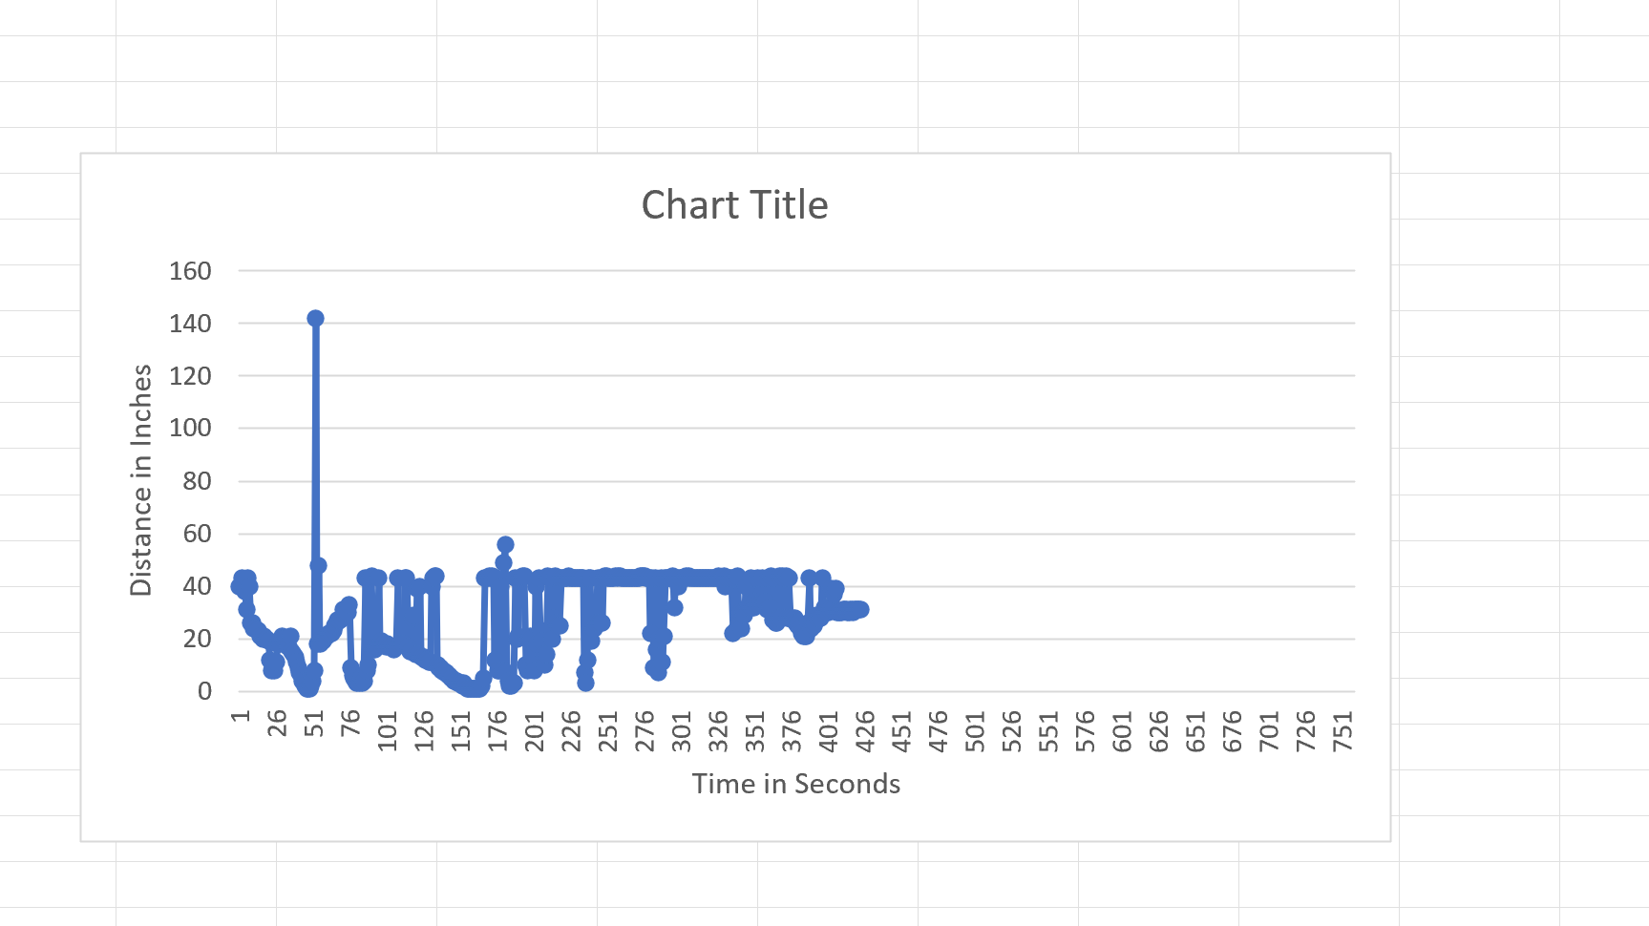
Plot of data

Slide 22
Adding Automated Light to Smart Home System

Slide 23
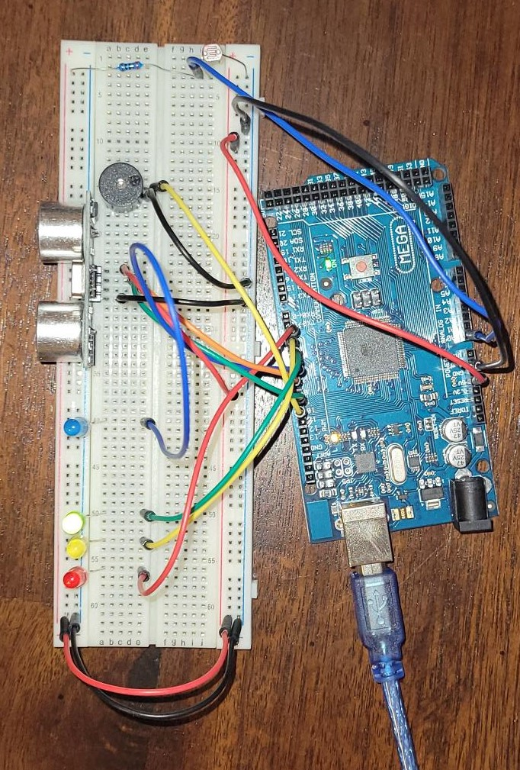
Circuit with automated LED off

Slide 24
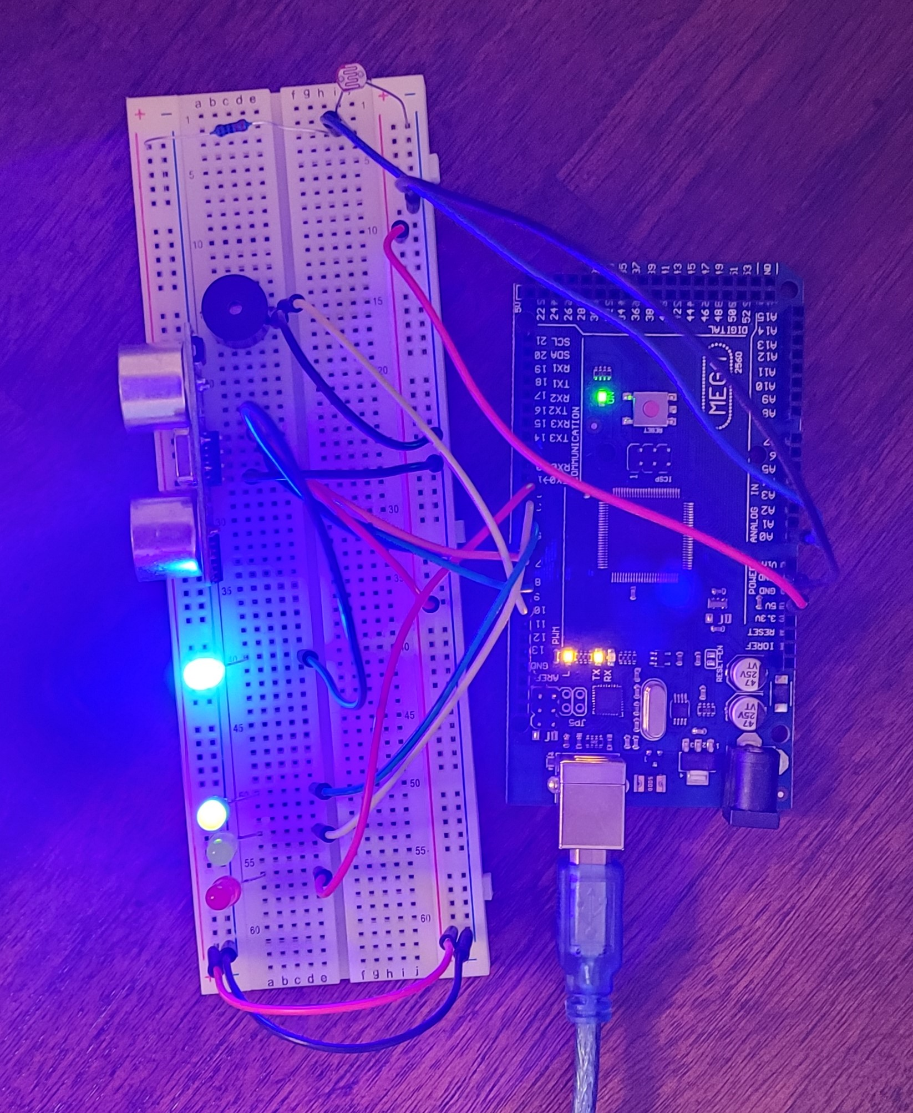
Circuit with automated LED on

Slide 25
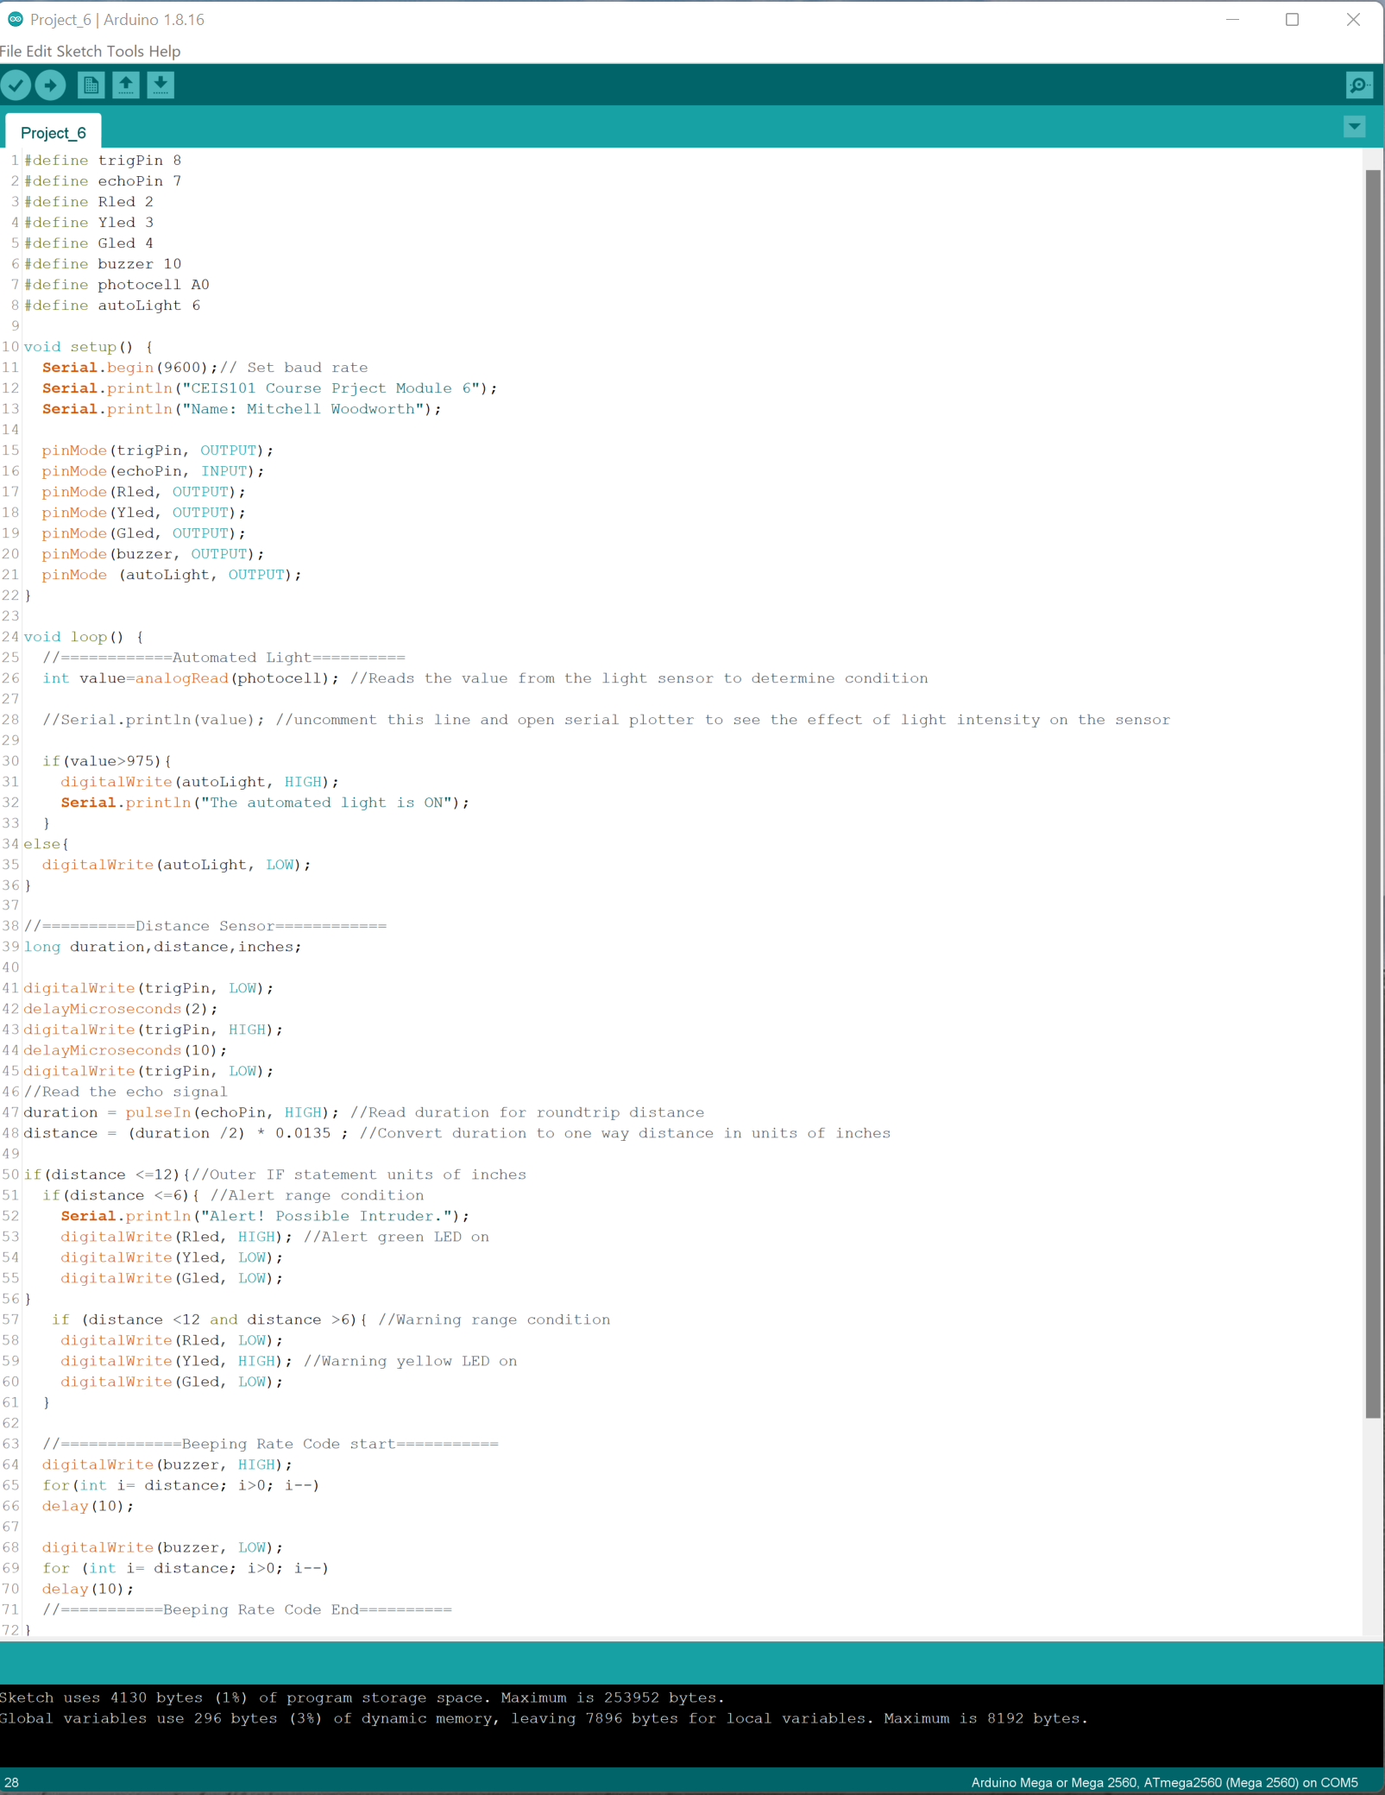
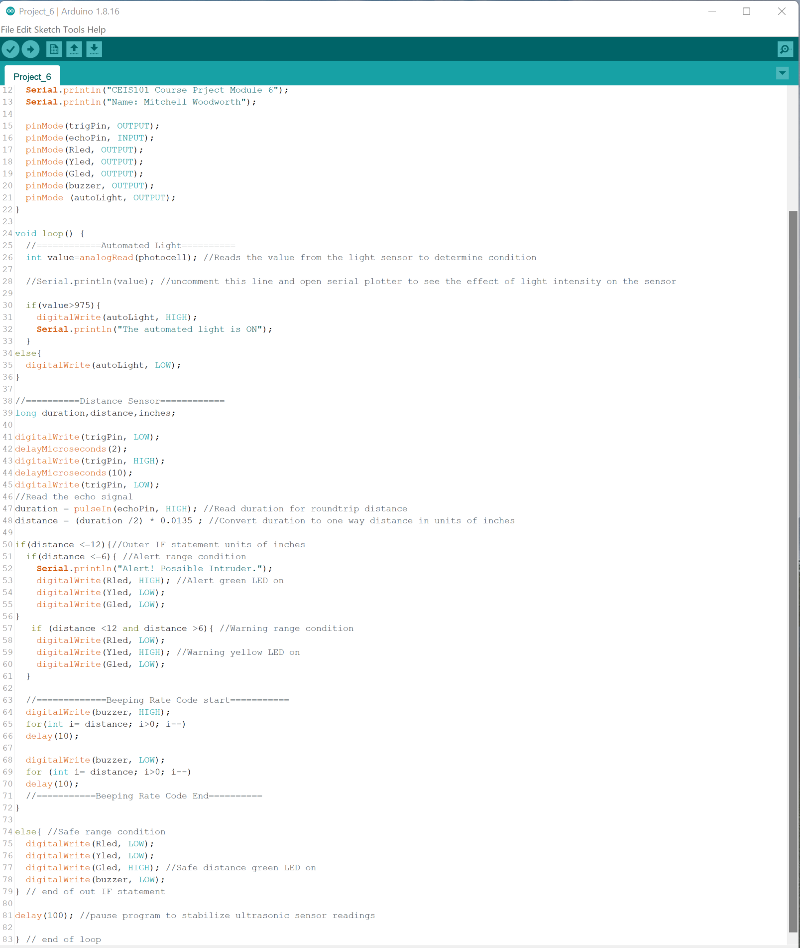
Arduino Code

Slide 26
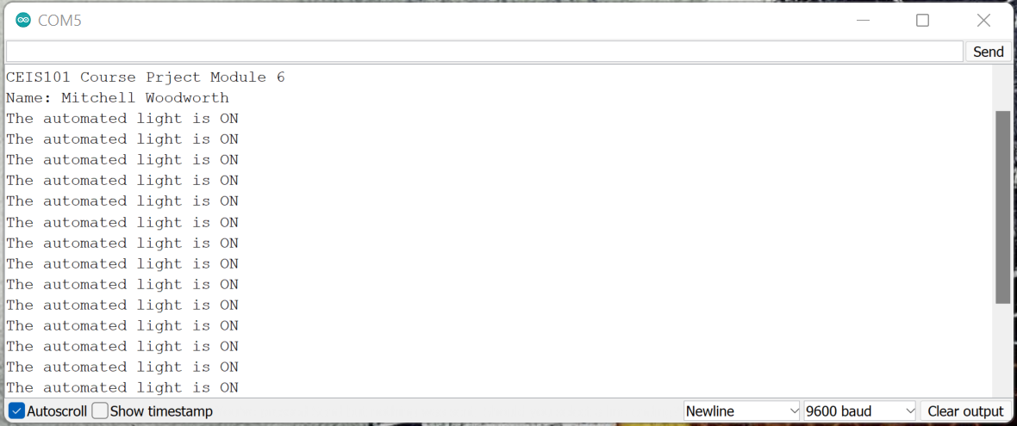
Serial Monitor

Slide 27
Challenges
Through out this projects I faced a few challenges. One major challenge I faced was not having the proper materials to make it easier to wire the nodes up without the boards being tilted up.
Another challenge is putting in the correct icons into the coding. With not having much experience in programming, I accidently press the wrong key when writing the script.

Slide 28
Career Skills Acquired
Hardware/device knowledge
Networking/connectivity ability
Coding/programming
Understanding of the IoT
Operating system fundamentals
Automation
Security awareness (at a minimum)

Slide 29
Conclusion
This projects was a great introduction to the world of IoT.
During this project we had many different nodes to attached with each one having it’s own ways was working.
I feel I got a goof basic understanding of the Arduino board as well as the ESP32 board

