Slide 1
CEIS110 Course Project
Programming with data
Presented by:
Mitchell Woodworth

Slide 2
Introduction
Data is growing exponentially
This project uses a cloud-based system to gather temperature and humidity data
The data is analyzed using programming and data analytics

Slide 3
Software Inventory
Before developing this program with data project, all software must be downloaded and installed
Software needed included SQLite, studio, Excel, and a python IDE - anaconda

Slide 4

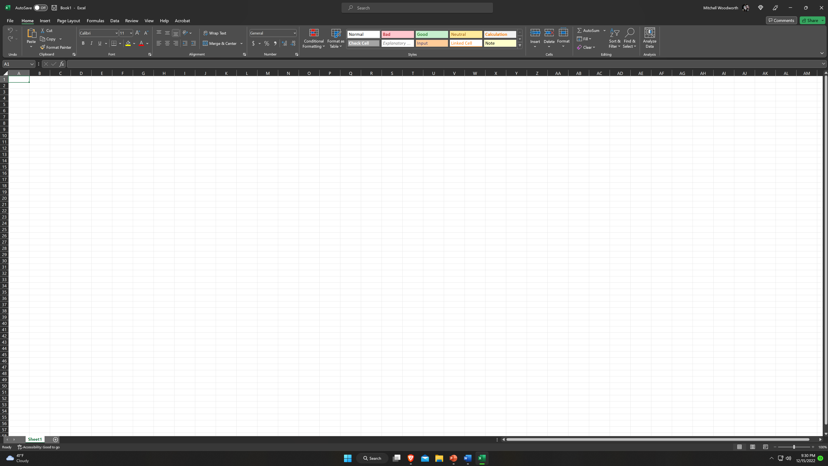
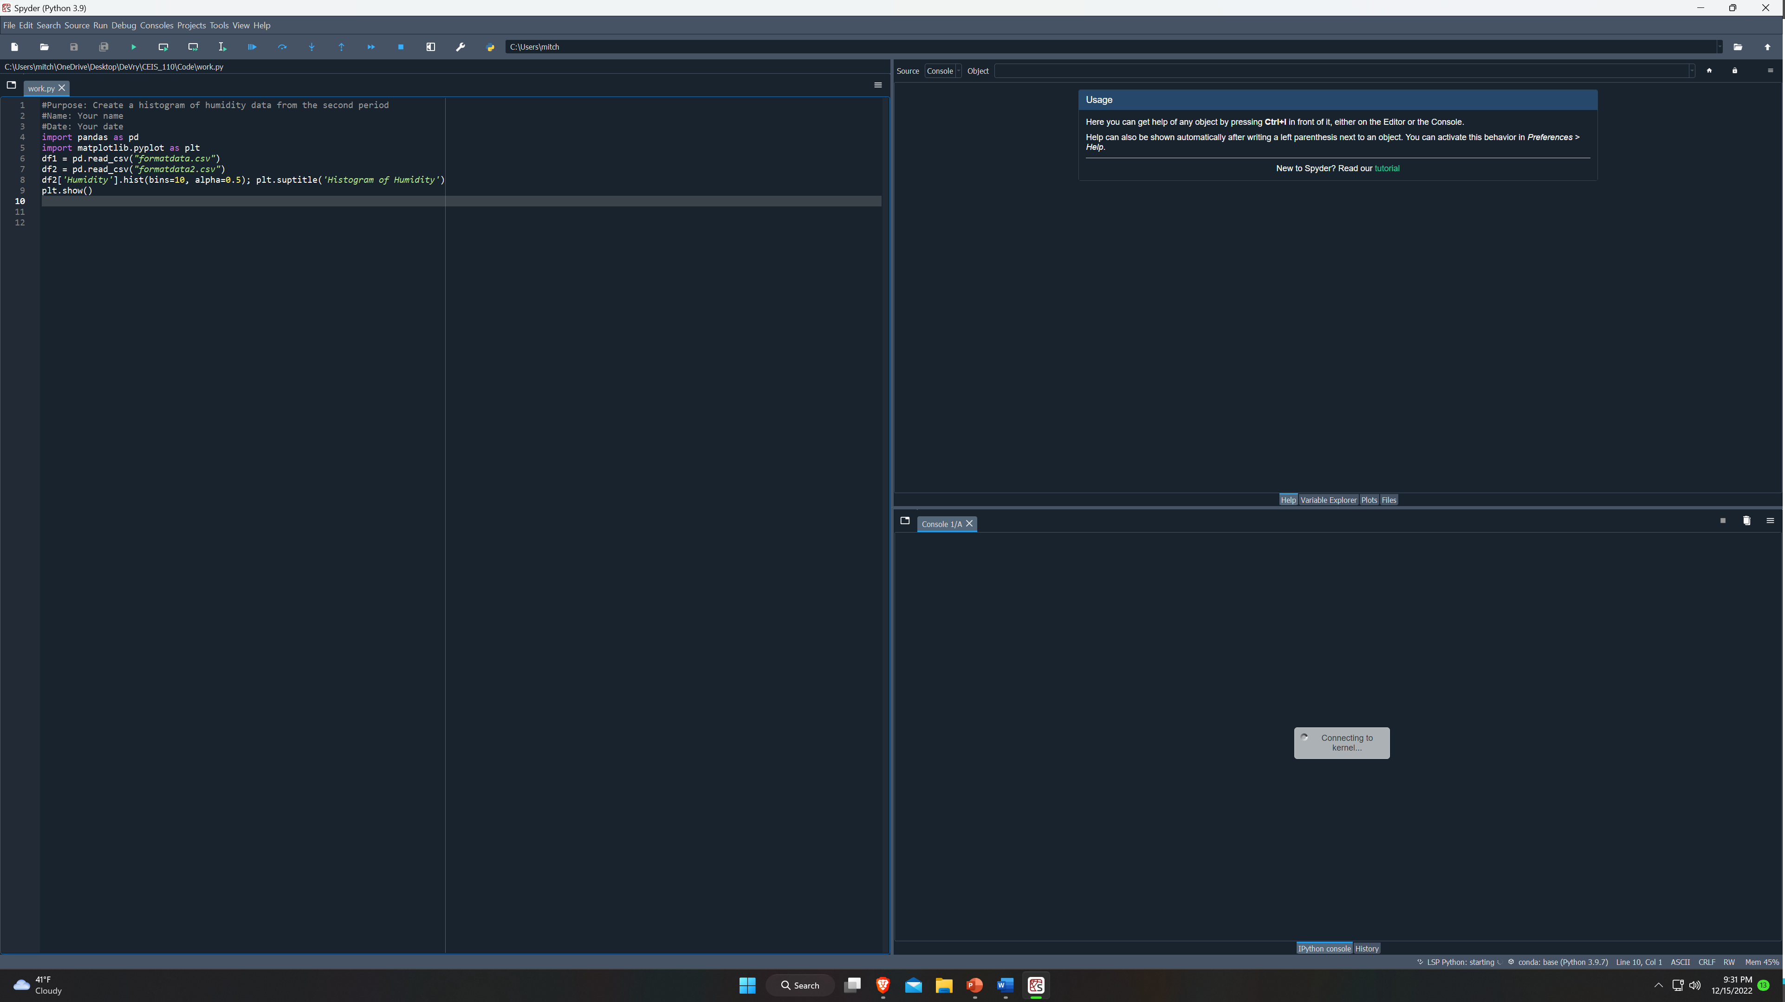
Software Inventory
Excel
Python IDE - anaconda

Slide 5
Planning and Design
After performing an inventory of the software needed for this project, a plan was created for the temperature data project
To Plan the design of this project, a flowchart was created

Slide 6
What are Flowcharts?
Flow charts are graphical representations of processes or workflows, and the flowchart developed illustrates the process and the output of this software development project.
Many companies use flowcharts as simple narratives

Slide 7
Flowchart
Start
Install Python module
Download weather data to database
Install python
Download weather data to the database
Extract weather data from database into a comma separated file with python
Cleanse weather data
Use Excel to manipulate data
Use python data analytics modules to develop graphical models
Extract weather data from database int csv file
Cleanse weather data
Use Excel to manipulate data
Use python data analytics module to develop graphical models
Stop

Slide 8
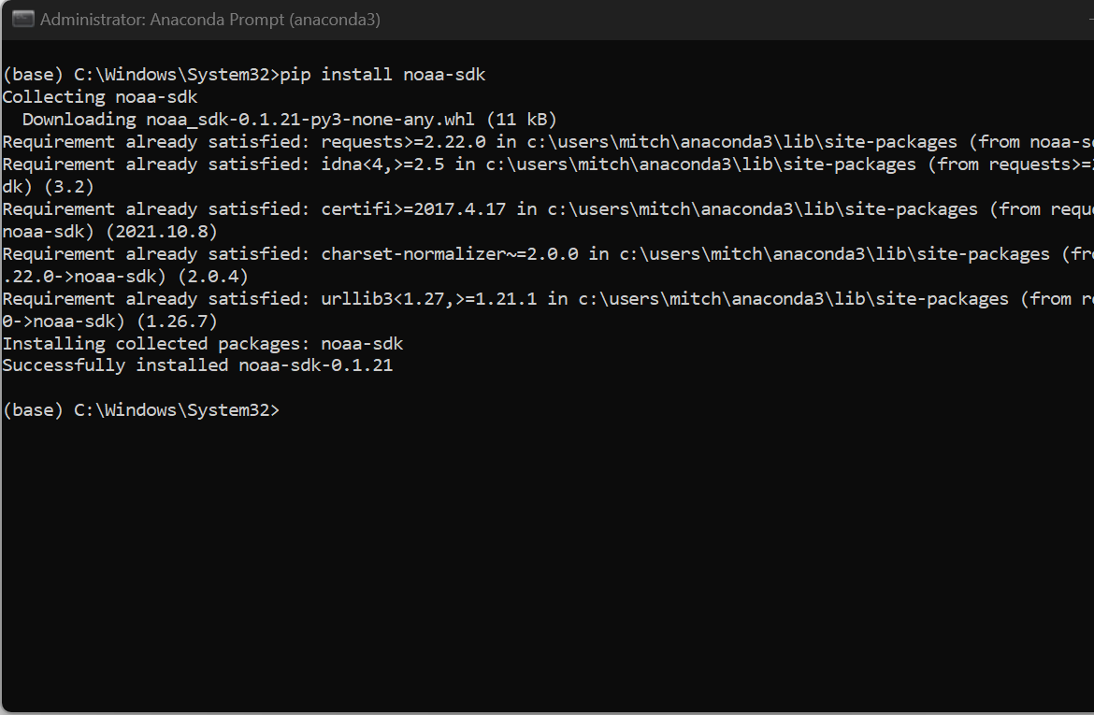
Adding the Library
In order for python to connect to the US government National Oceanic and Atmospheric Administration (NOOA) weather data service using cloud-based Application Programming Interface (API), a library module must be installed to use this service.
The screenshot show the NOAA-SDK library installed

Slide 9

Downloading Weather Data

Slide 10
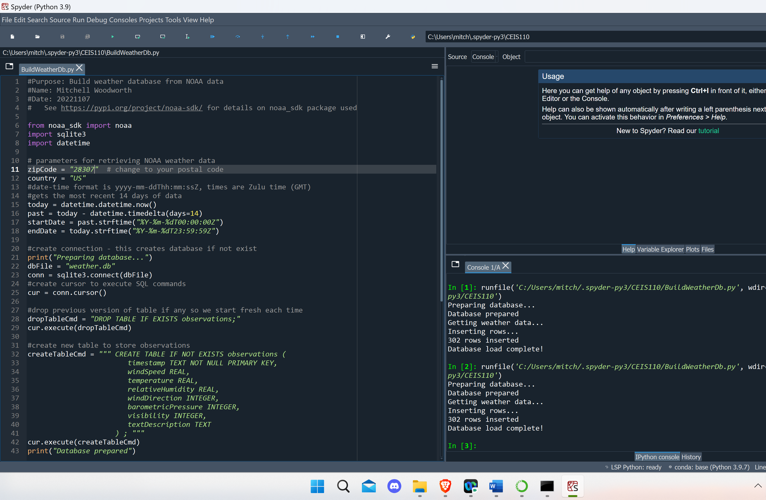
BuildWeatherDb.py Code
Screenshot of code in Spyder

Slide 11
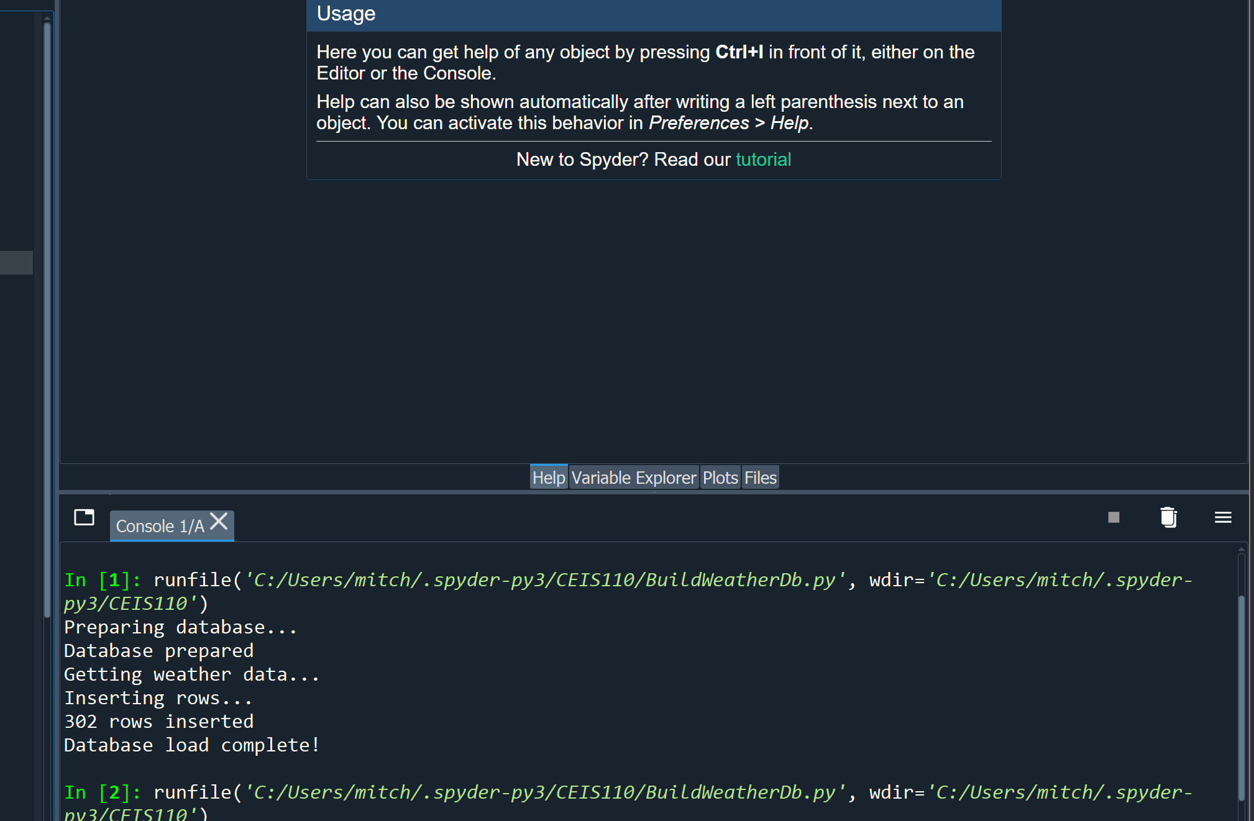
Python Console
Screenshot of program output in Python console showing program executed successfully

Slide 12
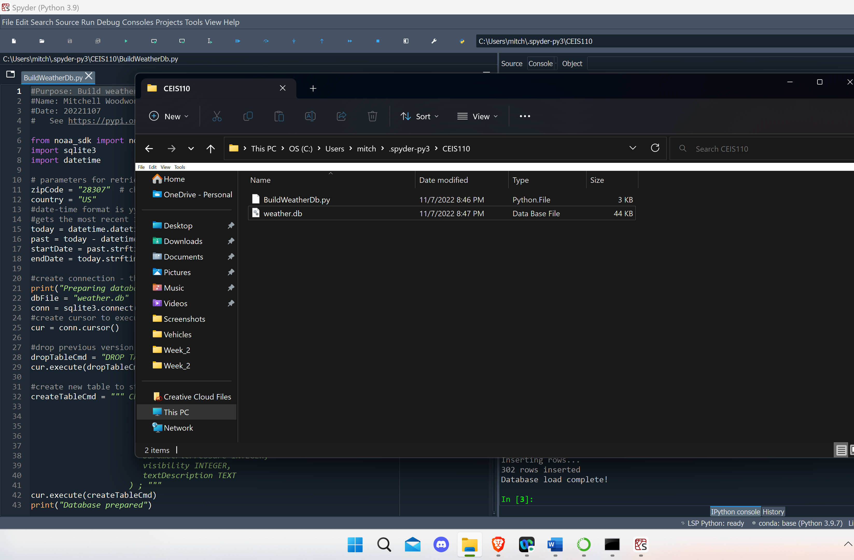
Weather.db File
Screenshot of Windows Explorer showing database file Weather.db was created

Slide 13

Querying the database with SQL

Slide 14
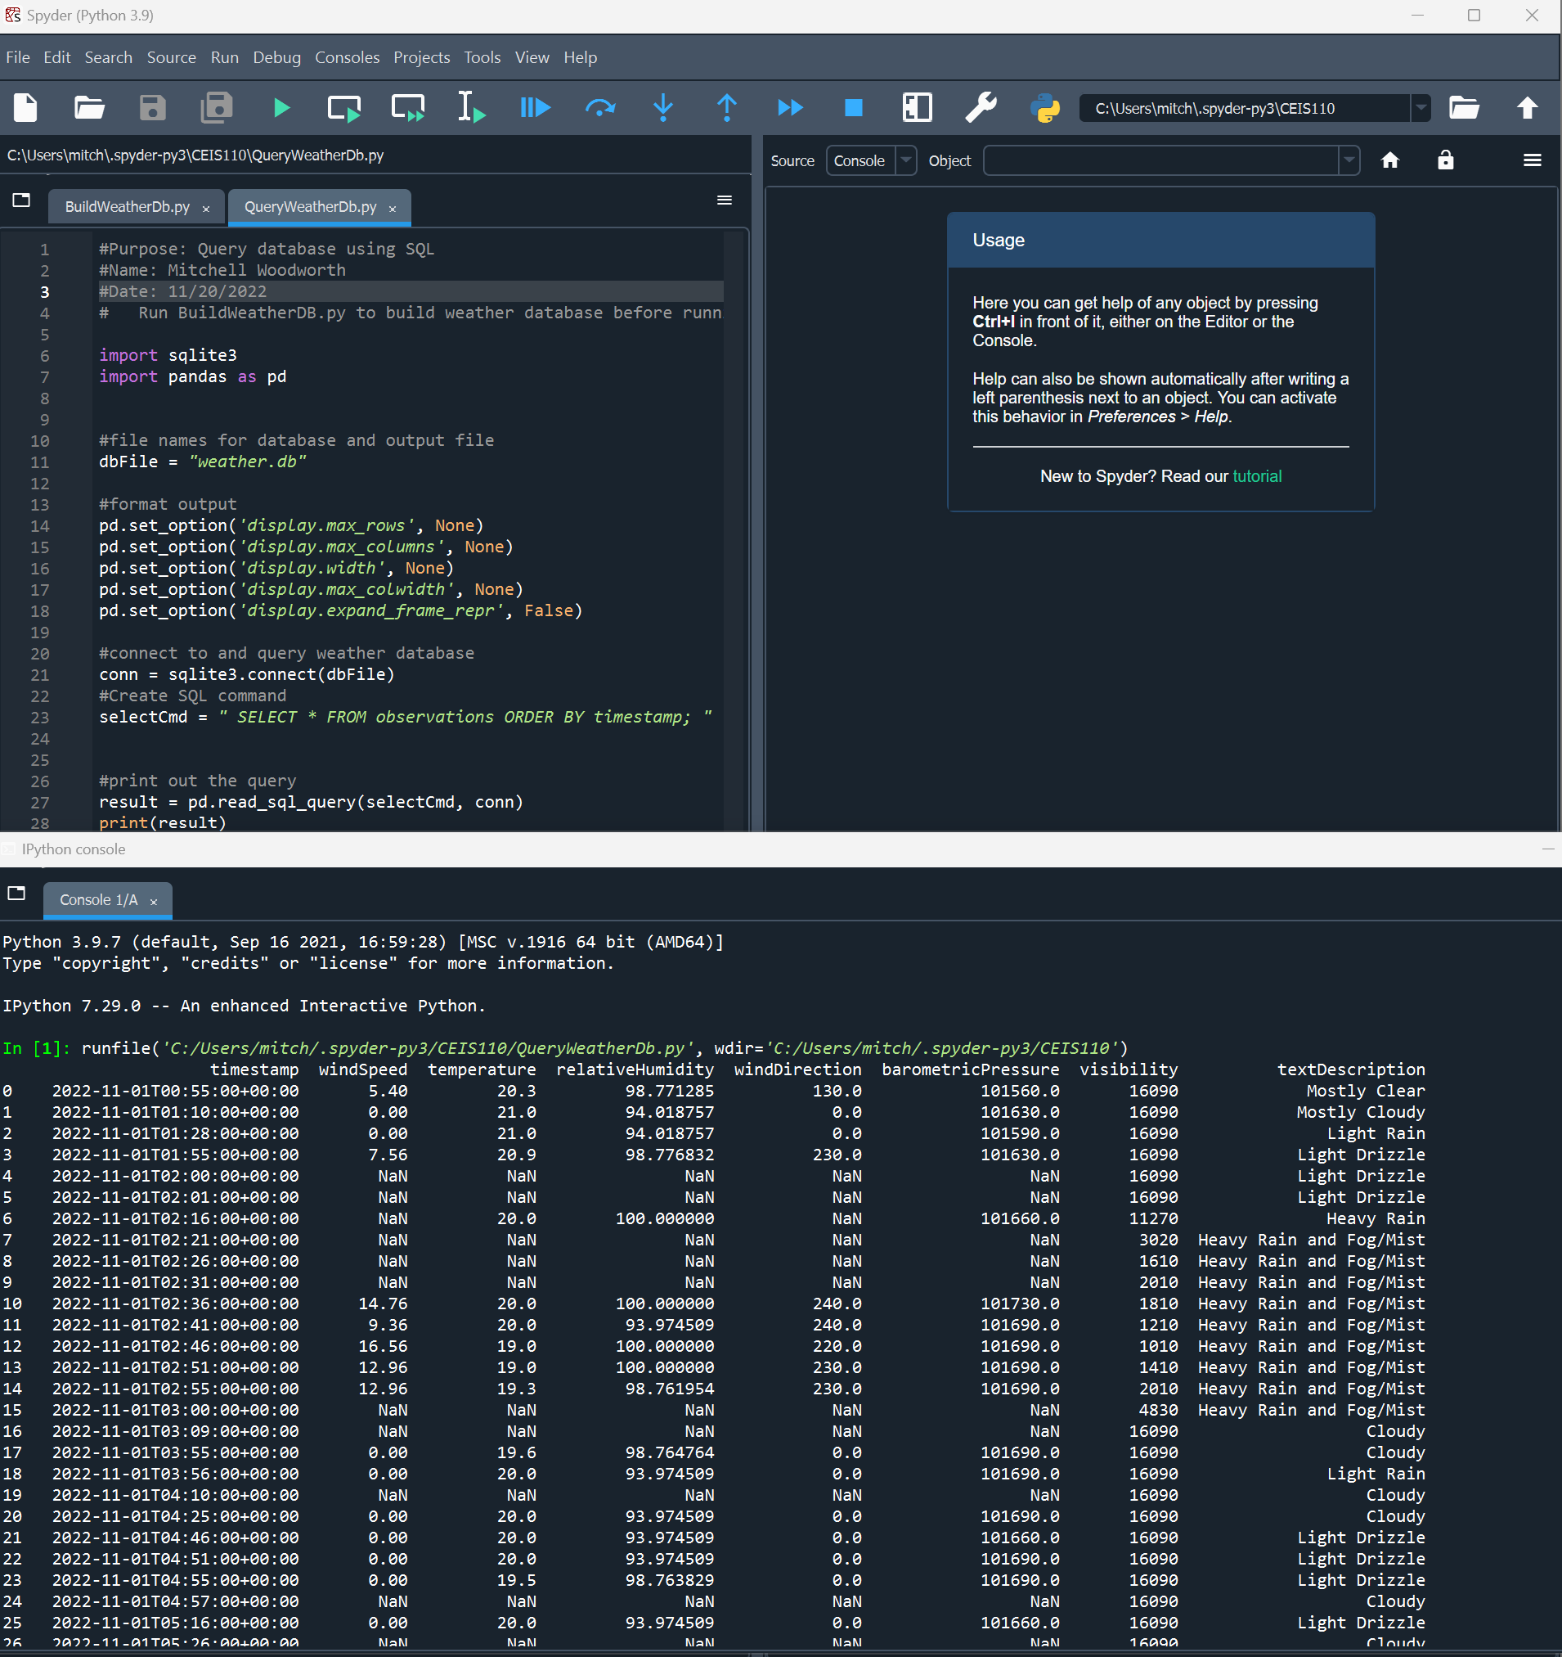
Query to retrieve all columns and all rows

Slide 15
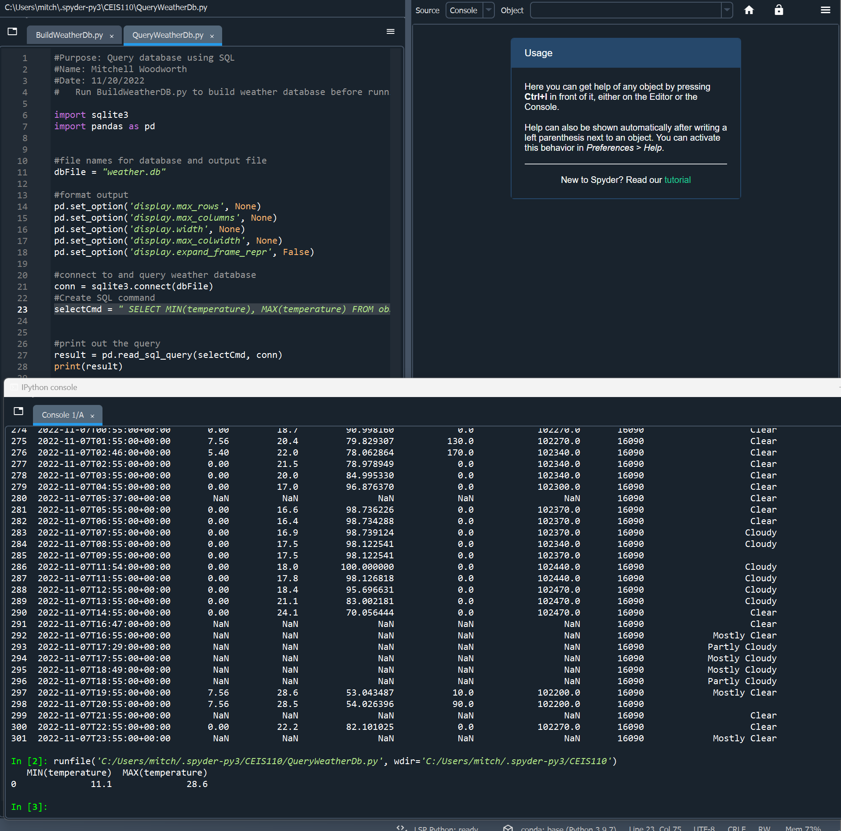
Query to retrieve lowest and highest temperatures

Slide 16
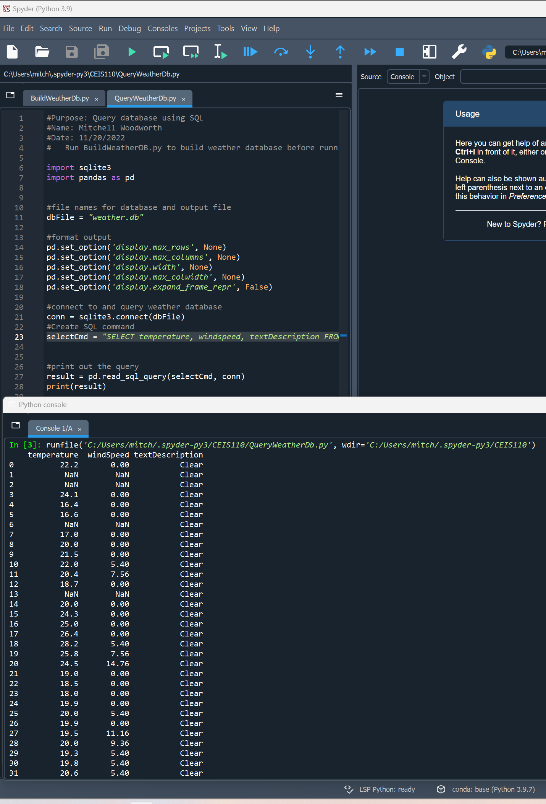
Query to retrieve all clear days

Slide 17
Querying and manipulating data with SQL and Python

Slide 18
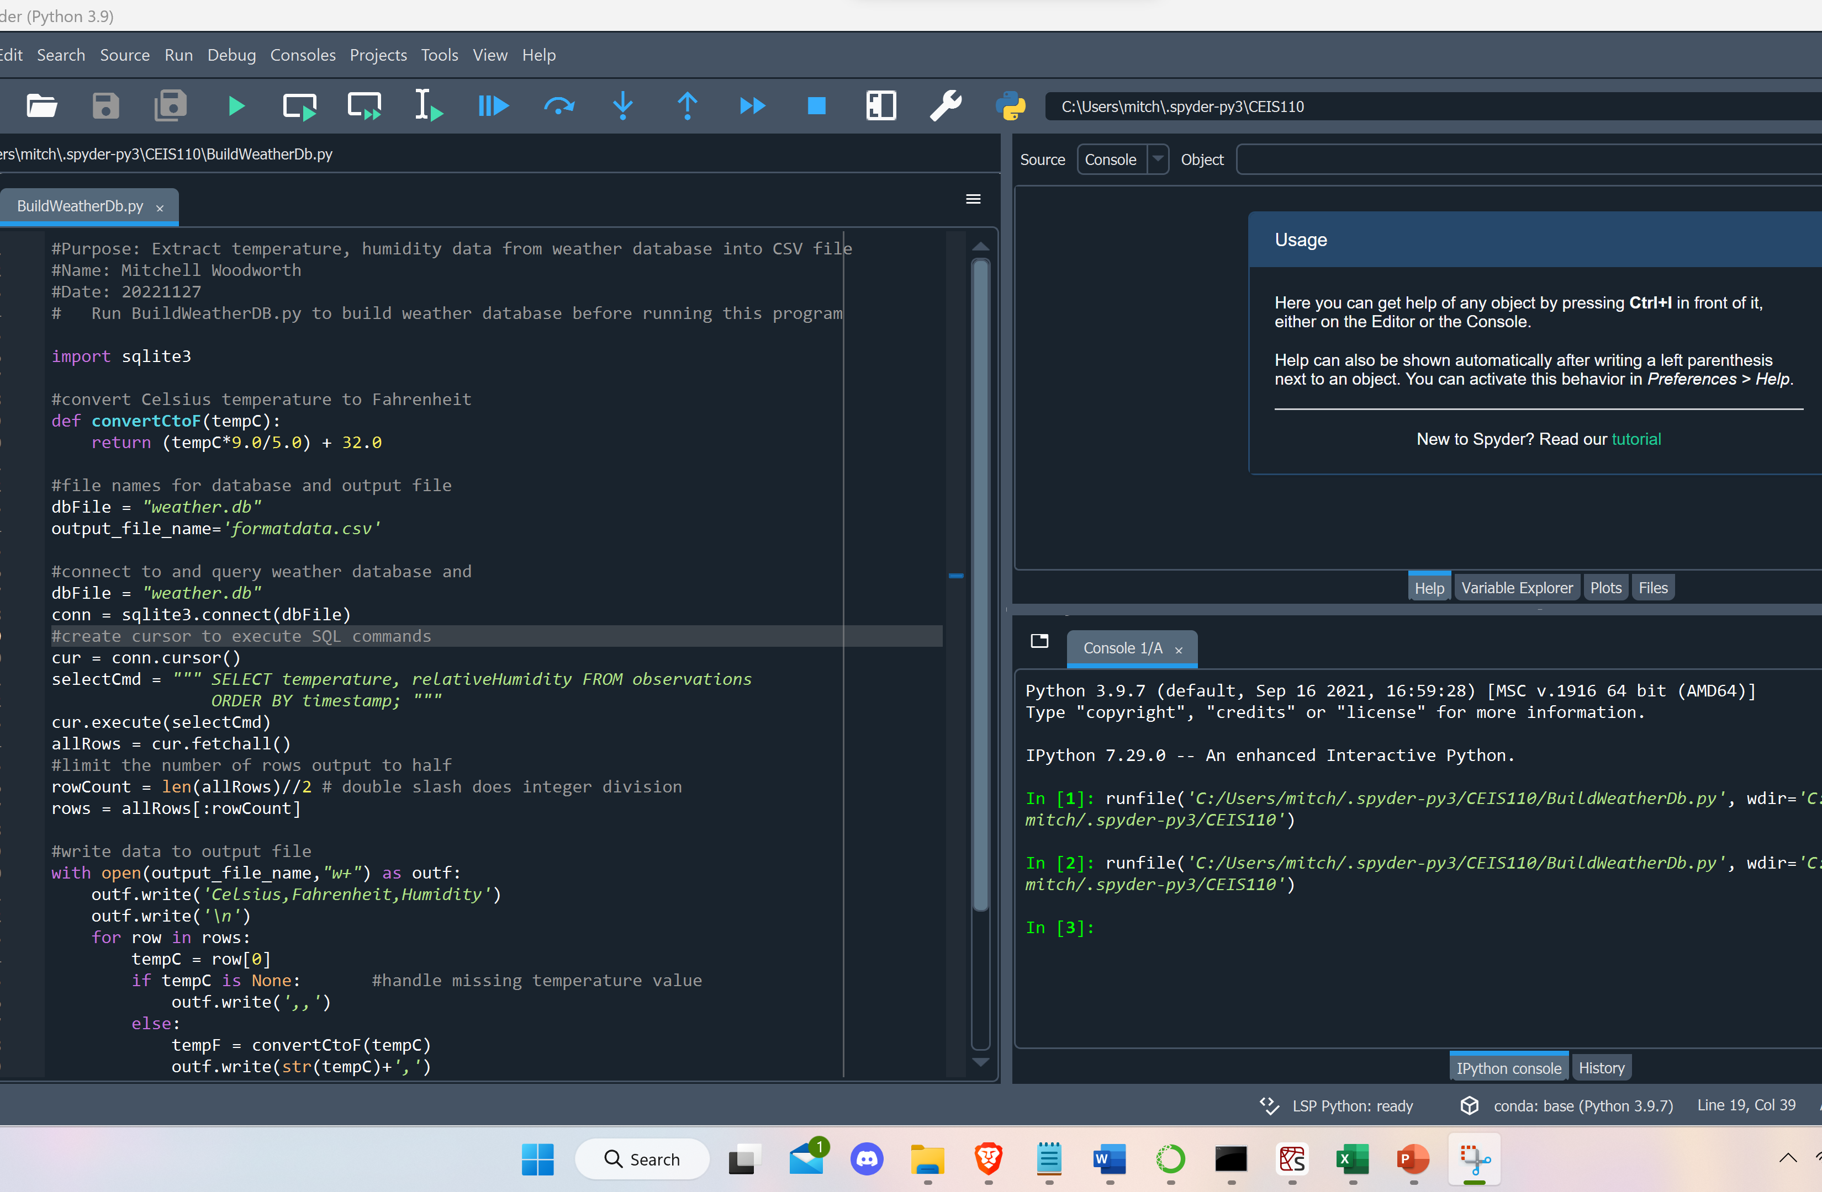
Python code
ExtractTempHumidity.py Python code

Slide 19
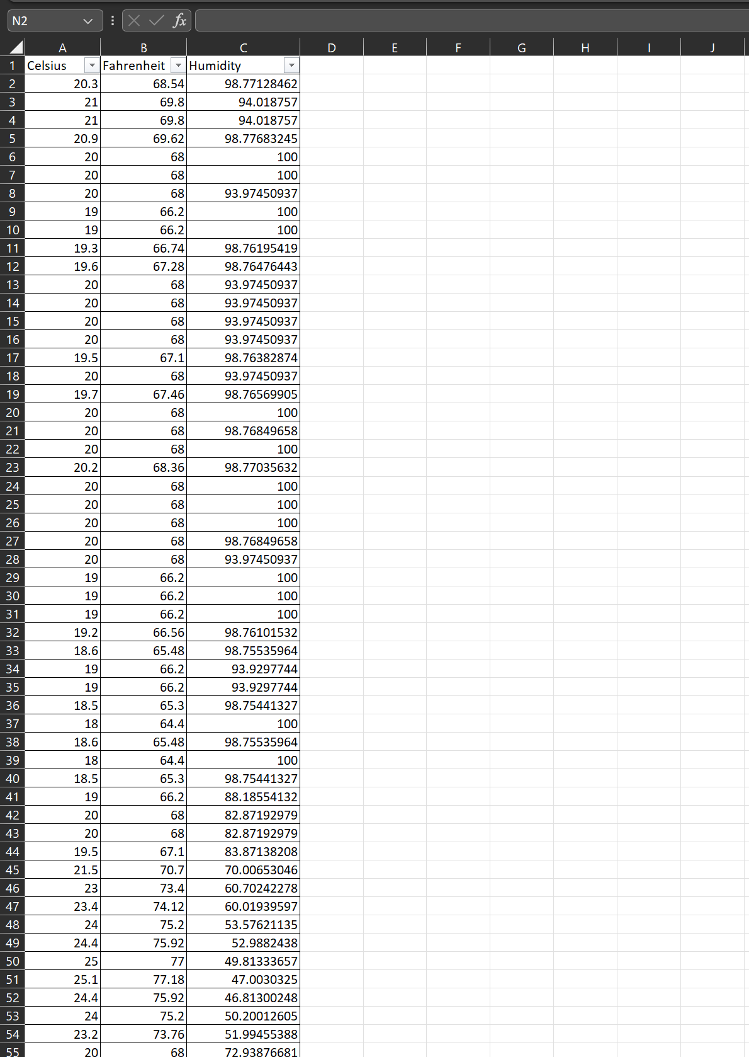
Retrieve and Convert Data to CSV Format

Slide 20
Temperature and Humidity Chart

Slide 21
Develop Graphical Models and Interpret Results

Slide 22
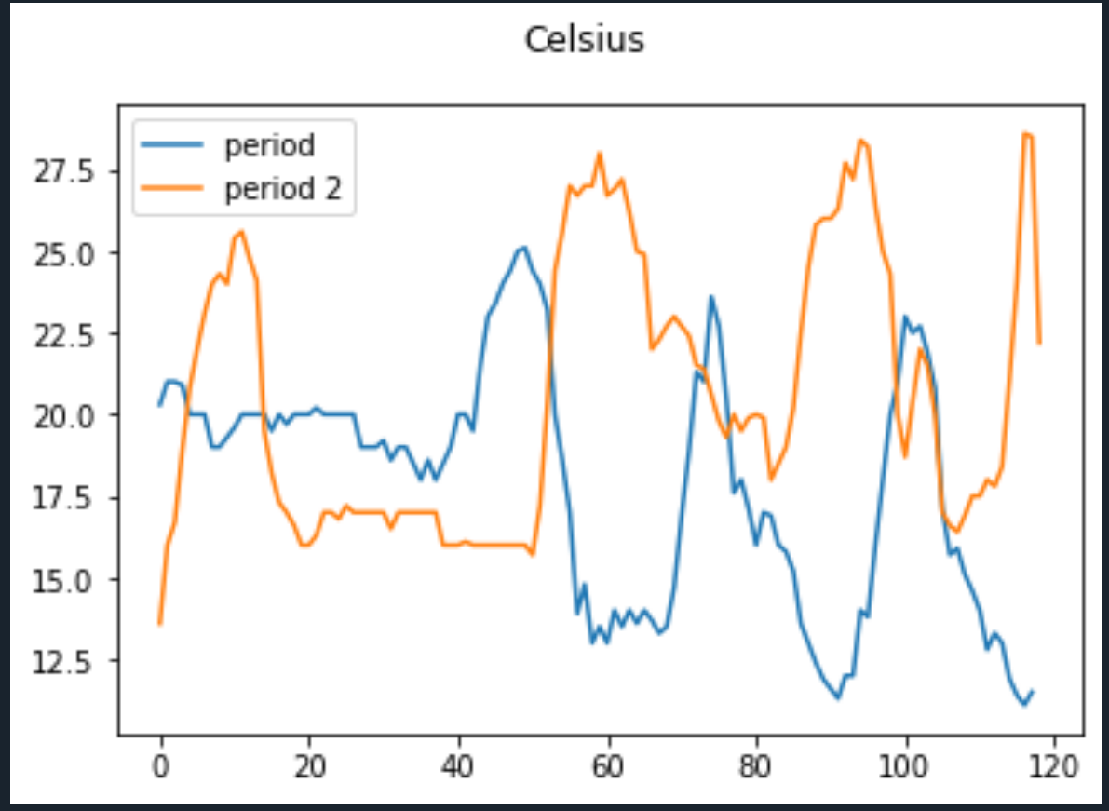
Graph 1

Slide 23
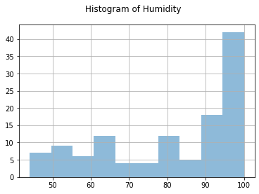
Graph 2

Slide 24
Analysis
What is the relationship between the two periods when is comes to humidity?
As the temperature goes higher, the humidity gets lower.

Slide 25
Prediction
Over the course of the following weeks as the temperature goes up the humidity will go down. Since we are going into the winter months, I see the temperature going down which will increase the humidity going up.

Slide 26
Challenges
A challenge I faced when doing this project, was sometimes inputting the incorrect keys while writing the script. Which would result in a frustrating error.

Slide 27
Career Skills Acquired
Coding/programming
Operating system fundamentals
Automation
Excel practice

Slide 28
Conclusion
This project was a great introduction to Python programming language.
I was able to manipulate data in order to graph out the data and make the data to be read in a user friendly way.

